Slide 1
Saliva in Health:
Microbiome, pH, and Caries Risk
Notes:
This session focuses on saliva and its role in caries as a dynamic disease process. Caries is driven by changes in the oral environment over time. Saliva plays a key role in maintaining balance, influencing pH, and shaping biofilm behavior.

Slide 2
Learning Objectives
Explain how salivary factors influence oral pH and biofilm behavior
Describe the role of acid and alkali production in caries risk
Interpret how changes in the oral environment contribute to disease progression
Identify evidence-informed strategies to support a less cariogenic environment
Notes:
The goals for this session are to achieve the following learning objectives: [read slide]

Slide 3
Review
What controls oral pH?
Salivary flow rate
What increases caries risk?
Frequent acid exposure
Buffering capacity (bicarbonate)
Bacterial metabolism (acid vs. alkali production)
Diet and frequency of sugar exposure
Low salivary flow (xerostomia)
Reduced buffering capacity
Acidogenic and acid-tolerant biofilm
Poor oral hygiene and high sugar intake
Notes:
[Review of session 9]
This is a quick review from the previous session to reconnect key concepts. Oral pH is controlled by several interacting factors. Buffering capacity helps neutralize acids. Bacterial metabolism drives acid or alkali production. Diet influences how often and how long the environment becomes acidic. These factors are constantly interacting, not working in isolation.
Caries risk increases when that balance shifts. Frequent acid exposure keeps the pH low for longer periods. Reduced saliva limits clearance and buffering. Weak buffering makes it harder to recover after an acid challenge. A dysbiotic biofilm favors acid-producing bacteria.
The key idea is that caries is not caused by a single factor. It is the result of an imbalance in the oral environment over time.

Slide 4
Tooth Health: Cariogenic Bacteria
Notes:
Maintaining a healthy oral microbiome can prevent dental diseases and promote overall oral health. Oral health prebiotics and probiotics play a part in counteracting cariogenic bacteria by nourishing beneficial bacteria and maintaining microbial balance.

Slide 5
Oral Health Prebiotics
Nutrients that you feed to your current/resident microbiome to create a favorable environment to promote commensal bacteria growth.
Product Examples
Arginine Toothpaste
Food Examples
Roots: garlic, onions, leeks, chicory root
Grains: barley, oats, flaxseeds, wheat bran
Xylitol Products
Urea Products
Fruits and veggies: bananas, apples, asparagus
Notes:
Oral health prebiotics are nutrients that you provide to your existing microbiome to create a favorable environment that promotes the growth of beneficial bacteria. Some product examples include arginine toothpaste, xylitol products, and urea products. Additionally, certain foods can act as prebiotics, such as roots like garlic, onions, leeks, and chicory root; grains like barley, oats, flaxseeds, and wheat bran; and fruits and vegetables such as bananas, apples, and asparagus. These products and foods help nourish your resident microbiome, supporting overall oral health.

Slide 6
When do you recommend oral care probiotics?
Caries or Periodontal Preventative Treatment Plan
Halitosis
Appliance Therapy
Periodontal Therapy/Recare
Notes:
Oral care probiotics can be recommended in the following situations:
Caries or Periodontal Preventative Treatment Plan: Recommend oral care probiotics to help reduce the risk of dental caries and periodontal disease by promoting a balanced and healthy oral microbiome.
Halitosis: Suggest oral care probiotics to patients experiencing bad breath, as they can help reduce the bacteria responsible for causing halitosis and improve overall oral hygiene.
Appliance Therapy: When a patient is undergoing appliance therapy, such as wearing braces or dentures, recommend oral care probiotics to maintain a healthy balance of oral bacteria and prevent issues like gum inflammation and bad breath.
Periodontal Therapy/Recare: For patients undergoing periodontal therapy or in the recare phase, recommend oral care probiotics to support the healing process, reduce inflammation, and prevent the recurrence of periodontal disease.

Slide 7
Sari Mahasneh and Adel Mahasneh, “Probiotics: A Promising Role in Dental Health,” Dent J (Basel), 5(4), (2017) 26, https://doi.org/10.3390/dj5040026.
Notes:
This article published in 2017 discusses how probiotics help maintain oral health by interacting with the oral microbiome and contributing to a healthy microbial balance. Although there is not yet substantial evidence to support the use of probiotics for preventing or treating oral diseases, they have not been shown to cause adverse effects or increase the risk of caries or periodontal diseases. This review explores the potential of probiotics in oral health care and the possibilities of developing advanced probiotics for future complementary treatments.
Reference:
Sari Mahasneh and Adel Mahasneh, “Probiotics: A Promising Role in Dental Health,” Dent J (Basel), 5(4), (2017) 26, https://doi.org/10.3390/dj5040026.

Slide 8
Tooth Health: Acidity & Buffer Capacity
Notes:
Tooth health is significantly influenced by the acidity and buffer capacity of the oral environment. Maintaining a balanced pH helps prevent dental caries and supports overall oral health. Arginine-rich biofilms play a key role in this balance by inhibiting harmful bacteria and promoting a pH-neutral environment.

Slide 9
Why arginine?
Biofilms with high amounts of arginine (either endogenously or exogenously delivered) are likely non-cariogenic.
Endogenous Examples
Protein Turnover
Exogenous Examples
Toothpaste
Excretion in Saliva
De Novo Generation
Foods
Candies
Notes:
Biofilms containing high amounts of arginine, whether produced within the body or supplied from external sources, are likely to be non-cariogenic. Endogenous sources of arginine include protein turnover, excretion in saliva, and de novo generation. Exogenous sources of arginine include toothpaste, foods such as leafy greens, and candies with added arginine.
Endogenous Examples
Protein Turnover
Excretion in Saliva
De Novo Generation
Exogenous Examples
Toothpaste
Foods
Candies

Slide 10
Why arginine?
Biofilms with high amounts of arginine (either endogenously or exogenously delivered) are likely non-cariogenic.
Arginine negatively affects the growth, pathogenic potential, and the ability to handle environmental stressors of Streptococcus mutans (cariogenic bacteria).
Increased levels of arginine, result in a more pH neutral oral environment.
Marcelle Nascimento, Valeria V. Gordan, Cyndi W. Garvan, Christopher M. Browngardt, and Robert A. Burne, “Correlations of oral bacterial arginine and urea catabolism with caries experience,” Oral Microbiology and immunology, 24(2), 89–95, 2009, https://doi.org/10.1111/j.1399-302X.2008.00477.x.
Brinta Chakraborty and Robert Burne, “Effects of Arginine on Streptococcus mutans Growth, Virulence Gene Expression, and Stress Tolerance,” Applied and environmental microbiology, 83(15), e00496-1, 2017, https://doi.org/10.1128/AEM.00496-17.
Ya-Ling Liu, Marcelle Nascimento, and Robert Burne, “Progress toward Understanding the Contribution of Alkali Generation in Dental Biofilms to Inhibition of Dental Caries,” International Journal of Oral Science, Sept. 2012, www.ncbi.nlm.nih.gov/pmc/articles/PMC3465751/.
Notes:
Biofilms with high amounts of arginine, whether delivered endogenously or exogenously, are likely non-cariogenic. Arginine negatively affects the growth, pathogenic potential, and ability of Streptococcus mutans, a cariogenic bacterium, to handle environmental stressors. Increased levels of arginine result in a more pH-neutral oral environment.
References:
Marcelle Nascimento, Valeria V. Gordan, Cyndi W. Garvan, Christopher M. Browngardt, and Robert A. Burne, “Correlations of oral bacterial arginine and urea catabolism with caries experience,” Oral Microbiology and immunology, 24(2), 89–95, 2009, https://doi.org/10.1111/j.1399-302X.2008.00477.x.
Brinta Chakraborty and Robert Burne, “Effects of Arginine on Streptococcus mutans Growth, Virulence Gene Expression, and Stress Tolerance,” Applied and environmental microbiology, 83(15), e00496-1, 2017, https://doi.org/10.1128/AEM.00496-17.
Ya-Ling Liu, Marcelle Nascimento, and Robert Burne, “Progress toward Understanding the Contribution of Alkali Generation in Dental Biofilms to Inhibition of Dental Caries,” International Journal of Oral Science, Sept. 2012, www.ncbi.nlm.nih.gov/pmc/articles/PMC3465751/.

Slide 11
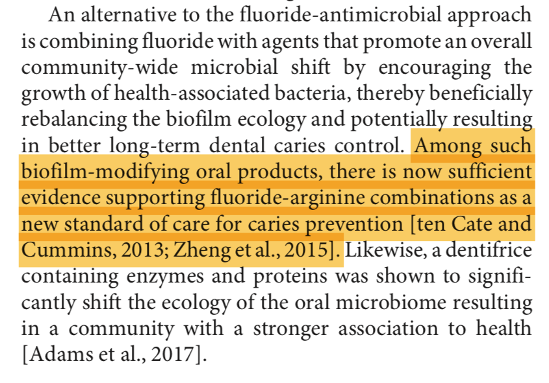
Nebu Philip, Bharat Suneja, and Laurence J. Walsh, “Ecological Approaches to Dental Caries Prevention: Paradigm Shift or Shibboleth?” Caries Research, 22 February 2018, 52 (1-2): 153–165, https://doi.org/10.1159/000484985.
Notes:
Contemporary views on dental caries focus on how the ecology of dental plaque biofilm and local environmental factors cause disease. There is growing recognition of the importance of a healthy oral microbiome in preventing caries and promoting oral health. This paper advocates for ecological preventive measures that disrupt cariogenic factors without harming bacteria and promote the growth of beneficial, diverse microbial communities, potentially offering more effective caries prevention than conventional methods.
Reference:
Nebu Philip, Bharat Suneja, and Laurence J. Walsh, “Ecological Approaches to Dental Caries Prevention: Paradigm Shift or Shibboleth?” Caries Research, 22 February 2018, 52 (1-2): 153–165, https://doi.org/10.1159/000484985.

Slide 12
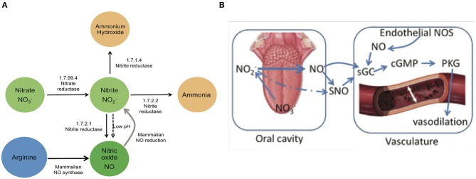
One Content
Optional Subhead
This is an example of how body copy should be treated in template. Starting body copy will default to Arial 24pt font. Keep the messaging clear, concise and to the point. Text can be sized up or down as the need should arise, but the best bet is to keep primary copy at this size.
  First level bullet
    Second level bullet
      Third level bullet
        Fourth level bullet
Gena D. Tribble, Nikola Angelov, Robin Weltman, Bing-Yan Wang, Sridhar V. Eswaran, Isabel C. Gay, Kavitha Parthasarathy, Doan-Hieu V. Dao, Katherine N. Richardson, Nadia M. Ismail, Iraida G. Sharina, Embriette R. Hyde, Nadim J. Ajami, Joseph F. Petrosino, and Nathan S. Bryan, “Frequency of Tongue Cleaning Impacts the Human Tongue Microbiome Composition and Enterosalivary Circulation of Nitrate,” Frontiers in Cellular and Infection Microbiology, 434270, 2019, https://doi.org/10.3389/fcimb.2019.00039.
Notes:
Another groundbreaking article researchers studied the microbiome of the tongue, and found that the nitric oxide, a component that helps with dilation of blood vessels in the body is produced by the bacteria on your tongue. Drinking water, eating green leafy vegetables helps these “good” bacteria grow.
However, using a broad-spectrum antimicrobial mouth rinse that you might get to freshen your breath alters this group of bacteria, and their ability to produce nitric oxide, resulting in high blood pressure and increase risk for cardiovascular disease.
Reference:
Gena D. Tribble, Nikola Angelov, Robin Weltman, Bing-Yan Wang, Sridhar V. Eswaran, Isabel C. Gay, Kavitha Parthasarathy, Doan-Hieu V. Dao, Katherine N. Richardson, Nadia M. Ismail, Iraida G. Sharina, Embriette R. Hyde, Nadim J. Ajami, Joseph F. Petrosino, and Nathan S. Bryan, “Frequency of Tongue Cleaning Impacts the Human Tongue Microbiome Composition and Enterosalivary Circulation of Nitrate,” Frontiers in Cellular and Infection Microbiology, 434270, 2019, https://doi.org/10.3389/fcimb.2019.00039.

Slide 13
Preventive Options to Improve Oral Microbiome
Improve Oral Hygiene
Xylitol or Baking Soda Toothpaste
Morph Microbiome
Drink more water (water with xylitol)
EDTA Gel
pH Basic Mouthwash
Chew xylitol or sugar-free gum/mints to increase saliva flow
Ingest prebiotics that contain arginine
Take an oral care probiotic
Notes:
There are several preventive options to improve your oral microbiome and enhance oral hygiene.
Use Xylitol or Baking Soda Toothpaste: These types of toothpaste can help reduce harmful bacteria in your mouth and maintain a healthy balance of oral microbes.
Try EDTA Gel: This gel is designed to disrupt the biofilm on your teeth, making them easier to clean and reducing plaque buildup.
Use a pH Basic Mouthwash: This type of mouthwash can help neutralize the acids in your mouth, creating a more favorable environment for beneficial bacteria.
Additionally, you can morph your microbiome by making lifestyle changes:
Drink More Water: Drinking water, especially water with xylitol, can help wash away food particles and bacteria.
Chew Xylitol or Sugar-Free Gum/Mints: These can help increase saliva flow, which is essential for maintaining a healthy oral environment.
Ingest Prebiotics that Contain Arginine: Eating foods or supplements with arginine can support the growth of beneficial bacteria in your mouth.
Take an Oral Care Probiotic: This can introduce beneficial bacteria into your mouth, promoting a healthier oral microbiome.

Slide 14
Oral Cleanliness: Ammonia
Notes:
What does ammonia have to do with oral health?

Slide 15
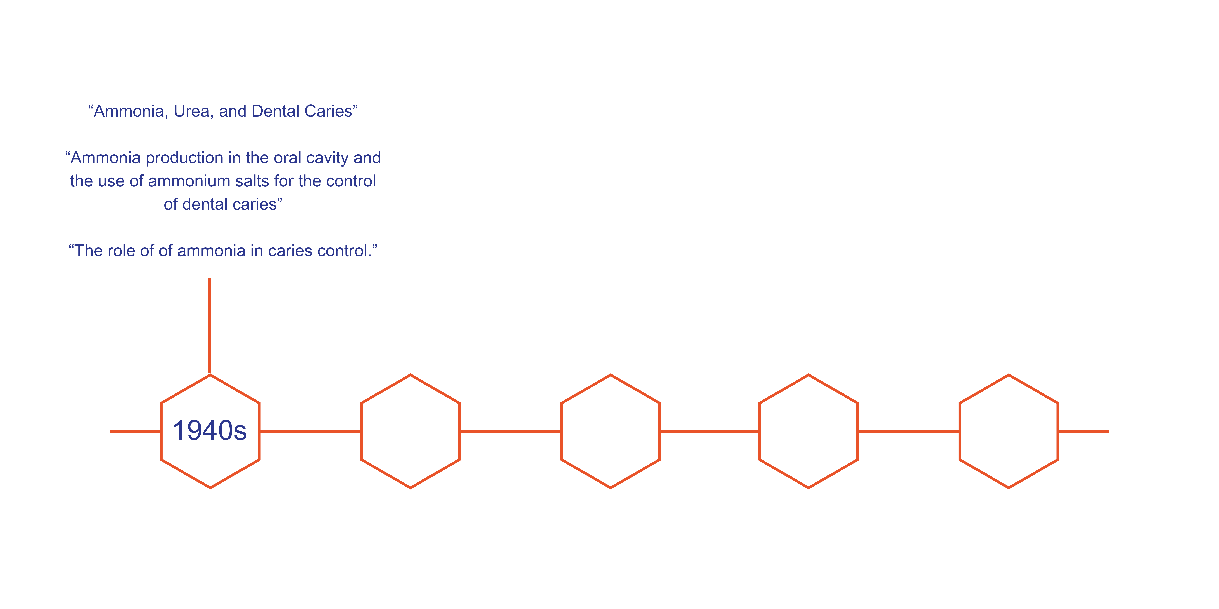
Ammonia Timeline
Notes:
In the 1940s, eight papers were published that highlighted the relationship between ammonia and oral health. One author, Robert G. Kesel, spearheaded many of these papers into the 1950s, with titles such as “Ammonia, Urea, and Dental Caries,” “Ammonia Production in the Oral Cavity and the Use of Ammonium Salts for the Control of Dental Caries,” and “The Role of Ammonia in Caries Control.”
A resurgence of papers and publications came in the early 2000s.

Slide 16
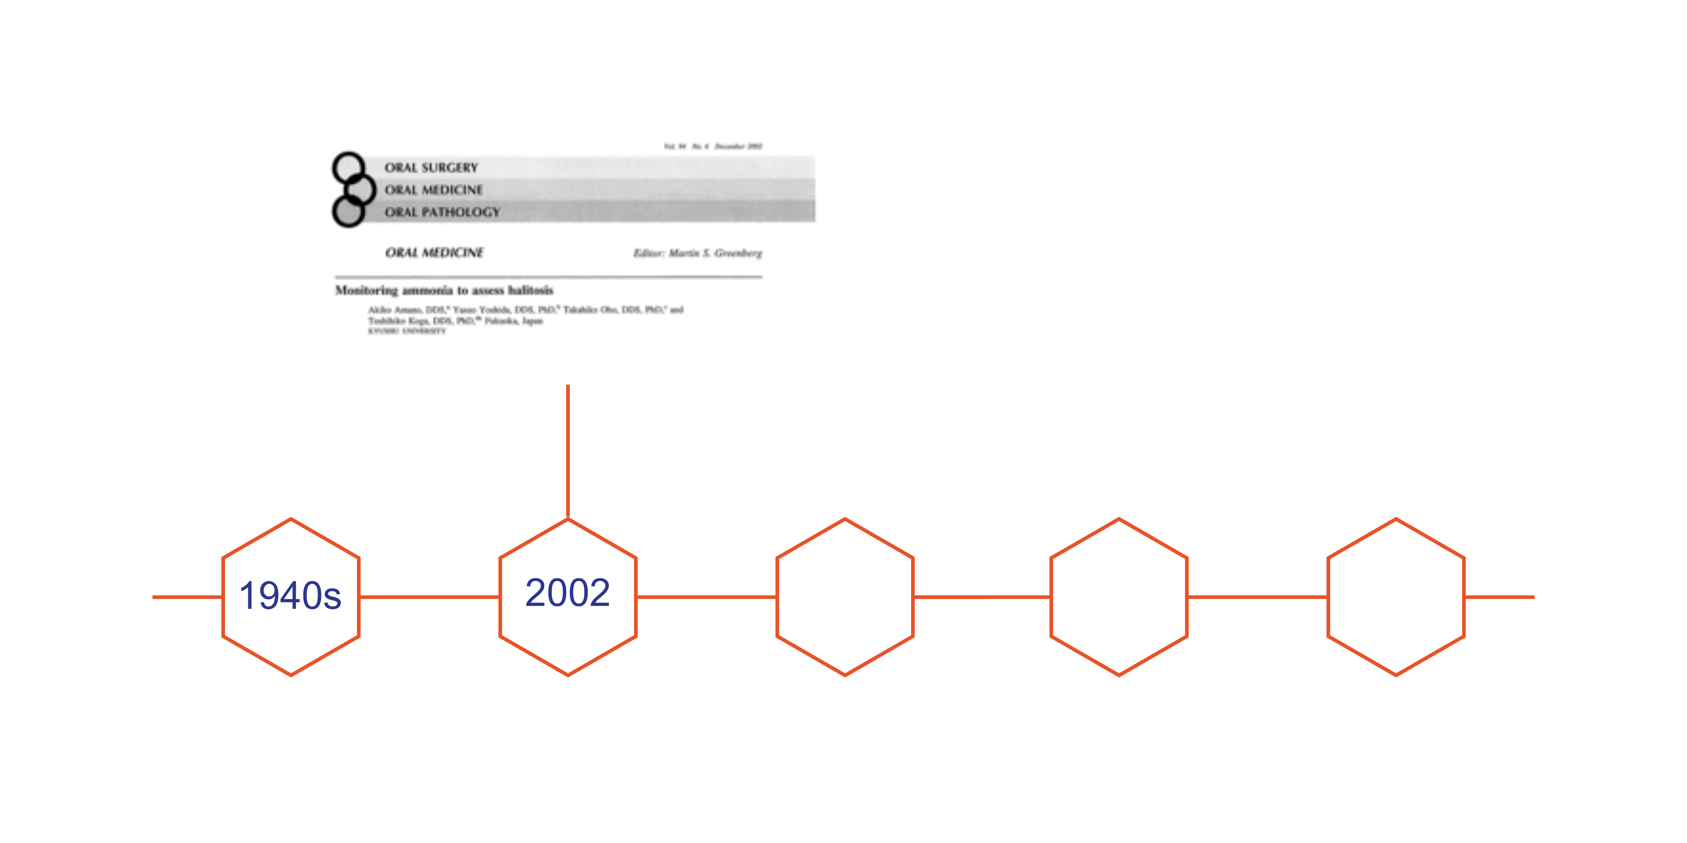
Ammonia Timeline
Akiko Amano, Yasuo Yoshida, Takahiko Oho, and Toshihiko Koga, “Monitoring ammonia to assess halitosis,” Oral Surgery, Oral Medicine, Oral Pathology, Oral Radiology, 94(6), (2002) 692–696, https://doi.org/10.1067/moe.2002.126911.
Notes:
A paper by Akiko Amano and others looked at ammonia to measure halitosis as a proxy for poor oral hygiene. They measured ammonia levels in three ways: organoleptic method, gas chromatography, and ammonia monitoring. They found that after brushing and scraping the tongue, ammonia levels decreased, showing that ammonia can possibly serve as a proxy for oral cleanliness.
Reference:
Akiko Amano, Yasuo Yoshida, Takahiko Oho, and Toshihiko Koga, “Monitoring ammonia to assess halitosis,” Oral Surgery, Oral Medicine, Oral Pathology, Oral Radiology, 94(6), (2002) 692–696, https://doi.org/10.1067/moe.2002.126911.

Slide 17
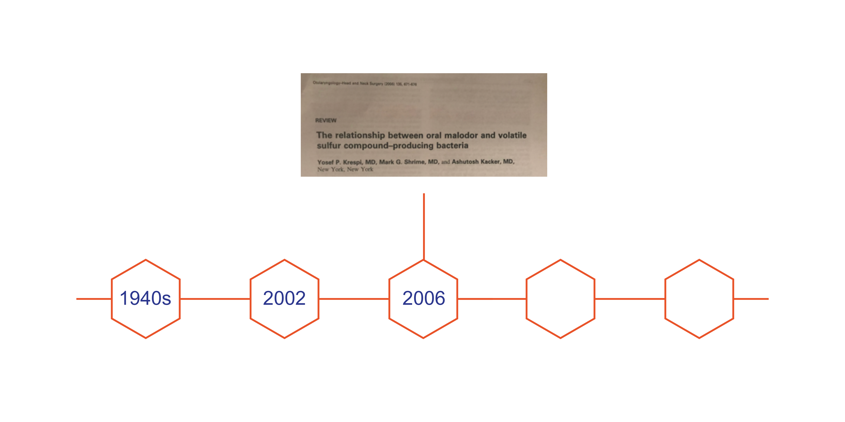
Ammonia Timeline
Yosef Krepi, Mark Shrime, and Ashutosh Kacker, “The relationship between oral malodor and volatile sulfur compound-producing bacteria,” Otolaryngology-Head and Neck Surgery, 2006, https://journals.sagepub.com/doi/abs/10.1016/j.otohns.2005.09.036?rfr_dat=cr_pub%3Dpubmed&url_ver=Z39.88-2003&rfr_id=ori%3Arid%3Acrossref.org&journalCode=otoj.
Notes:
In 2006, Krespi et al. associate certain bacterial with such malodor-causing bacteria on the tongue as Porphyromonoas, Prevotella, Actinobacillus, and Fusobacterium species, and on the teeth as T. denticola, P. gingivialis, and B. forsythus. One of the groups of bacteria associated with fresh breath is Streptococcus salivarius, and it is not associated with halitosis.
Reference:
Yosef Krepi, Mark Shrime, and Ashutosh Kacker, “The relationship between oral malodor and volatile sulfur compound-producing bacteria,” Otolaryngology-Head and Neck Surgery, 2006, https://journals.sagepub.com/doi/abs/10.1016/j.otohns.2005.09.036?rfr_dat=cr_pub%3Dpubmed&url_ver=Z39.88-2003&rfr_id=ori%3Arid%3Acrossref.org&journalCode=otoj.

Slide 18
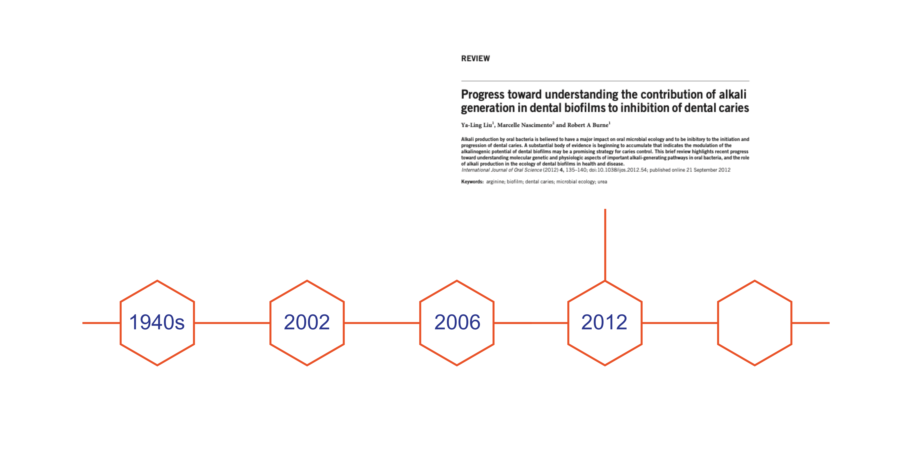
Ammonia Timeline
Ya-Ling Liu, Marcelle Nascimento, and Robert Burne, “Progress toward Understanding the Contribution of Alkali Generation in Dental Biofilms to Inhibition of Dental Caries,” International Journal of Oral Science, Nature Publishing Group, Sept. 2012, www.ncbi.nlm.nih.gov/pmc/articles/PMC3465751/.
Notes:
Afterward, a shift occurred in the literature, transitioning from an emphasis on halitosis (its origin, cause, and treatment) to an exploration of the human oral cavity's microbiome.
This paper contributes to our understanding of the advantages of alkali generation in the oral cavity.
Reference:
Ya-Ling Liu, Marcelle Nascimento, and Robert Burne, “Progress toward Understanding the Contribution of Alkali Generation in Dental Biofilms to Inhibition of Dental Caries,” International Journal of Oral Science, Nature Publishing Group, Sept. 2012, www.ncbi.nlm.nih.gov/pmc/articles/PMC3465751/.

Slide 19
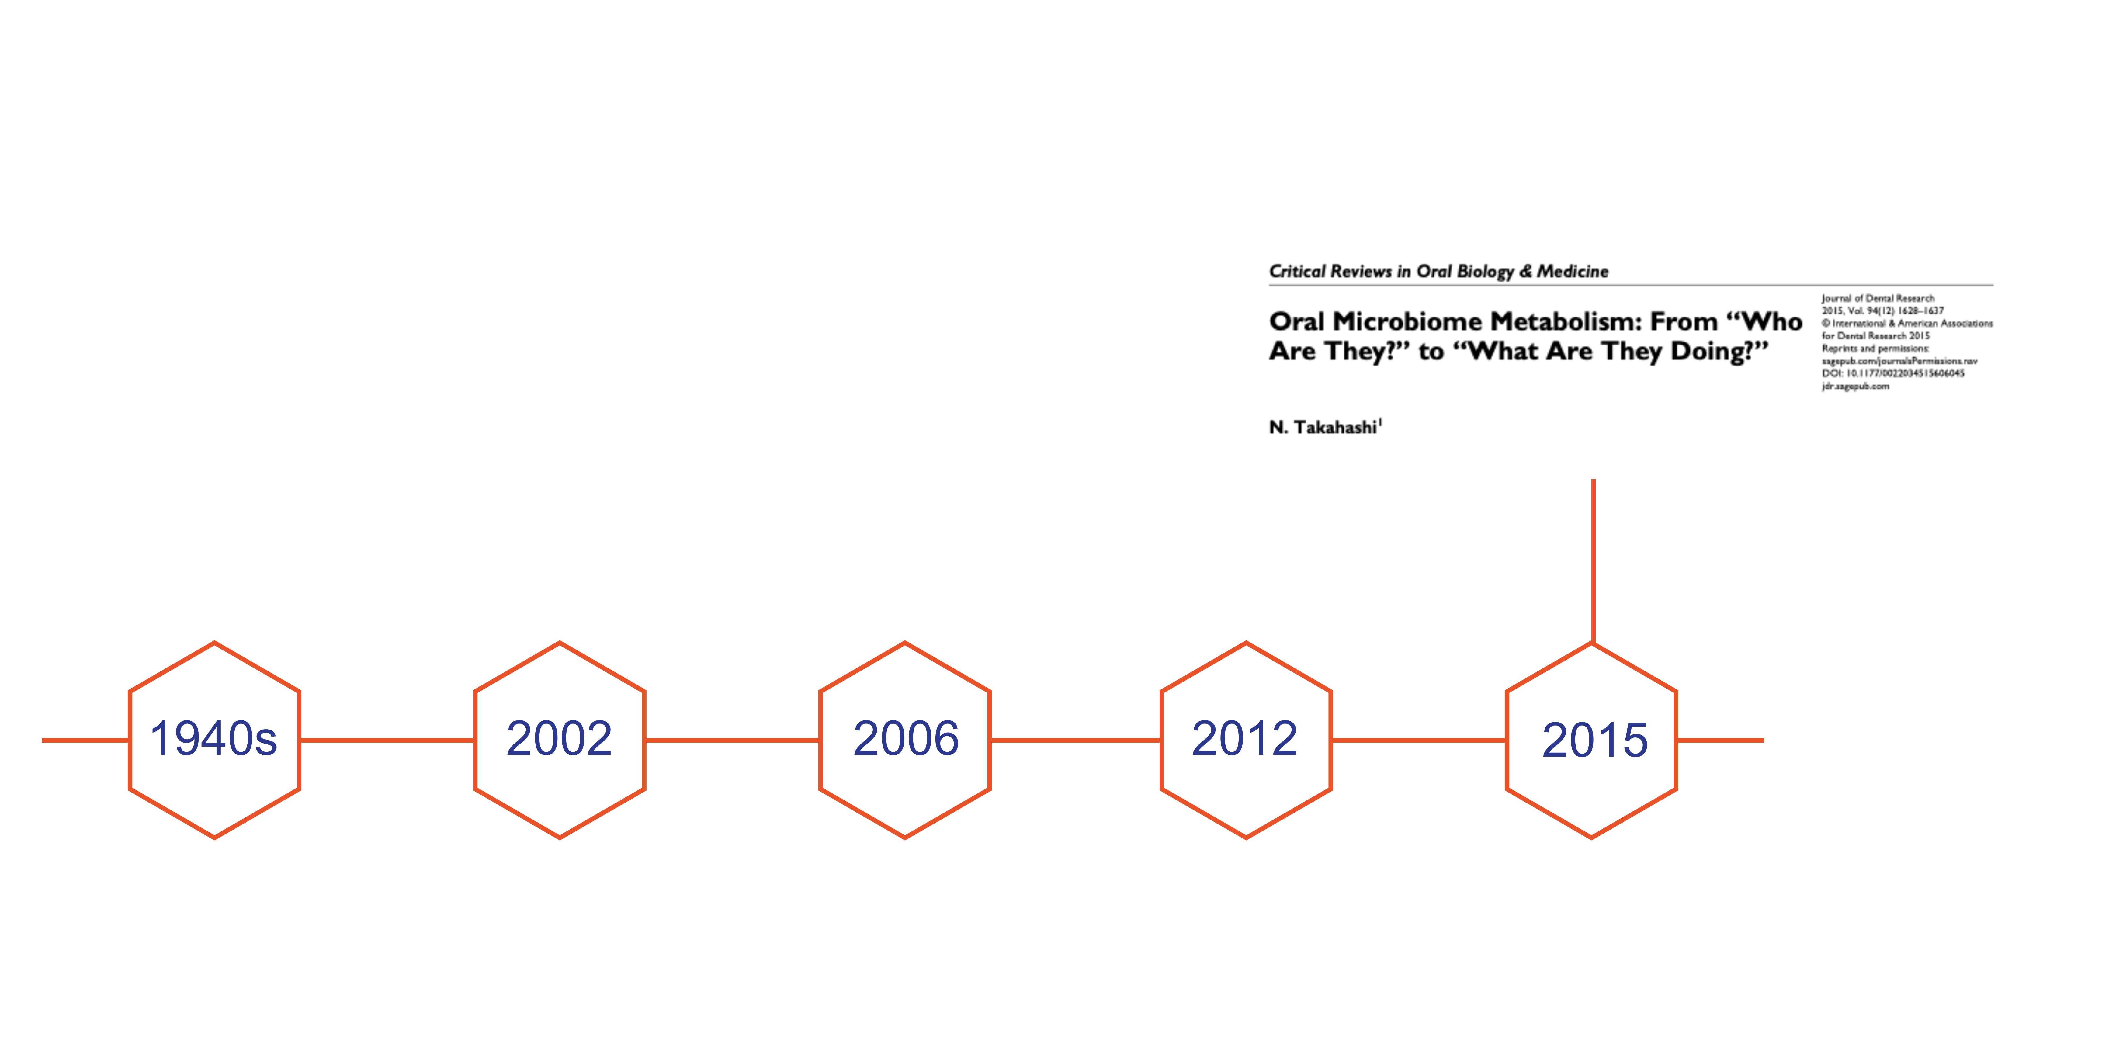
Ammonia Timeline
N. Takahashi, “Oral Microbiome Metabolism: From ‘Who Are They?’ to ‘What Are They Doing?’” Journal of Dental Research, 94(12), (2015) 1628–1637, https://doi.org/10.1177/0022034515606045.
Notes:
This 2015 article talks about how recent progress in molecular biology has helped us figure out what makes up the oral microbiome. But we still don't know much about what it actually does.
The review brings together what we currently know about how the oral microbiome works, focusing on two main things: how bacteria that break down sugars create acids that lead to cavities, and how bacteria that break down proteins produce substances that contribute to gum disease and bad breath.
It stresses the importance of using a metabolomic approach to learn more about how microbial activity affects the oral environment, making bacteria more harmful.
Reference:
Nobuhiro Takahashi, “Oral Microbiome Metabolism: From ‘Who Are They?’ to ‘What Are They Doing?’” Journal of Dental Research, 94(12), 1628–1637,2015, https://doi.org/10.1177/0022034515606045.

Slide 20
Nobuhiro Takahashi, “Oral Microbiome Metabolism: From ‘Who Are They?’ to ‘What Are They Doing?’” Journal of Dental Research, 94(12), 1628–1637, 201,5 https://doi.org/10.1177/0022034515606045.
Notes:
The article also helps understand the measurement between health and disease, particularly focusing on demineralization versus remineralization. It explains how the balance between these processes affects oral health. Additionally, the article explores how ecological factors have impacted the oral microbiome and its role in oral health and disease.
To put it all together, healthy microbiomes tend to be basic and generate ammonia, and do not produce caries. Pathogenic biofilms are acidic, produce minimal ammonia, and have pathogens in an environment that result in caries.
Reference:
Nobuhiro Takahashi, “Oral Microbiome Metabolism: From ‘Who Are They?’ to ‘What Are They Doing?’” Journal of Dental Research, 94(12), 1628–1637, 201,5 https://doi.org/10.1177/0022034515606045.

Slide 21
Ammonia Timeline
Marcelle Nascimento, Andres J. Alvarez, X. Huang, Shawn Hanway, S. Perry, Amy Luce, Vincent P. Richards, and R.A. Burne, “Arginine Metabolism in Supragingival Oral Biofilms as a Potential Predictor of Caries Risk,” JDR clinical and translational research, 4(3), 262–270, 2019, https://doi.org/10.1177/2380084419834234.
Notes:
This 2018 article talks about how there's a connection between cavities and low levels of arginine breakdown in the mouth biofilms of kids and their teeth over time.
They suggest that checking how well the body breaks down arginine, using something called the arginine deiminase system, could help find people and tooth areas more likely to get cavities.
Reference:
Marcelle Nascimento, Andres J. Alvarez, X. Huang, Shawn Hanway, S. Perry, Amy Luce, Vincent P. Richards, and R.A. Burne, “Arginine Metabolism in Supragingival Oral Biofilms as a Potential Predictor of Caries Risk,” JDR clinical and translational research, 4(3), 262–270, 2019, https://doi.org/10.1177/2380084419834234.

Slide 22
Preventive Options to Improve Ammonia Levels
Poor Oral Hygiene
Educate patient on OHI (electric toothbrush)
Boost Commensal Bacteria
Probiotics
Drink more water (water with xylitol)
Chew xylitol or sugar-free gum/mints to increase saliva flow
Use toothpaste products with arginine bicarbonate
Candy with arginine
pH basic mouthwash
Notes:
To improve ammonia levels and address poor oral hygiene, several preventive options can be recommended. First, educate the patient on proper oral hygiene practices, including the use of an electric toothbrush. Encourage the patient to drink more water, especially water containing xylitol. Chewing xylitol or sugar-free gum and mints can help increase saliva flow. Using a pH-basic mouthwash can also be beneficial. Additionally, boosting commensal bacteria through probiotics is advisable. Products such as toothpaste containing arginine bicarbonate and candies with arginine can further support oral health.

Slide 23
Small Group Activity
Notes:
Now we will have a small group activity looking into different salivary diagnostic screenings available.

Slide 24
Salivary Diagnostics
Oral Fluid Biocomponents (only including tests for oral diseases):
  Hormones
  Cytokines
  Antibodies
  Proteins and Enzymes
  Growth Factors
  Nucleic Acids
  Viruses
  Bacteria
  Fungi
  Drugs
  Metabolites
  Tumor Markers
Notes:
Salivary diagnostics involve analyzing oral fluid biocomponents to test for various oral diseases. These biocomponents include hormones, cytokines, antibodies, proteins and enzymes, growth factors, nucleic acids, viruses, bacteria, fungi, drugs, metabolites, and tumor markers.

Slide 25
Small Group Exercise
Each group will be assigned to research a saliva screening (found on the next slide) and take 5 minutes to report back the following:
Notes:
For this small group exercise, each group will be assigned to research a saliva screening method, as described on the next slide. You will have 5 minutes to report back on the following points:
What is the test measuring?
What markers are being used?
What does the literature say about those markers?
How accurate are the tests?
How could you use this information to shape patient care?
Would this test impact your preventive treatment plan?

Slide 26
Small Group Exercise
Saliva Screenings:
  My Perio IL-6
  Celsus One
  OraRisk HPV
  OraRisk HSV
  My PerioPath
  Hr5 Test
  OraRisk Caries
  OraRisk CT/NG
  Viome
Saliva Check Buffer
Bristle
OraRisk Candida
SillHa Oral Wellness System Tooth Health
SillHa Oral Wellness System Gum Heath
SillHa Oral Wellness System Oral Cleanliness
Simply Perio Test
Notes:
Now we will divide into groups and assign each group one of these salivary diagnostic screenings.
[Divide students into small groups and assign a saliva screening to each group. Allow 5 minutes for each group to report their findings to the class.]

Slide 27
Chairside Screening
Notes:
Let’s discuss chairside screening that includes a 5-Point Approach to help your patients interpret and address their saliva reports.

Slide 28
Connection between 5-Point Plan and Chart
Image on the right modified from:
Brian Nový, Erinne Kennedy, Janice Donahoe, and Susan Fournier, “Minimizing Aerosols with Non-Surgical Approaches to Caries Management,” Journal of the Michigan Dental Association, 48–56, July 2020.
Notes:
With your patients, you want to create a personalized prevention plan by assessing their salivary flow to understand demineralization. During the chairside and in-person consultations, you will work on shifting their microbiome and ensuring their salivary chemistry is optimal. Salivary chemistry should include adequate levels of calcium and phosphate and proper acidity to help decrease inflammation, especially in the gum tissue.
To the right are resources to improve salivary function. At the top, you can see the desired treatment effects based on whether the patient's saliva is more cariogenic or acidic. The rows help align the treatment with the patient’s preferences for delivery.
Image on the right modified from:
Brian Nový, Erinne Kennedy, Janice Donahoe, and Susan Fournier, “Minimizing Aerosols with Non-Surgical Approaches to Caries Management,” Journal of the Michigan Dental Association, 48–56, July 2020.

Slide 29
One Content
Patient Factors
Acid Reflux
Obstructive Sleep Apnea
Habits
(smoking, nutrition, or supplement)
Dry Mouth (medication, age, disease or radiation induced)
Eating Disorder (bulimia)
Other
Optional Subhead
This is an example of how body copy should be treated in template. Starting body copy will default to Arial 24pt font. Keep the messaging clear, concise and to the point. Text can be sized up or down as the need should arise, but the best bet is to keep primary copy at this size.
  First level bullet
    Second level bullet
      Third level bullet
        Fourth level bullet
Notes:
[Review]
These are patient factors that that influence pH levels and acidity in oral health.
Acid Reflux (GERD): Acid reflux can result from a high-fat or spicy diet eaten before bed, or from medications like those for high blood pressure. It can also be caused by obstructive sleep apnea (OSA).
Obstructive Sleep Apnea (OSA): Screening tools for OSA include STOP, STOP-BANG (SB), the Epworth Sleepiness Scale (ESS), and the 4-Variable screening tool (4-V). Patients with OSA often report high blood pressure, GERD, and weight gain. Treating OSA may reduce GERD symptoms.
Eating Disorder (Bulimia): Vomiting from bulimia produces extra saliva, but it cannot counteract the acid produced. Treatment of the disorder is crucial, and rinsing with baking soda water after vomiting can help reduce acid exposure on teeth.
Dry Mouth (Medication, Age, Disease, or Chemotherapy Induced): Dry mouth can be caused by medications, age, diseases like Sjogren's Syndrome, or radiation. Although acid stimulates saliva production, saliva pH mainly depends on flow rate. Patients may not always recognize dry mouth, but signs include carrying water around, sour taste, changes in food taste, difficulty swallowing, ill-fitting dentures, white crusts at mouth corners, and persistent thirst.
Habits: Reviewing these factors with patients can reveal habits like drinking sugary coffee or snacking on granola bars or candy at work, which also affect oral health.

Slide 30
Chairside Screening
Measure | Tool | Associated Disease
Other Pathogens (HIV, HPV, STD’s) | OraQuick® OraRisk HPV® OraRisk HSV® OraRisk® Candida OraRisk® CT/NG OraSure® HIV-1 | HIV – Virus HPV – Virus HSV – Virus Candida – Fungus Chlamydia trachomatis / Neisseria gonorrhea – Bacterial HIV
Genetic Polymorphisms | Alert 2™ MyPerio ID® IL-6 or IL-1 MyPerioPath® | Periodontal Disease
CD44 Total Protein | OraMark™ Test | Oral Cancer
mRNA | OraMark OSCC® | Oral Cancer
“Salivary Diagnostics,” American Dental Association, www.ada.org/en/resources/ada-library/oral-health-topics/salivary-diagnostics.
Notes:
The ADA updated their list of saliva systems and instruments in August 2018. At that time, there were no FDA-approved salivary diagnostic tests for evaluating risk of periodontal disease or dental caries, or of head and neck cancer.
However, these tools can be useful for assessing a patient’s risk or screening for early signs of the disease.
Reference:
“Salivary Diagnostics,” American Dental Association, www.ada.org/en/resources/ada-library/oral-health-topics/salivary-diagnostics.

Slide 31
Caries Risk — Chairside Screening
Measure | Tool
Quantity of Saliva (Flow Rate) | Beaker Saliva-Check BUFFER Testing Mat by GC America BokaFlo
Quality of Saliva (Consistency) | Saliva-Check BUFFER Testing Mat by GC America
Bacterial Count (S. mutans, Lactobacillus spp) | SillHa Oral Wellness System by ARKRAY BiofilmGS™ BiofilmDNA™
Buffering Capacity | Hand Held pH Meter SillHa Oral Wellness System by ARKRAY Saliva-Check BUFFER Testing Mat by GC America
pH | pH Test Strips SillHa Oral Wellness System by ARKRAY Saliva-Check BUFFER Testing Mat by GC America
“Salivary Diagnostics,” American Dental Association, www.ada.org/en/resources/ada-library/oral-health-topics/salivary-diagnostics.
Notes:
The list continues here.
Reference:
“Salivary Diagnostics,” American Dental Association, www.ada.org/en/resources/ada-library/oral-health-topics/salivary-diagnostics.

Slide 32
How can chairside screening be used?
  Ask better questions
  Make co-decisions
Notes:
The goal of chairside screening in a practice is for the following reasons:
First, it allows providers to ask better questions.
Second, it is best to follow a co-decision-making process when developing the patient’s treatment plan.
The patient’s needs, desires, values, time, and insight are given utmost importance. The aim is to place the patient at the center of the process. Together, information such as X-rays, intraoral photos, periodontal charts, and the saliva test reports are utilized to discuss what is observed, available options, and potential courses of action.
Implementing this co-decision-making process not only ensures that the patient's preferences are taken in account but also increases their likelihood of compliance with the treatment plan.

Slide 33
How can chairside screening be used?
  Ask better questions
  Make co-decisions
  Practice evidence-based dentistry
“Evidence-based databases,” American Dental Association, accessed April 8, 2026, https://www.ada.org/en/resources/ada-library/evidence-based-databases.
Notes:
Third, it enables providers to adjust their preventive treatment plan based on new evidence.
Above is a figure from the American Dental Association illustrating the definition of evidence-based dentistry (EBD).
The sources of evidence are evolving so providers can assess a patient's risk for caries more accurately at each appointment.
Reference:
“Evidence-based databases,” American Dental Association, accessed April 8, 2026, https://www.ada.org/en/resources/ada-library/evidence-based-databases.

Slide 34
How can chairside screening be used?
  Ask better questions
  Make co-decisions
  Practice evidence-based dentistry
  Learn how to assess the oral environment before disease is present
  Create preventive treatment plans
Notes:
Finally, it will help providers learn to assess the oral environment before disease develops, understand the difference between environmental factors and disease, and create preventive treatment plans.

Slide 35
Wrap-Up
Salivary diagnostics detect oral diseases early by analyzing saliva biomarkers, aiding prompt prevention and treatment.
Arginine-rich biofilms prevent cavities by stopping harmful bacteria growth and maintaining a neutral mouth pH.
Chairside screening proactively assesses oral environments, identifying disease risks and enabling personalized treatment plans.
Notes:
In summary, biofilms rich in arginine tend to be non-cariogenic, as arginine inhibits the growth and virulence of cariogenic bacteria like Streptococcus mutans, promoting a neutral oral pH environment. Utilizing salivary diagnostics enables early detection of oral diseases by analyzing various biomarkers present in saliva, ranging from bacteria to tumor markers, aiding in implementing timely preventive and treatment measures. Chairside screening offers a proactive approach to oral health by allowing dental professionals to assess patients' oral environments and identify potential risk factors for diseases, facilitating the development of personalized treatment plans tailored to individual needs.

Slide 36
Caries Management and Prevention: A Risk-Based Approach by CareQuest Institute
To continue learning, explore our other sessions:
Session 1: Understanding Dental Caries: Disease Process and Epidemiology
Session 2: Caries Disease Process: Demineralization, Remineralization, and Biofilm
Session 3: Caries Transmission and Ecological Dysbiosis
Session 4: Caries Risk Assessment: Disease Indicators, Risk Factors, and Protective Factors
Session 5: Applying Caries Risk Assessment: Clinical Decision-Making
Session 6: Applying Prevention Strategies: Risk-Based Caries Management
Session 7: Caries Risk Assessment: Case-Based Application
Session 8: Saliva in Health: Foundations and Mechanisms
Session 9: Saliva in Health: Microbiome, pH, and Caries Risk
Session 10: Saliva in Disease: Cardiovascular Conditions and Caries Risk
Session 11: Saliva in Disease: Asthma, Allergic Rhinitis, and Caries Risk

