Slide 1
Saliva in Disease: Cardiovascular Conditions and Caries Risk
Notes:
In this session, we will explore the connection between bacteria, saliva, and dental caries, examining their implications for stroke and heart disease.

Slide 2
Learning Objectives
Discuss the connection of bacteria in saliva to stroke and heart disease.
Examine the relationship between caries and stroke and heart disease.
Evaluate the saliva and clinical case of a patient with congestive heart failure and assess how their oral findings correlate.
Notes:
Our goals for this lesson are to achieve the following learning objectives: [read slide]

Slide 3
Factors Influencing Saliva Composition and Flow
Normal biological variability
Circadian rhythm (time of day)
Flow state (unstimulated vs. stimulated)
Systemic conditions (e.g., xerostomia, Sjögren’s)
Aging (indirect effects via medications and disease)
Medications (especially anticholinergics)
Notes:
Saliva composition varies across individuals due to normal biological variability. Factors such as genetics, diet, medications, systemic conditions, and oral health all influence the composition and function of saliva.
While disease can impact saliva, it is one of several contributing factors.
Circadian rhythm also plays a role, influencing both salivary flow rate and composition. As a result, saliva can differ between morning and evening within the same individual. These changes are regulated by neuroendocrine mechanisms that affect salivary gland activity.
Saliva composition also depends on whether it is collected under resting or stimulated conditions. Unstimulated saliva is produced at rest, without eating or drinking. Stimulated saliva is produced during activities such as eating or chewing. Increased flow during stimulation changes ion concentration, buffering capacity, and protein composition.
Salivary flow does not decline significantly with normal aging alone. However, older adults are more likely to experience reduced salivary flow due to medications or systemic conditions. Xerostomia, or the sensation of dry mouth, and hyposalivation, or reduced salivary flow, are often associated with medication use or underlying disease and can alter saliva’s protective functions.

Slide 4
Notes:
Disease impacts saliva, and the environment alters the oral microbiome. These shifts are interconnected with overall health and disease processes within the body.
Various diseases and health events will be explored to illustrate how they influence saliva and susceptibility to dental caries.

Slide 5

In the US, how often does a stroke occur?
Once every 10 seconds
Once every 20 seconds
Once every 30 seconds
Once every 40 seconds
Notes:
[Read slide and have learners vote for an answer by show of hands.]

Slide 6
In the US, how often does a stroke occur?
Once every 10 seconds
Once every 20 seconds
Once every 30 seconds
Once every 40 seconds
Notes:
[Read answer on slide.]

Slide 7
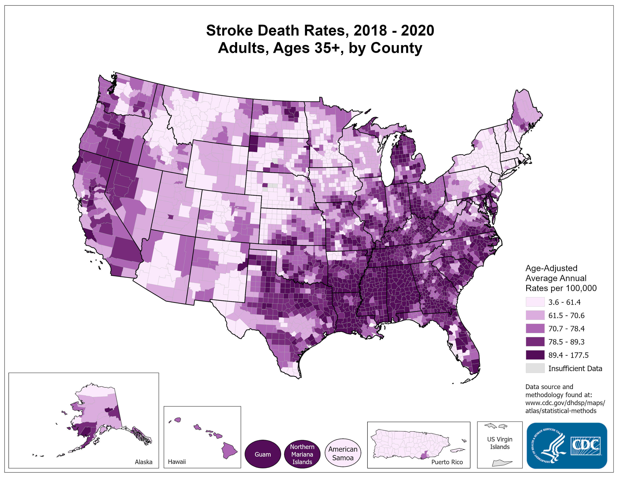
“Heart Disease and Stroke Maps,” Centers for Disease Control and Prevention, accessed April 10, 2026, https://www.cdc.gov/heart-disease-and-stroke-data/.
Notes:
For individuals aged 35 and above, a significant portion of annual strokes in the United States is concentrated in the southeastern region. In general, approximately 795,000 people experience a stroke each year, equating to one stroke occurring every 40 seconds in the US. More alarmingly, around 140,000 adults succumb to strokes annually, accounting for 1 in 20 deaths.
Reference:
“Heart Disease and Stroke Maps,” Centers for Disease Control and Prevention, accessed April 10, 2026, https://www.cdc.gov/heart-disease-and-stroke-data/.

Slide 8
How Does This Relate to Dental Caries?
Notes:
How does a stroke relate to dental caries?
The connection between a stroke and dental caries lies in the potential impact of diabetes on cardiovascular inflammatory events. Dental caries induces inflammation in the body, and this inflammation can spread, potentially leading to a stroke. The link is further established by the association between inflammation and strokes.

Slide 9
Which of the following species are involved in cerebral microbleeds?
S. oralis
S. salivarius
S. mutans
S. mitis
Notes:
[Read slide and have learners vote for an answer by show of hands.]

Slide 10
Which of the following species are involved in cerebral microbleeds?
S. oralis
S. salivarius
S. mutans
S. mitis
Notes:
[Read answer on slide.]

Slide 11
Kazuhiko Nakano, Kazuya Hokamura, Naho Tahiguchi, et. al., “The collagen-binding protein of Streptococcus mutans is involved in haemorrhagic stroke,” Nature Communications, 2(1), (2011) 1-10. https://doi.org/10.1038/ncomms1491.
Notes:
The collagen-binding protein in Streptococcus mutans plays a role in hemorrhagic strokes, with S. mitis being a related factor. S. mutans was identified in the biofilm associated with cerebral microbleeds. Drawing parallels between periodontal disease and Alzheimer’s, bacteria implicated in periodontal disease were discovered in areas of increased protein coagulation in the brains of Alzheimer’s patients. Similarly, certain bacteria associated with caries exhibit a similar pattern.
The oral bacteria biofilm has the capability to traverse the brain-blood barrier, and when it does, it has been detected in microbleeds that contribute to hemorrhagic strokes. It’s important to note that strokes can manifest in two forms: those causing occlusion in the cerebral vasculature and those leading to a hemorrhagic response, involving bleeding in the brain.
In this article, they looked at this problem from many angles.
In Figure 2, you will be able to understand a few key points:
a) They wanted to see if they could detect these virulent bacteria S. mutans in various parts of the body. They only found them on the same side of the brain as where the damage was located from the stroke.
b) Image b shows that the count of these bacteria were highest on the same side of the brain as the stroke damage. An image of the brain tissue during this accumulation is seen in image c.
d/e) This is an SEM photo of how the virulent bacteria are interacting and attaching to the exposed collagen.
Reference:
Kazuhiko Nakano, Kazuya Hokamura, Naho Tahiguchi, et. al., “The collagen-binding protein of Streptococcus mutans is involved in haemorrhagic stroke,” Nature Communications, 2(1), (2011) 1–10. https://doi.org/10.1038/ncomms1491.

Slide 12
Which of the following is not a serotype of S. mutans?
c
k
f
z
Notes:
[Read slide and have learners vote for an answer by show of hands.]

Slide 13
Which of the following is not a serotype of S. mutans?
c
k
f
z
Notes:
[Read answer on slide.]

Slide 14
Which of the following serotypes was associated with the greatest inhibition of collagen-induced platelet aggregation in patients with strokes?
c
k
f
z
Notes:
[Read slide and have learners vote for an answer by show of hands.]

Slide 15
Which of the following serotypes was associated with the greatest inhibition of collagen-induced platelet aggregation in patients with strokes?
c
k
f
z
Notes:
[Read answer on slide.]

Slide 16
Kazuhiko Nakano, Kazuya Hokamura, Naho Tahiguchi, et. al., “The collagen-binding protein of Streptococcus mutans is involved in haemorrhagic stroke,” Nature Communications, 2(1), (2011) 1-10. https://doi.org/10.1038/ncomms1491.
Notes:
This study is the first to indicate that infection with CBP-expressing S. mutans poses a potential risk factor for hemorrhagic stroke. Bacteria-related aggravation of cerebral hemorrhage was demonstrated in mice infected with serotype k S. mutans strains. Notably, administered bacteria were detected in the ipsilateral hemisphere, emphasizing the role of the interaction between serotype k S. mutans and damaged blood vessels in the development of cerebral hemorrhage. The aggravation of cerebral hemorrhage induced by serotype k S. mutans strains appears to be a common effect across various animal species, including humans. Specifically, serotype k S. mutans exhibited significant inhibition of collagen-induced platelet aggregation.
The saliva of patients at risk for stroke is likely to harbor higher levels of cariogenic bacteria. Exploring ways to reduce this bacterial load could potentially assist patients in preventing acute ischemic stroke (AIS).
Reference:
Kazuhiko Nakano, Kazuya Hokamura, Naho Tahiguchi, et al., “The collagen-binding protein of Streptococcus mutans is involved in haemorrhagic stroke,” Nature Communications, 2(1), (2011) 1-10. https://doi.org/10.1038/ncomms1491.

Slide 17
F. Miyatani, N. Kuriyama, I. Watanabe, et. al., “Relationship between Cnm-positive Streptococcus mutans and cerebral microbleeds in humans,” Oral diseases, 21(7), (2015) 886–893, https://doi.org/10.1111/odi.12360.
Notes:
A few years later, a research group conducted a similar study, investigating the connection between S. mutans strains carrying the Cnm-positive gene and their impact on microbleeds in humans. Their earlier research had explored the biological pathways of this in mice and a few small human groups.
In this study, they utilized a specialized type of MRI, employing susceptibility-weighted imaging to identify asymptomatic microbleeds in the brain. This means detecting signs of bleeding in the brain before the occurrence of a major stroke.
The findings revealed a significantly higher incidence of cerebral microbleeds in individuals carrying S. mutans positive for the Cnm protein, which is encoded by the Cnm gene and possesses collagen-binding ability. However, there was no significant difference observed in the presence or number of dental caries between the two groups. These results underscore the association between the presence of Cnm-positive S. mutans and an increased risk of cerebral microbleeds, independent of dental caries.
Reference:
F. Miyatani, N. Kuriyama, I. Watanabe, et. al., “Relationship between Cnm-positive Streptococcus mutans and cerebral microbleeds in humans,” Oral diseases, 21(7), (2015) 886–893, https://doi.org/10.1111/odi.12360.

Slide 18
Chikanori Inenaga, Kazuya Hokamura, Kazuhiko Nakano, et. al., “A Potential New Risk Factor for Stroke: Streptococcus Mutans With Collagen-Binding Protein," World neurosurgery, 113, (2018) e77–e81, https://doi.org/10.1016/j.wneu.2018.01.158.
Notes:
This study looked at S. mutans and patients who had various cardiac and stroke events in a large hospital system. They were able to collect the data on the bacteria via salivary diagnostics.
This Table 2 suggests that Cnm-positive SM is a risk factor for cardioembolic stroke (CES), non-CES infarct, intracerebral hemorrhage (ICH), and ruptured intracranial aneurysm (RIA).
Reference:
Chikanori Inenaga, Kazuya Hokamura, Kazuhiko Nakano, et. al., “A Potential New Risk Factor for Stroke: Streptococcus Mutans With Collagen-Binding Protein," World neurosurgery, 113, (2018) e77–e81, https://doi.org/10.1016/j.wneu.2018.01.158.

Slide 19
In a 2019 report from the American Heart Association, which of the following bacteria were found in plaques associated with acute ischemic stroke?
S. mutans
S. salivarius
S. mitis
S. oralis
Notes:
We discussed hemorrhagic strokes characterized by bleeding in the brain. In contrast, an ischemic stroke occurs when there's a blockage in the brain, impeding blood flow and resulting in cell death in the surrounding area.
[Read slide and have learners vote for an answer by show of hands.]

Slide 20
In a 2019 report from the American Heart Association, which of the following bacteria were found in plaques associated with acute ischemic stroke?
S. mutans
S. salivarius
S. mitis
S. oralis
Notes:
[Read answer on slide.]

Slide 21
Olli Patrakka, Juha-Pekka Pienimäki, Sari Tuomisto, et. al., “Bacterial Signatures in Cerebral Thrombi of Patients With Acute Ischemic Stroke Treated With Thrombectomy,” Journal of the American Heart Association, 8(11), (May 2019) e012330, https://doi.org/10.1161/JAHA.119.012330.
Notes:
Certain chronic infections have been linked to coronary heart disease and ischemic stroke. In this study involving 75 patients with either ischemic stroke or brain bleeds, the S. mitis group was identified in tooth decay and associated with areas of ischemia. Notably, the examination of thrombi did not reveal the presence of Aggregatibacter actinomycetemcomitans (AA) or P. gingivalis, two factors associated with periodontal disease in Alzheimer’s. This suggests a stronger association between tooth decay and strokes in this context.
Reference:
Olli Patrakka, Juha-Pekka Pienimäki, Sari Tuomisto, et al., “Bacterial Signatures in Cerebral Thrombi of Patients With Acute Ischemic Stroke Treated With Thrombectomy,” Journal of the American Heart Association, 8(11), (May 2019) e012330, https://doi.org/10.1161/JAHA.119.012330.

Slide 22
Improving Oral Health May Support Systemic Health and Reduce Cardiovascular Risk
Notes:
Managing oral biofilm and improving oral health may contribute to overall systemic health and may play a role in reducing risk factors associated with cardiovascular disease.

Slide 23
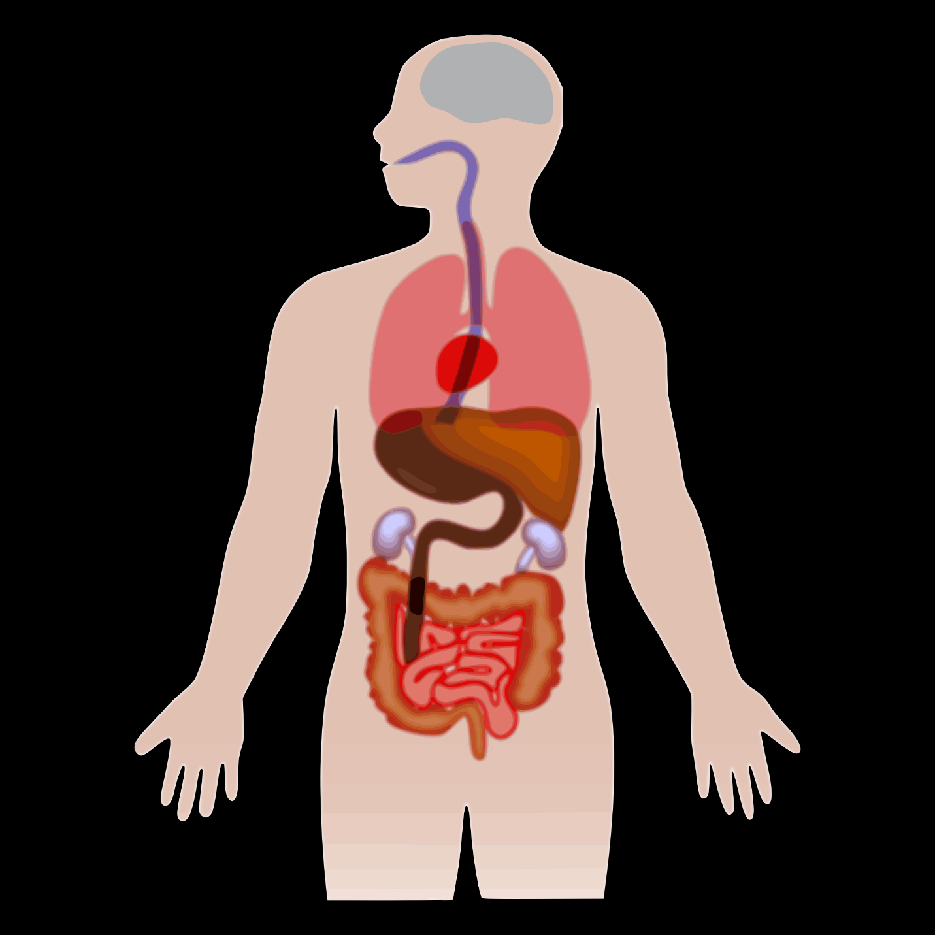
Stroke
Coronary Heart
Disease
Notes:
Next, we will look at coronary heart disease and search for similar ways where oral health can improve overall health.

Slide 24
“Heart Disease Facts,” Centers for Disease Control and Prevention, October 24, 2024, https://www.cdc.gov/heart-disease/data-research/facts-stats/index.html.
Notes:
On the left is an illustration of a normal, healthy artery. Over time, factors such as high cholesterol, smoking, hypertension, diabetes, and chronic inflammation contribute to plaque accumulation along the arterial walls, leading to narrowing and reduced blood flow.
Early plaque buildup may not significantly affect blood flow due to compensatory changes in the vessel. However, as plaque progresses, it can restrict circulation. Acute events often occur when plaque ruptures, triggering clot formation that partially or completely blocks blood flow.
Atherosclerosis develops gradually and can affect arteries throughout the body. When blood flow is blocked in the coronary arteries, it can result in a heart attack. When it occurs in the arteries supplying the brain, it can result in a stroke.
Coronary heart disease is the most common form of cardiovascular disease and affects the arteries of the heart.
Reference:
“Heart Disease Facts,” Centers for Disease Control and Prevention, October 24, 2024, https://www.cdc.gov/heart-disease/data-research/facts-stats/index.html.

Slide 25
In the US, how often does someone die from heart disease?
Once every 17 seconds
Once every 27 seconds
Once every 37 seconds
Once every 47 seconds
Notes:
[Read slide and have learners vote for an answer by show of hands.]

Slide 26
In the US, how often does someone die from heart disease?
Once every 17 seconds
Once every 27 seconds
Once every 37 seconds
Once every 47 seconds
Melonie Heron, “Deaths: Leading Causes for 2017,” National Vital Statistics Reports, 68(6), June 24, 2019,
https://www.cdc.gov/nchs/data/nvsr/nvsr68/nvsr68_06-508.pdf.
Notes:
[Read answer on slide.]
Reference:
Melonie Heron, “Deaths: Leading Causes for 2017,” National Vital Statistics Reports, 68(6), June 24, 2019,
https://www.cdc.gov/nchs/data/nvsr/nvsr68/nvsr68_06-508.pdf.

Slide 27
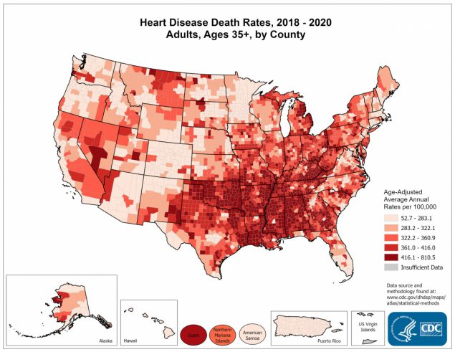
“Heart Disease Facts,” Centers for Disease Control and Prevention, October 24, 2024, https://www.cdc.gov/heart-disease/data-research/facts-stats/index.html.
Notes:
Do you observe any parallels between death rates from heart disease and death rates from stroke?
You will notice that there are higher heart disease death rates in the southeast US. You can see the rates follow similar deaths caused by strokes.
They seem to be concentrated in the same region. Allocating more funding to these states for the development of programs targeting high-risk patients could have a positive impact on reducing mortality rates and improving oral health outcomes.
Reference:
“Heart Disease Facts,” Centers for Disease Control and Prevention, October 24, 2024, https://www.cdc.gov/heart-disease/data-research/facts-stats/index.html.

Slide 28
How Does This Relate to Dental Caries?
Notes:
How does heart disease related to dental caries? In 2019, it was established that there is a connection between dental caries and both stroke and heart disease.

Slide 29
In a 2019 article in Nature’s Scientific Reports, which of the following clinical outcomes was shown to have a dose-dependent relationship with severity of tooth decay?
Heart attack
Headaches
Coronary heart disease
Pregnancy
Notes:
[Read slide and have learners vote for an answer by show of hands.]

Slide 30
In a 2019 article in Nature’s Scientific Reports, which of the following clinical outcomes was shown to have a dose-dependent relationship with severity of tooth decay?
Heart attack
Headaches
Coronary heart disease
Pregnancy
Notes:
[Read answer on slide.]

Slide 31
Kyuwoong Kim, Seulggie Choi, Jooyoung Chang, et. al., “Severity of dental caries and risk of coronary heart disease in middle-aged men and women: a population-based cohort study of Korean adults, 2002-2013,” Scientific reports, 9(1), (2019) 10491, https://doi.org/10.1038/s41598-019-47029-3
Notes:
A study conducted in Korea highlighted the global health perspective of countries focusing on specific diseases relevant to their populations. In this case, Korea aimed to comprehensively understand cardiovascular disease and identify ways to decrease or improve related risk factors. The study revealed a correlation between the severity of dental caries and an elevated risk of coronary heart disease, particularly among middle-aged adults.
In Table 2 of this article, we see that patients with a higher number of outpatient visits and more severe disease were associated significantly with the highest risk estimate for coronary heart disease.
Reference:
Kyuwoong Kim, Seulggie Choi, Jooyoung Chang, et al., “Severity of dental caries and risk of coronary heart disease in middle-aged men and women: a population-based cohort study of Korean adults, 2002-2013,” Scientific Reports, 9(1), (2019) 10491, https://doi.org/10.1038/s41598-019-47029-3

Slide 32
Kyuwoong Kim, Seulggie Choi, Jooyoung Chang, et. al., “Severity of dental caries and risk of coronary heart disease in middle-aged men and women: a population-based cohort study of Korean adults, 2002-2013,” Scientific reports, 9(1), (2019) 10491, https://doi.org/10.1038/s41598-019-47029-3
Notes:
In this table, they break this association down further to show a dose-dependent relationship with disease severity in relation to tooth decay and the number of events related to CHD.
Reference:
Kyuwoong Kim, Seulggie Choi, Jooyoung Chang, et al., “Severity of dental caries and risk of coronary heart disease in middle-aged men and women: a population-based cohort study of Korean adults, 2002-2013,” Scientific reports, 9(1), (2019) 10491, https://doi.org/10.1038/s41598-019-47029-3

Slide 33
Which of the following species was most commonly found in heart valve tissue and the plaques?
S. oralis
S. salivarius
S. mutans
S. oralis
Notes:
[Read slide and have learners vote for an answer by show of hands.]

Slide 34
Which of the following species was most commonly found in heart valve tissue and the plaques?
S. oralis
S. salivarius
S. mutans
S. oralis
Notes:
[Read answer on slide.]

Slide 35
Kazuhiko Nakano, Hiroaki Inaba, Ryota Nomura, et. al., ”Detection of Cariogenic Streptococcus mutans in Extirpated Heart Valve and Atheromatous Plaque Specimens,” Journal of Clinical Microbiology, 44(9), (2006) 3313–3317, https://doi.org/10.1128/JCM.00377-06.
Notes:
If you take a look at this table, this research group identified specific species of Streptococcus in heart values and atherosclerotic plaques.
They found S. mutans in the dental plaque was most common in heart valve tissue and the plaques, whereas S. sanguinis was commonly in the dental plaque but less likely to be found in the diseased valves or plaques.
The heart valve and atheromatous plaque specimens exhibited rare detection of other species, such as S. sobrinus, S. salivarius, and S. oralis. However, in dental plaque, S. oralis and S. salivarius were prevalent at ratios ranging from 71.4% to 72.2% and from 16.7% to 21.4%, respectively.
Reference:
Kazuhiko Nakano, Hiroaki Inaba, Ryota Nomura, et al., ”Detection of Cariogenic Streptococcus mutans in Extirpated Heart Valve and Atheromatous Plaque Specimens,” Journal of Clinical Microbiology, 44(9), (2006) 3313–3317, https://doi.org/10.1128/JCM.00377-06.

Slide 36
Kazuhiko Nakano, Hiroaki Inaba, Ryota Nomura, et. al., ”Detection of Cariogenic Streptococcus mutans in Extirpated Heart Valve and Atheromatous Plaque Specimens,” Journal of Clinical Microbiology, 44(9), (2006) 3313–3317, https://doi.org/10.1128/JCM.00377-06.
Notes:
Looking at Table 3 on the left, it becomes apparent that streptococcal species were consistently identified, with their quantities varying significantly from those in the heart valve specimens. Furthermore, dental plaque exhibited a notable presence of periodontitis-related bacteria in both quantity and frequency. In contrast, the method used indicated their negligible presence in heart valve tissue.
Looking at Table 4 on the right side, it is evident that streptococcal species were the most frequently detected, with a frequency of 88.9% and a quantity of 81.1%. S. mutans emerged as the predominant species, accounting for 77.8% in frequency and 48.1% in quantity. The incidence of other species, including periodontitis-related bacteria, was negligible compared to S. mutans. The analysis of dental plaque samples revealed significant differences in bacterial profiles for both frequency and quantity when compared to atheromatous plaque.
Overall, the bacterial species found in diseased heart valves and atherosclerotic plaques varied, with the most common species being Streptococcus, caries-causing bacteria. Using the method in this paper, caries bacteria were associated with these diseased sites more frequently than periodontally associated bacteria.
Reference:
Kazuhiko Nakano, Hiroaki Inaba, Ryota Nomura, et al., ”Detection of Cariogenic Streptococcus mutans in Extirpated Heart Valve and Atheromatous Plaque Specimens,” Journal of Clinical Microbiology, 44(9), (2006) 3313–3317, https://doi.org/10.1128/JCM.00377-06.

Slide 37
Kazuhiko Nakano, Hiroaki Inaba, Ryota Nomura, et. al., ”Detection of Cariogenic Streptococcus mutans in Extirpated Heart Valve and Atheromatous Plaque Specimens,” Journal of Clinical Microbiology, 44(9), (2006) 3313–3317, https://doi.org/10.1128/JCM.00377-06.
Notes:
This article looked at the serotypes of S. mutans present in cardiovascular valves and atherosclerotic plaques. It also looked at the distribution of these serotypes among patients undergoing cardiovascular operations compared to healthy mothers and children.
The serotype distribution frequency of S. mutans–positive specimens is summarized in Table 4. The study found that the frequency of serotype c in cardiovascular specimens and oral specimens from subjects undergoing cardiovascular operations was significantly lower than in oral specimens from healthy mothers and children (P < 0.05). Conversely, the rates for serotypes e and k, as well as untypable specimens, were significantly higher in cardiovascular specimens compared to oral specimens from healthy mothers and children (P < 0.05).
Reference:
Kazuhiko Nakano, Hiroaki Inaba, Ryota Nomura, et al., ”Detection of Cariogenic Streptococcus mutans in Extirpated Heart Valve and Atheromatous Plaque Specimens,” Journal of Clinical Microbiology, 44(9), (2006) 3313–3317, https://doi.org/10.1128/JCM.00377-06.

Slide 38
How Does Saliva Change?
Notes:
How does saliva change in our patients?

Slide 39
Patient Case
Notes:
Here, a 51-year-old male with a history of congestive heart failure was recently consulted for medical evaluation. Upon reviewing his medical history, it was noted that he hadn't seen his cardiologist in the past two years. Three years ago, he experienced a heart attack attributed to coronary artery disease, and this marked his third such episode. The patient also has a history of high blood pressure, high cholesterol, and epilepsy.
Given the medications prescribed for heart failure, a recommendation was made for the patient to consult with both his primary care physician (PCP) and cardiologist to apprise them of his current condition. Additionally, it was suggested to discuss the use of epinephrine in conjunction with the prescribed medications.
A full mouth series of radiographs revealed significant oral health issues. The patient presented with severe periodontal disease, and localized areas showed severe tooth decay, particularly in tooth #19. The caries risk assessment indicated a high risk, with a significant amount of dental work needed.

Slide 40
Patient Case: Radiographic Findings
Tooth #3 displayed super eruption and severe bone loss.
Tooth #4 exhibited severe bone loss and Class III mobility.
Teeth #8 and #9 showed severe bone loss and Class III mobility.
Tooth #17 displayed severe bone loss and Class II mobility.
Tooth #18 had gross decay of the disto-occlusal lingual (DOL) surfaces.
Teeth #23-26 presented severe bone loss and Class III mobility.
Notes:
Specific findings from the radiographs include:
Tooth #3 displayed super eruption and severe bone loss. Prognosis will be assessed after non-surgical periodontal treatment (NSPT), and extraction might be considered.
Tooth #4 exhibited severe bone loss and Class III mobility.
Teeth #8 and #9 showed severe bone loss and Class III mobility.
Tooth #17 displayed severe bone loss and Class II mobility.
Tooth #18 had gross decay of the disto-occlusal lingual (DOL) surfaces.
Teeth #23-26 presented severe bone loss and Class III mobility.
These oral health issues, combined with the patient’s medical history and ongoing cardiac concerns, underscore the importance of a comprehensive approach involving collaboration between dental and medical professionals to address both systemic and oral health.
This patient presented with heart issues, and as evident from their gum health assessment, it’s notably problematic. The patient exhibited elevated levels of protein, leukocytes, and high blood pressure. Remarkably, this patient experienced a heart attack within six months prior to visiting the dental office, and the salivary output observed aligns consistently with the findings from the recent studies we've reviewed.

Slide 41
Wrap Up
  Using chairside screening and a proactive oral health preventive plan, you can reduce your patients’ risk for developing tooth decay.
  Dental professionals have a role in the health care team in providing interprofessional care for patients to prevent stroke and heart disease.
Notes:
By implementing chairside screening and adopting a proactive oral health preventive plan, you can minimize the risk of tooth decay for your patients. Dental professionals play an important role in the health care team by delivering interprofessional care to prevent stroke and heart disease in patients.

Slide 42
Caries Management and Prevention: A Risk-Based Approach by CareQuest Institute
To continue learning, explore our other sessions:
Session 1: Understanding Dental Caries: Disease Process and Epidemiology
Session 2: Caries Disease Process: Demineralization, Remineralization, and Biofilm
Session 3: Caries Transmission and Ecological Dysbiosis
Session 4: Caries Risk Assessment: Disease Indicators, Risk Factors, and Protective Factors
Session 5: Applying Caries Risk Assessment: Clinical Decision-Making
Session 6: Applying Prevention Strategies: Risk-Based Caries Management
Session 7: Caries Risk Assessment: Case-Based Application
Session 8: Saliva in Health: Foundations and Mechanisms
Session 9: Saliva in Health: Microbiome, pH, and Caries Risk
Session 10: Saliva in Disease: Cardiovascular Conditions and Caries Risk
Session 11: Saliva in Disease: Asthma, Allergic Rhinitis, and Caries Risk

