Slide 1
The Oral Microbiome and Caries:
From Dysbiosis to Prevention
Notes:
In this session, learners will explore how the quantity and quality of saliva impacts oral health. This presentation will examine the effects of acidity, pH levels, and buffering capacity on saliva, and how these factors influence the oral microbiome.
This session builds your foundation. Focus on how saliva works and why it matters.

Slide 2
Learning Objectives
Explain the functions of saliva in oral health.
Differentiate how the quality and quantity of saliva affect patients’
disease status.
Describe how saliva influences caries risk.
Identify factors that alter salivary flow and composition.
Notes:
Our goals for this lesson are to achieve the following learning objectives: [read slide]

Slide 3
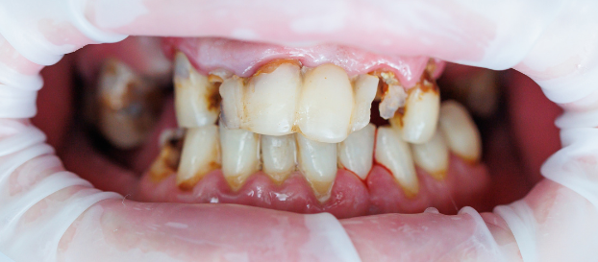
One Content
What Do You See?
Optional Subhead
This is an example of how body copy should be treated in template. Starting body copy will default to Arial 24pt font. Keep the messaging clear, concise and to the point. Text can be sized up or down as the need should arise, but the best bet is to keep primary copy at this size.
  First level bullet
    Second level bullet
      Third level bullet
        Fourth level bullet
Notes:
Use think-pair-share.
What do you already know about saliva?
What does saliva do?
What happens when it is reduced?
How might it affect disease?
----------------------------------------
Option #2
What do you see? [Pause for answers.]
Now let’s take a step back and look at the full picture. What do you see? [Pause for answers.]
The initial answers provided were diagnoses or symptoms, skipping many observation steps and jumping straight to identifying issues like decay, recession, abfractions, and periodontal disease.
This shows how dental professionals often diagnose quickly without pausing to thoroughly examine each tooth and the entire mouth before making an assessment. This rushed approach can cause to miss important details.
Additionally, in this image, the saliva cannot be seen, including its organic and inorganic components. Although it can be inferred from the shiny appearance that saliva is there, the composition of it cannot be assessed from a diagnostic image or radiograph. Sometimes, what cannot be seen is just as important as what can be seen.

Slide 4
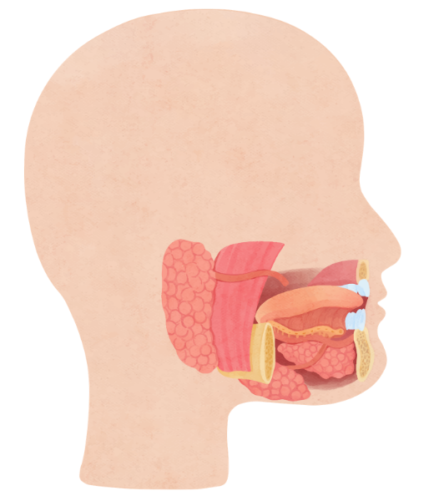
Why Saliva Matters
Maintains oral homeostasis
Protects teeth and tissues
Supports digestion and comfort
Critical for caries prevention
Core Functions:
  Protection
  Repair
  Maintenance
Notes:
Saliva plays a critical role in maintaining oral health and overall balance in the oral environment. It helps maintain oral homeostasis, meaning it keeps conditions stable despite constant challenges like eating, drinking, and bacterial activity. It protects teeth and soft tissues by buffering acids and supporting the integrity of the oral environment. Saliva also supports digestion and overall comfort by aiding in swallowing, lubrication, and speech.
Most importantly, it is a factor in caries prevention through its role in remineralization and biofilm balance.

Slide 5
Quantity vs. Quality
Notes:
Saliva is a balance between quality and quantity. When it comes to the quality of saliva, it is important to recognize there is bad saliva and good saliva. When it comes to quantity, we refer to salivary flow.
How much saliva do you think the average person produces per year? [Pause for answers.]
Quantity = flow rate
Quality = composition
Both influence disease risk
Measuring the quantity of a patient’s saliva is important. Ideally, saliva should be high quantity and high quality.
Patients with low quality, whether they have high or low quantity, will always have disease because saliva can't remineralize and buffer.
You can help patients achieve a sustainable quantity and quality of saliva to maintain their oral health.

Slide 6
Notes:
Saliva is liquid gold and a complex mixture of:
Gingival secretions, or gingival crevicular fluid
Nasal secretions, aka where I got the word “Booger.”
Epithelial cells
Serum and blood derivatives
Bacteria
Viruses
Fungi
Food debris
Other cellular components

Slide 7
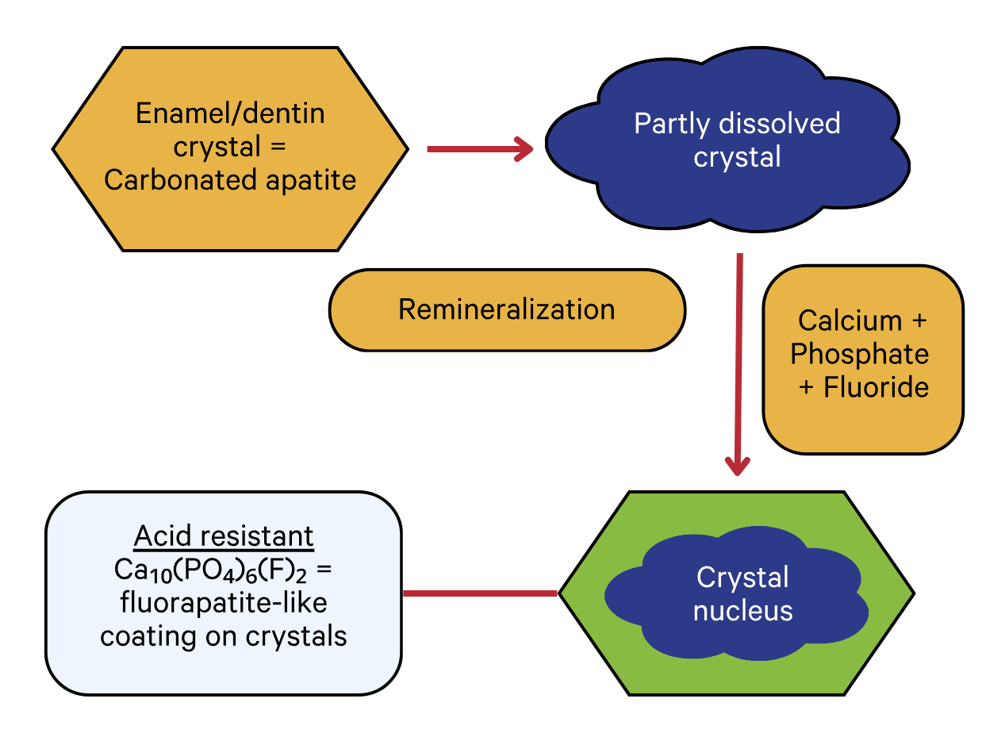
Remineralization
Saliva contains calcium and phosphate
Supports enamel repair
Prevents mineral loss
Image modified from: John Featherstone, “Dental caries: A dynamic disease process,” Australian Dental Journal, 53(3), (2018) 286–291, https://doi.org/10.1111/j.1834-7819.2008.00064.x.
Notes:
Early lesions can reverse.
Saliva contains calcium and phosphate
Supports enamel repair
Prevents mineral loss
Image modified from: John Featherstone, “Dental caries: A dynamic disease process,” Australian Dental Journal, 53(3), (2018) 286–291, https://doi.org/10.1111/j.1834-7819.2008.00064.x.

Slide 8
Saliva
Maria Greabu, Maurizio Battino, Maria Mohora et al., “Saliva—a diagnostic window to the body, both in health and in disease,” J Med Life, 2(2), (2009) 124–132, https://pubmed.ncbi.nlm.nih.gov/20108531/.
Mohammad Javaid, Ahad Ahmed, Robert Durand, Simon Tran, “Saliva as a diagnostic tool for oral and systemic diseases,” Journal of Oral Biology and Craniofacial Research, (2016) 6(1):66–75, doi:10.1016/j.jobcr.2015.08.006.
David Wong, ”Salivaomics,” The Journal of the. American Dental Association, 143 (2012) 19S-24S, https://jada.ada.org/article/S0002-8177(14)63755-7/fulltext.
Notes:
Another way to quantify the value of saliva is to think about the quality of composition of the saliva.
These two teardrops of saliva, is there a component in here that you are surprised that is in saliva? [Pause for answers.]
Inorganic components of saliva include ions, minerals, and electrolytes. In dentistry, you might quickly think about calcium and phosphate. Important elements that help prevent demineralization and erosion.
A great example is patients with cystic fibrosis, or CF, They typically have higher levels of calcium and phosphate, which may be linked to their increased propensity for calculus formation.
Organic components are extensive. Although you may initially think of screening for genetic markers for disease or for pathogens, whether it be a bacterium, virus, or fungus, there are many other organic components to saliva that can be measured.
In fact, in a recent article in JADA, Dr. Wong highlighted the five diagnostic alphabets of saliva: proteins, mRNAs, miRNAs, metabolic compounds, and microbes.
References:
Maria Greabu, Maurizio Battino, Maria Mohora et al., “Saliva—a diagnostic window to the body, both in health and in disease,” J Med Life, 2(2), (2009) 124–132, https://pubmed.ncbi.nlm.nih.gov/20108531/.
Mohammad Javaid, Ahad Ahmed, Robert Durand, Simon Tran, “Saliva as a diagnostic tool for oral and systemic diseases,” Journal of Oral Biology and Craniofacial Research, (2016) 6(1):66–75, doi:10.1016/j.jobcr.2015.08.006.
David Wong, ”Salivaomics,” The Journal of the. American Dental Association, 143 (2012) 19S-24S, https://jada.ada.org/article/S0002-8177(14)63755-7/fulltext.

Slide 9
Effects on Saliva
Normal Human Variability
Unstimulated vs. Stimulated Saliva
Aging
Medications
Disease
(ex. CF, Sjögren’s Syndrome)
Circadian Rhythms
Notes:
Salivary flow and composition are not constant. They vary based on several factors, which can influence oral health and caries risk. There is normal human variability, meaning each individual has a different baseline level of saliva in both quantity and quality. Saliva also changes depending on whether it is unstimulated or stimulated. Unstimulated saliva reflects resting conditions, while stimulated saliva increases during activities like eating and plays a role in buffering and clearance. Aging can impact salivary function, although changes are often more related to associated factors like medication use rather than age alone.

Slide 10
Salivary Components
  Static vs. Dynamic
Notes:
It is important to realize that salivary components are not static or the same all the time.
Salivary components can be static, constant release, or present throughout the day, or dynamic released when stimulated by activity (eating/chewing/drinking).
Static: baseline protection
Dynamic: response to challenges

Slide 11
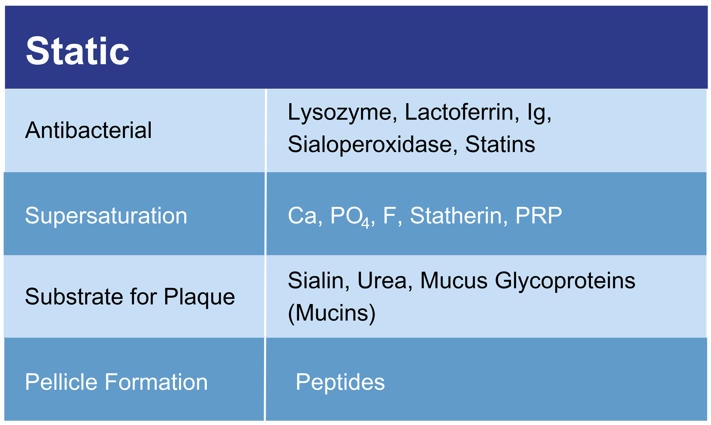
Static Anti-Caries Actions of Saliva
W.M. Edgar and S.M. Higham, “Role of Saliva in Caries Models,” Advances in Dental Research, 9(3), (November 1995) 235–238, https://doi.org/10.1177/08959374950090030701.
Notes:
This chart shows static anti-caries functions of saliva that are static in nature. Examples of these anti-bacterial static components include enzymes like lysozymes, lactoferrins, immunoglobulins, and statins. Plasma-rich protein (PRP) aid in preventing cavities by inhibiting bacterial growth. Additionally, saliva provides substrates for plaque formation.
Reference:
W.M. Edgar and S.M. Higham, “Role of Saliva in Caries Models,” Advances in Dental Research, 9(3), (November 1995) 235–238, https://doi.org/10.1177/08959374950090030701.

Slide 12
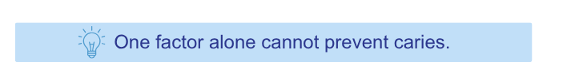
Antimicrobial Role
What it does | How it works
Controls bacterial growth Disrupts harmful activity Supports balance | Contains proteins that help regulate microbial activity Contributes to maintaining balance in the oral microbiome Works as part of a broader host-defense system
Notes:
Saliva plays an important antimicrobial role in the oral environment. It helps control bacterial growth, disrupts harmful activity, and supports overall balance within the biofilm. This is made possible through salivary proteins that help regulate microbial activity and contribute to maintaining balance in the oral microbiome. Saliva also functions as part of a broader host-defense system, working alongside other protective factors in the mouth.
It is important to recognize that while saliva plays a protective role, it is only one part of the overall picture. No single factor alone can prevent caries. Caries is a multifactorial disease that depends on the interaction of biofilm, diet, host factors, and time.

Slide 13
Antimicrobial Proteins
Lysozyme
Antimicrobial enzyme (protein) that breaks down gram-positive bacterial cell walls
Lactoferrin
Antimicrobial non-enzymatic protein
Histatin
Histatin rich proteins inhibit C. albicans growth
Salivary Peroxidase System
Inhibits transport of vital components for bacteria, damages inner membrane of cell wall, and alters gradients
Masoumeh Moslemi, Mandana Sattari, Fahimeh Kooshki, et al., “Relationship of Salivary Lactoferrin and Lysozyme Concentrations with Early Childhood Caries,” J Dent Res Dent Clin Dent Prospects, 9(2), (2015) 109–114, doi:10.15171/joddd.2015.022.
Notes:
Instructor Note: Delete this slide if this is too deep for your learners at this stage.
Reference Note: This study evaluated salivary levels of lysozyme and lactoferrin in children with and without early childhood caries. Differences were observed, but these findings do not establish causation or predictive value. These proteins are part of the overall host response, not standalone indicators of caries risk.
Lysozyme
• Antimicrobial enzyme found in saliva and gingival crevicular fluid
• Breaks down bacterial cell walls and disrupts bacterial activity
Lactoferrin
• Binds iron, limiting bacterial growth
• Contributes to antimicrobial defense through nutritional immunity
Histatins
• Inhibit growth of fungi such as Candida albicans
Salivary Peroxidase System
• Interferes with bacterial metabolism and transport mechanisms
Reference:
Masoumeh Moslemi, Mandana Sattari, Fahimeh Kooshki, et al., “Relationship of Salivary Lactoferrin and Lysozyme Concentrations with Early Childhood Caries,” J Dent Res Dent Clin Dent Prospects, 9(2), (2015) 109–114, doi:10.15171/joddd.2015.022.

Slide 14
Supersaturation
Statherin
CaPO₄ salts are soluble, and when they are supersaturated in the saliva it allows enamel to remineralize. Statherins prevent the crystallization or precipitation of these salts.
Proline-Rich Proteins (PRP)
Keep CaPO₄ from forming crystals.
Notes:
Statherin plays a vital role in oral health by maintaining the solubility of calcium phosphate (CaPO₄) salts in saliva, enabling enamel remineralization. It achieves this by preventing the crystallization or precipitation of these salts.
Proline-Rich Proteins (PRP) serve a similar function by preventing the formation of crystals of calcium phosphate (CaPO₄) helping to maintain the solubility of these salts in saliva.

Slide 15
Substrates for Plaque & Pellicle Formation
Sialin
Participates in anion transport and duct maintenance.
Mucin
Protects the hard and soft tissue and is a part of the pellicle formation. It also lubricates, aggregates bacteria, and blocks bacterial adhesion.
L. Li, H. Wang, L. Hu, et al., “Age associated decrease of sialin in salivary glands,” Biotechnic & histochemistry : official publication of the Biological Stain Commission, 93(7), (2018) 505–51, https://doi.org/10.1080/10520295.2018.1463453.
Notes:
Sialin plays a role in saliva by facilitating the transport of anions and maintaining the integrity of ducts within the salivary glands.
Mucin, another essential component of saliva, serves multiple functions to protect oral tissues. It aids in pellicle formation, which shields both hard and soft tissues. Mucin acts as a lubricant, aggregates bacteria, and prevents bacterial adhesion, contributing to overall oral health.
Reference:
L. Li, H. Wang, L. Hu, et al., “Age associated decrease of sialin in salivary glands,” Biotechnic & histochemistry: Official publication of the Biological Stain Commission, 93(7), (2018) 505–51, https://doi.org/10.1080/10520295.2018.1463453.

Slide 16
Dynamic Anti-Caries Actions of Saliva
W.M. Edgar and S.M. Higham, “Role of Saliva in Caries Models,” Advances in Dental Research, 9(3), (November 1995) 235–238, https://doi.org/10.1177/08959374950090030701.
Notes:
Dynamic actions, on the other hand, are activated in response to the Stephan Curve. The Stephan Curve marks the pH response to eating or drinking. When a patient eats or drinks something with a carbohydrate or sugar, there is a challenge. The body releases additional products into the saliva, like bicarbonate and water to clear the acid or sugar and neutralize the pH.
Because these quantities of these products change in response to eating or drinking, they are known as dynamic.
Reference:
W.M. Edgar and S.M. Higham, “Role of Saliva in Caries Models,” Advances in Dental Research, 9(3), (November 1995) 235–238, https://doi.org/10.1177/08959374950090030701.

Slide 17
“Several decades ago, the ecologist C.S. Holling mentioned that when ecosystems are studied, there is a ‘tendency to emphasize the quantitative (i.e., a single time point) rather than the qualitative (i.e., fluctuations over time),’ while only the latter informs about resilience.”
Notes:
Patients may face challenges with their saliva, especially when viewed at a specific moment in time. Echoing the observation of ecologist C.S. Holling, who noted a tendency to focus on quantitative aspects rather than qualitative fluctuations in ecosystem studies, it’s essential to recognize that understanding qualitative changes over time is important for assessing resilience.

Slide 18
Co-Decision-Making Process
Notes:
In the dental practice, it is best to follow a co-decision-making process when developing the patient’s treatment plan.
The patient’s needs, desires, values, time, and insight are given utmost importance. The aim is to place the patient at the center of the process. Together, information such as X-rays, intraoral photos, periodontal charts, and the saliva test reports are utilized to discuss what is observed, available options, and potential courses of action.
Implementing this co-decision-making process not only ensures that the patient’s preferences are taken into account but also increases their likelihood of compliance with the treatment plan.

Slide 19
Saliva and the Oral Microbiome
Notes:
The composition of saliva plays a key role in shaping the oral microbiome. It influences the overall oral environment, including factors like pH, nutrient availability, and protective components. These factors directly affect bacterial activity, determining which organisms thrive and how active they are. As a result, saliva can support a state of health or contribute to conditions that allow disease to develop.

Slide 20
Oral Bacteria
Notes:
When discussing with patients, the concept of the oral microbiome is often simplified. Each individual harbors varying quantities of various species, categorized into two main types: commensal (beneficial bacteria) and pathogenic (harmful bacteria).

Slide 21
Microbiome Markers
When it comes to dental caries, the risk and the health of the microbiome are measured by the following factors:
Bacterial Load / Composition
Ammonia Levels (health associated bacteria)
pH (acidity)
Buffer Capacity (proteins)
Notes:
When considering , we can assess your risk and the health of your microbiome by examining several factors: bacterial load and composition, ammonia levels (good bacteria), pH levels (acidity), and buffer capacity (proteins).

Slide 22
How Is Ammonia Produced in the Oral Cavity?
Urea is found at the same level as in blood serum (3–10mM).
Urea is hydrolyzed (water added) to produce carbon dioxide and ammonia.
Robert Burne and Robert Marquis, “Alkali production by oral bacteria and protection against dental caries,” FEMS Microbiology Letters, 193(1), (2000) 1–6. https://doi.org/10.1111/j.1574-6968.2000.tb09393.x.
Notes:
Two processes generate free ammonia in the mouth, both stemming from a healthy oral biofilm. Let's start with how the body breaks down urea, a compound present in saliva, to maintain a balanced environment.
Urea exists in the saliva secreted by salivary glands at a concentration equivalent to that in your bloodstream (3–10 mM). It undergoes rapid hydrolysis (the addition of water, as you might recall from organic chemistry), catalyzed by bacterial urease enzymes, resulting in the production of ammonia and water. Under normal pH conditions, urease activity is suppressed since there’s no need to raise pH levels for the benefit of beneficial bacteria. However, when faced with acidic conditions, urease enzymes kick in, swiftly generating their alkaline byproducts.
Common microbes involved: S. salivarius, Actinomyces naeslundii.
Reference:
Robert Burne and Robert Marquis, “Alkali production by oral bacteria and protection against dental caries,” FEMS Microbiology Letters, 193(1), (2000) 1–6. https://doi.org/10.1111/j.1574-6968.2000.tb09393.x.

Slide 23
How Is Ammonia Produced in the Oral Cavity?
Arginine
Found in saliva through diet, protein turnover, or generation through citrulline.
High levels of this system is associated with decreased cariogenicity of biofilms
Notes:
Another compound in saliva capable of generating ammonia is arginine.
Arginine is obtained from dietary sources and is also synthesized in the body through protein breakdown and the creation of citrulline.
Commensal organisms utilize the arginine dihydrolase system (ADS) and the agmatine deiminase system to convert arginine into ornithine (an amino acid), ammonia, and carbon dioxide. This conversion process has been strongly linked to decreasing the cavity-causing potential of oral biofilms.

Slide 24
Why Is Alkali Generation Important?
Counteracts acid production
Helps maintain pH balance
Reduces risk of demineralization
Ya-Ling Liu, Marcelle Nascimento, and Robert Burne, “Progress toward understanding the contribution of alkali generation in dental biofilms to inhibition of dental caries,” International journal of oral science, 4(3), (2012) 135–140, https://doi.org/10.1038/ijos.2012.54.
Notes:
Alkali generation plays an important role in maintaining balance in the oral environment. It helps counteract acid production from bacterial metabolism, which is a key driver in the caries process. By neutralizing acids, alkali production supports a more stable pH in the oral cavity. This balance is critical because when pH drops, demineralization of enamel can occur. By helping maintain a healthier pH, alkali generation reduces the risk of demineralization.
Reference:
Ya-Ling Liu, Marcelle Nascimento, and Robert Burne, “Progress toward understanding the contribution of alkali generation in dental biofilms to inhibition of dental caries,” International journal of oral science, 4(3), (2012) 135–140, https://doi.org/10.1038/ijos.2012.54.

Slide 25
Oral Microbiome Examples
Yosef Krespi, Mark Shrime, and Ashutosh Kacker, “The relationship between oral malodor and volatile sulfur compound-producing bacteria,” Otolaryngology--head and neck surgery : official journal of American Academy of Otolaryngology-Head and Neck Surgery, 135(5), (2006) 671–676. https://doi.org/10.1016/j.otohns.2005.09.036.
Notes:
The oral microbiome is far more intricate. An individual's mouth hosts around 100 species of bacteria, while collectively among all humans, there are around 700 species present in oral microbiomes.
Reference:
Yosef Krespi, Mark Shrime, and Ashutosh Kacker, “The relationship between oral malodor and volatile sulfur compound-producing bacteria,” Otolaryngology—head and neck surgery: official journal of American Academy of Otolaryngology-Head and Neck Surgery, 135(5), (2006) 671–676. https://doi.org/10.1016/j.otohns.2005.09.036.

Slide 26
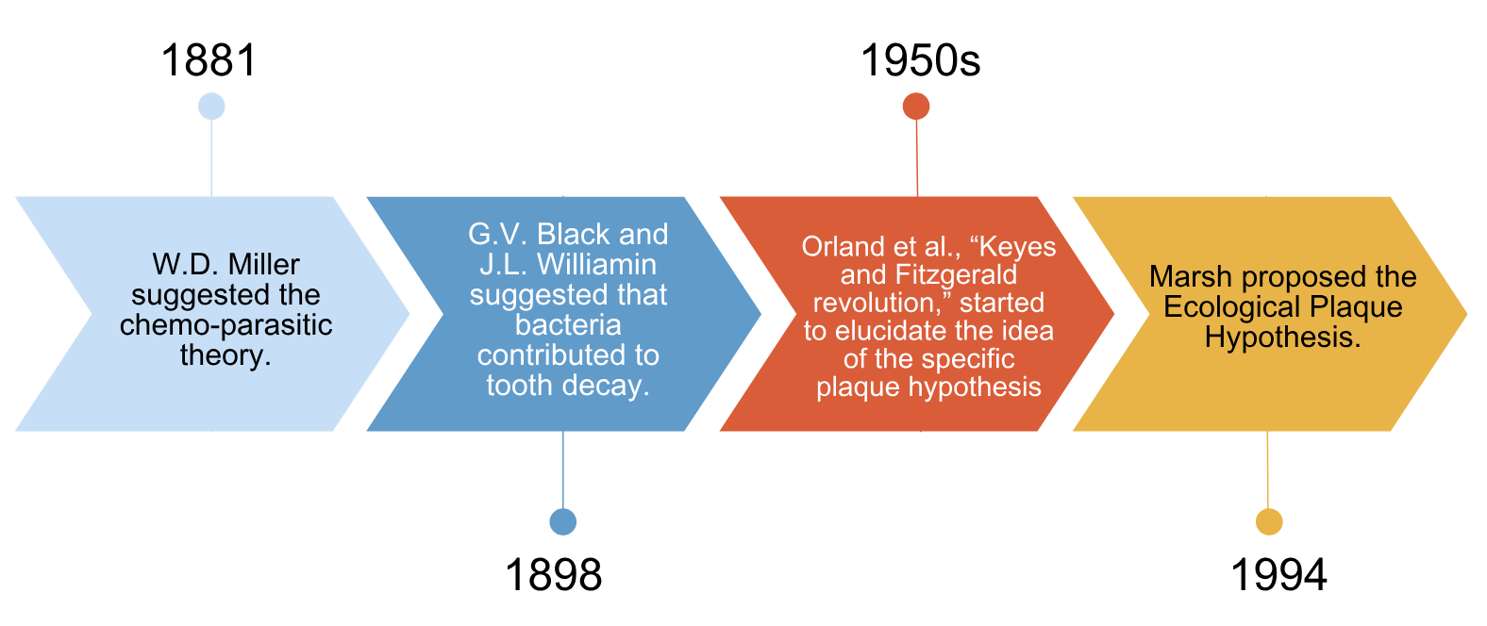
Model for Dental Caries
Carounanidy Usha and Sathyanarayanan R., “Dental caries - A complete changeover (Part I),” Journal of conservative dentistry : JCD, 12(2), (2009) 46–54. https://doi.org/10.4103/0972-0707.55617.
Notes:
In 1881, the renowned Miller proposed the chemo-parasitic theory, suggesting that the combination of acid and certain bacteria led to tooth decalcification. This theory evolved over time with contributions from dentists like Louis Pasteur and Robert Koch.
In 1898, Black and Williamin began to grasp the connection between plaque buildup and tooth decay. They also recognized that bacteria-produced acids were causing tooth demineralization.
By the 1950s, specific bacteria such as Streptococci, Lactobacilli, and Actinomyces were linked to dental cavities. Around this time, it was also discovered that the disease could be transmitted.
In 1994, Marsh proposed the Ecological Plaque Hypothesis, suggesting that the shift from a healthy to a disease-causing state in the mouth occurs due to interactions between bacteria and the environment.
Reference:
Carounanidy Usha and Sathyanarayanan R., “Dental caries—A complete changeover (Part I),” Journal of conservative dentistry : JCD, 12(2), (2009) 46–54. https://doi.org/10.4103/0972-0707.55617.

Slide 27
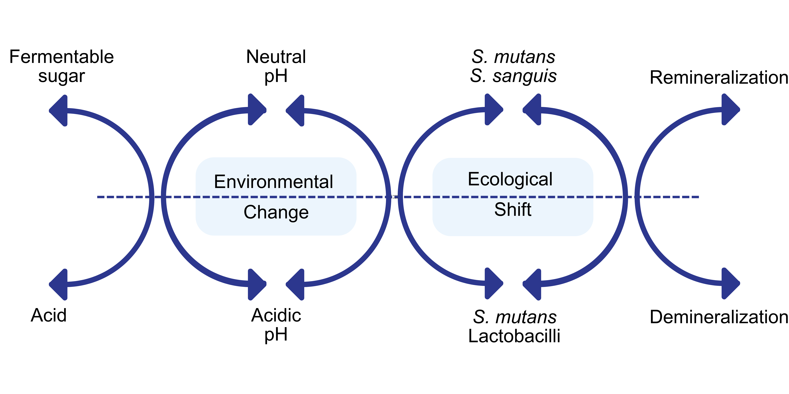
Ecological Plaque Hypothesis
Carounanidy Usha and Sathyanarayanan R., “Dental caries - A complete changeover (Part I),” Journal of conservative dentistry : JCD, 12(2), (2009) 46–54. https://doi.org/10.4103/0972-0707.55617.
Notes:
In 1991, a new idea called the “ecological plaque hypothesis” was suggested. It suggests that changes in the environment where plaque lives make certain bacteria more likely to cause disease in certain parts of the body. This hypothesis doesn't just focus on the bacteria themselves but also on what causes the environment of the plaque to change.
Reference:
Carounanidy Usha and Sathyanarayanan R., “Dental caries - A complete changeover (Part I),” Journal of conservative dentistry : JCD, 12(2), (2009) 46–54. https://doi.org/10.4103/0972-0707.55617.

Slide 28
Ecological Plaque Hypothesis
Carounanidy Usha and Sathyanarayanan R., “Dental caries - A complete changeover (Part I),” Journal of conservative dentistry : JCD, 12(2), (2009) 46–54. https://doi.org/10.4103/0972-0707.55617.
Notes:
Sucrose causes caries because it’s easy for bacteria to break it down into acid. This acid production leads to the creation of sticky substances both inside and outside bacteria cells. Outside, these sticky substances help bacteria stick to teeth and form a strong layer of biofilm. Inside the bacteria, the substances act as a kind of sugar storage, keeping the acid production going even when there's no sugar in the diet.
Reference:
Carounanidy Usha and Sathyanarayanan R., “Dental caries—A complete changeover (Part I),” Journal of conservative dentistry: JCD, 12(2), (2009) 46–54. https://doi.org/10.4103/0972-0707.55617.

Slide 29
Why Is Alkali Generation Important?
Evelyn Reyes, Javier Martin, Gustavo Moncada et al., “Caries-free subjects have high levels of urease and arginine deiminase activity,” J Appl Oral Sci. 2014 Jun;22(3):235-40. doi: 10.1590/1678-775720130591.
Notes:
Additional, studies have shown that ammonia released by the urease and ADS activity is higher and nearly equal in saliva. However, in plaque, although higher, urease generates the most ammonia in plaque among caries-free individuals.
In summary, if there is an increased production of alkali substrates, then it is associated with a lower incidence of dental caries lesions.
Reference:
Evelyn Reyes, Javier Martin, Gustavo Moncada et al., “Caries-free subjects have high levels of urease and arginine deiminase activity,” J Appl Oral Sci. 2014 Jun;22(3):235-40. doi: 10.1590/1678-775720130591.

Slide 30
Notes:
Non-restorative guidelines begin at D2 and continue downwards below D1. Intervention can begin before a patient starts experiencing dental caries by altering their saliva composition. Therefore, our objective is to comprehend environmental changes more deeply so that we can effectively address the root causes of dental caries.

Slide 31
pH and Acidity
Notes:
Next, let’s discuss pH and acidity.
Before you eat, your saliva’s pH sits around 6.7, which is fairly neutral. However, once you consume foods high in carbohydrates, the pH takes a dip, dropping below 5 for about 15–20 minutes. If it falls below 5.5, it can trigger demineralization of tooth enamel. So, how fast your body reacts to this acid attack and how well it can counteract the low pH become important for preventing cavities.
The time it takes for your mouth to respond to this acid attack varies, ranging from 40–60 minutes or even longer. Many factors come into play here:
Are there fermentable carbohydrates present?
Are these carbs being cleared effectively, especially in cases like dry mouth or dentures?
Are bacterial enzymes working properly at that pH level?
The unstimulated buffering capacity of saliva and plaque are also key factors.
Additionally, the speed of salivary film flow over plaque influences the response time.
It's worth noting that stimulating saliva too frequently or for too long can alter its composition. This often affects bicarbonate secretion, making it tougher for the body to neutralize acids.
To keep track of saliva pH, patients can use pH test strips at home during these times:
Wake up in the morning
After meals
Following consumption of certain acidic foods
When the mouth feels dry
Reference: Michael Edgar, Colin Dawes, and Denis O’Mullane, Saliva and oral health, Fourth Edition, 3–4, 2012

Slide 32
Patient Factors
Acid Reflux
Obstructive Sleep Apnea
Habits
(smoking, nutrition, or supplement)
Dry Mouth (medication, age, disease or radiation induced)
Eating Disorder (bulimia)
Other
Notes:
These are patient factors that that influence pH levels and acidity in oral health.
Acid Reflux (GERD): Acid reflux can be induced from diet when patients eat a high-fat or spicy diet right before bed, or it can be induced by taking medication. High blood pressure medication is a sneaky culprit. Also, it can be caused from obstructive sleep apnea (OSA).
Obstructive Sleep Apnea (OSA): There are great resources for screening for OSA such as STOP, STOP-BANG (SB), Epworth Sleepiness Scale (ESS), and 4-Variable screening tool (4-V). The STOP and STOP-BANG questionnaire consist of four and eight questions, respectively. Often, patients with OSA, whether they are being treated or not, report high blood pressure, GERD, and weight gain. When a patient has their OSA treated, it may show a reduction in GERD signs and symptoms as well.
Eating Disorder (Bulimia): When it comes to vomiting associated with an eating disorder such as bulimia, it is important to recognize even though the body produces extra saliva before and after you vomit, that increased flow rate alone cannot counteract the amount of acid that is produced. The teeth are still susceptible. Treatment of the eating disorder is important, but also, rinsing the mouth with baking soda water after vomiting can be helpful to decrease the amount of acid the teeth are exposed to.
Dry Mouth (Medication, Age, Disease, or Chemotherapy Induced): Treating dry mouth is an entire course; however, it is important to remember that dry mouth can be caused by multiple factors including medications, age, diseases such as Sjögren’s Syndrome, or after radiation. Acid is the most potent stimulus for salivary secretion and leads to production of an alkaline saliva. Although this seems like a good thing, it’s actually not. pH of saliva is mainly dependent on the flow rate, or how much you produce and to a lesser extent is influenced by acidic attacks.
It is not enough to ask patients, “Is your mouth dry?” Often, they may not be able to tell, but what they can tell you is how their life has changed. Examples include carrying around a bottle of water, a sour taste in their mouth, food not tasting the same or having trouble swallowing at meals, dentures fitting differently, white crusts at the corners of their mouth, or always feeling thirsty.
Habits: Lastly, when these factors are reviewed with patients, you can learn more about their habits, such as drinking coffee with sugar, carrying candy or granola bars in their pockets, or snacking at work.

Slide 33
Why Baking Soda?
Increases plaque pH
Increases buffer capacity
Supports a less acidic oral environment
Notes:
Baking soda is another way to support alkali activity in the oral environment. When used as a rinse, baking soda helps neutralize acids produced by bacterial metabolism. It can increase plaque pH and enhance the buffering capacity of saliva, making the environment less favorable for acid-driven processes. It may also help inhibit plaque formation, contributing to a more balanced biofilm.
Similar to the arginine and urea pathways, baking soda supports a less acidic oral environment.
By helping maintain a higher pH, it reduces the conditions that lead to demineralization.

Slide 34
Buffering Capacity
Notes:
pKa tells us if an acid is strong or weak, while pH shows if a system is acidic or alkaline. If an acid has a high pKa, it’s weak; if it has a low pKa, it’s strong.
In saliva, there are both fixed and mobile buffers. Fixed buffers are mainly due to bacterial proteins or plaque composition. Meanwhile, mobile include acids like bicarbonate and phosphate. Among these mobile acids, there are those with high pKa, which are effective for neutralizing pH and strengthening the buffering system. High pKa acids have a stronger proton-holding capacity, enhancing their buffering capabilities.

Slide 35
Buffering Capability of Common Salivary Acids
Notes:
High pKa acids such as acetate do a better job of creating a neutral pH compared to low pKa acids such as lactate. The amount of lactic acid in the system is what determines the minimum pH.
The rise in bicarbonate concentration, which is related to the carbonic acid level, also leads to a rise in salivary pH, which directly neutralizes the plaque acidity.

Slide 36
Salivary Buffering Systems
M. Lenander-Lumikari and V. Loimaranta, “Saliva and Dental Caries,” Advances in Dental Research, 14(1), (December 2000) 40–47, https://doi.org/10.1177/08959374000140010601.
Notes:
Buffering of the saliva involves three major systems: the protein, phosphate, and bicarbonate system, with the bicarbonate system making the most contribution to overall buffering capacity.
The phosphate system has a pKa range of 6.8–7.0 and the bicarbonate system a pKa of 6.10–6.3.
The buffering capacity of saliva is affected by hormonal and metabolic changes and overall health. Men typically have a greater buffering capacity than women. Specifically, within women, the buffer capacity decreases throughout pregnancy and then rebounds after delivery.
Reference:
M. Lenander-Lumikari and V. Loimaranta, “Saliva and Dental Caries,” Advances in Dental Research, 14(1), (December 2000) 40–47, https://doi.org/10.1177/08959374000140010601.

Slide 37
Stephan Curve and Dental Caries
Michael Edgar, Colin Dawes, and Denis O’Mullane, Saliva and oral health, Stephen Hancocks Limited, 2012.
Notes:
The lowest pH, usually around 5.6 or 4.6 depending on the person, corresponds to the peak concentration of lactic acid in a Stephan curve.
This also involves reduced levels of acetate, succinate, and propionate anions, along with most amino acids and ammonia. It’s important that this minimum pH remains below 5.5 to prevent enamel damage.
When saliva and plaque fluid are at physiological pH, they are saturated with respect to enamel's hydroxyapatite phase, allowing for remineralization. However, when a person consume carbs, plaque pH drops and undergoes neutralization, as seen in the Stephan Curve. If pH falls below the critical level, teeth dissolve to maintain saliva saturation.
During remineralization, phosphate and hydroxyl ions from saliva take up protons, slowing or reversing pH fall. Ideally, this process reprecipitates exceeded minerals at damaged sites when pH rises.
Reference:
Michael Edgar, Colin Dawes, and Denis O’Mullane, Saliva and oral health, Stephen Hancocks Limited, 2012.

Slide 38
How Can You Boost Your Patient’s Capacity?
Chew sugar-free gum!
Sugar-free gum stimulates salivary flow
Increased saliva can raise plaque pH
It supports clearance of food and sugars
It may reduce caries risk when used regularly
Xylitol is noncariogenic and may reduce levels of cariogenic bacteria
Steffen Mickenautsch, Soraya Coelho Leal, Veerasamy Yengopal, et al., “Sugar-free chewing gum and dental caries: a systematic review,” J Appl Oral Sci., 2007 Apr;15(2):83–8. doi: 10.1590/s1678-775720.
Notes:
Sugar-free gum works primarily by stimulating saliva. This can help raise pH and improve buffering, which supports a less cariogenic environment. Xylitol-containing gums may reduce levels of cariogenic bacteria, but the evidence is mixed, and the effect is best considered an adjunct, not a primary prevention strategy.
This systematic review found that sugar-free gum may reduce caries risk, primarily by increasing salivary flow and improving the oral environment. The evidence is suggestive but not definitive, and the benefit should be considered an adjunct to other preventive strategies.
Reference:
Steffen Mickenautsch, Soraya Coelho Leal, Veerasamy Yengopal, et al., “Sugar-free chewing gum and dental caries: a systematic review,” J Appl Oral Sci., 2007 Apr;15(2):83–8. doi: 10.1590/s1678-77572007000200002.

Slide 39
Preventative Options to Improve Acidity and Buffering Capacity
Improve Oral Hygiene
Baking soda toothpaste
Stimulate Salivary Flow
Drink more water (water with xylitol)
pH neutral or increasing mouthwash (e.g., baking soda rinse)
Chew xylitol or sugar-free gum/mints to increase saliva flow
Candies with arginine
Notes:
Preventative options to enhance acidity and buffering capacity include improving oral hygiene through the use of baking soda toothpaste or pH-neutral mouthwash. Additionally, stimulating salivary flow can be achieved by increasing water intake or consuming water with xylitol, chewing xylitol or sugar-free gum, or consuming candies containing arginine.

Slide 40
Wrap Up
Saliva plays a key role in maintaining the oral environment and supporting oral health.
Salivary flow, pH, and buffering capacity influence caries risk.
Improving salivary flow supports a less acidic, more protective oral environment.
Notes:
Saliva is a key modifier of the oral environment. While salivary characteristics to achieve caries balance, along with emphasizing preventive they should always be interpreted alongside clinical findings, patient behaviors, and other risk factors.

Slide 41
Caries Management and Prevention: A Risk-Based Approach
To continue learning, explore our other sessions:
Session 1: Foundations of Dental Caries: Disease Process and Epidemiology
Session 2: Understanding the Caries Process: Demineralization, Remineralization, and Biofilm Management
Session 3: Caries as a Disease: Etiology, Risk Factors, and Protective Factors
Session 4: Caries Risk Assessment: Identifying and Interpreting Patient Risk
Session 5: Personalized Caries Prevention: Applying Risk-Based Strategies
Session 6: Levels of Prevention in Dental Caries: From Primordial to Tertiary Care
Session 7: Clinical Decision-Making: Applying Caries Risk Assessment to Patient-Centered Care
Session 8: The Oral Microbiome and Caries: From Dysbiosis to Prevention
Session 9: Saliva and Caries: Function, Composition, and Clinical Implications
Session 10: Caries Risk Modification: Behavioral, Environmental, and Therapeutic Interventions
Session 11: Integrating Caries Management: Case-Based Application and Clinical Planning

