Slide 1
Clinical Decision-Making: Applying Caries Risk Assessment to Patient-Centered Care
Notes:
In this session, we will be applying the CAMBRA protocol to two clinical case studies. You will utilize the caries risk assessment form and caries management by risk assessment chart.

Slide 2
Learning Objectives
Identify disease indicators, risk factors, and protective factors.
Determine caries risk level using clinical evidence.
Justify your risk assessment using findings from the case.
Notes:
Our goals for this lesson are to achieve the following learning objectives: [read slide]

Slide 3
Connecting Prevention to Risk
In the last session, you selected prevention strategies.
Today, you will determine who needs what level of prevention.
Risk assessment guides clinical decision-making.
Notes:
Last session focused on prevention strategies and what approaches can help prevent disease. This session builds on that by taking the next step: determining who needs what level of prevention. Not every patient needs the same approach, and that is where risk assessment becomes important. Risk assessment guides clinical decision making by helping match prevention strategies to a patient’s individual needs, risk factors, and overall caries risk.

Slide 4
Let’s Practice
Notes:
Organize yourselves into small groups consisting of 3 to 4 individuals. Each person will receive a case study packet to fill out. Collaborate within your group for 10 minutes to evaluate the patient's caries risk and address the questions at the end of each case. Remember, you may not know the answer, and that is okay. The goal is to identify risk factors and protective factors while learning to analyze and interpret cases. Subsequently, we will dedicate 10 minutes as a class to collectively review and discuss the cases and questions. Following this, we will repeat the process with Clinical Case 2.
Break into small groups (3–4).
We are going to walk through two cases.
In your group:
Identify key findings in the case.
Determine caries risk level.
Be ready to justify your decision.
Note: If information is missing, identify what you would need.

Slide 5


Case 1
Patient Name: Carl
Notes:
You will have 10 minutes to work on Clinical Case 1.

Slide 6
Case 1 – Carl, Age 5
Notes:
We will take 10 minutes to walk through Case 1 as a class.
Pause after each question and allow students to respond. Do not provide answers immediately. Ask follow-up questions to deepen reasoning.
Step 1: Identify What disease indicators do you see?
Prompt: Look for evidence of current or past disease.
What risk factors are present?
Prompt: Think about behaviors, environment, and clinical findings.
What protective factors are present or missing?
Prompt: What is helping this patient? What is not in place that should be?
Step 2: Interpret Which factors matter most in this case?
Prompt: If you had to choose one or two key drivers, what would they be?
What patterns do you notice?
Prompt: Are these short-term exposures or ongoing patterns?
What additional information would help you feel more confident?
Prompt: What would you ask the caregiver? Step 3: Classify What is Carl’s caries risk level? What evidence supports your decision?
Prompt: Which findings made you decide high, moderate, or low?
If groups disagree: Why are your answers different?

Slide 7
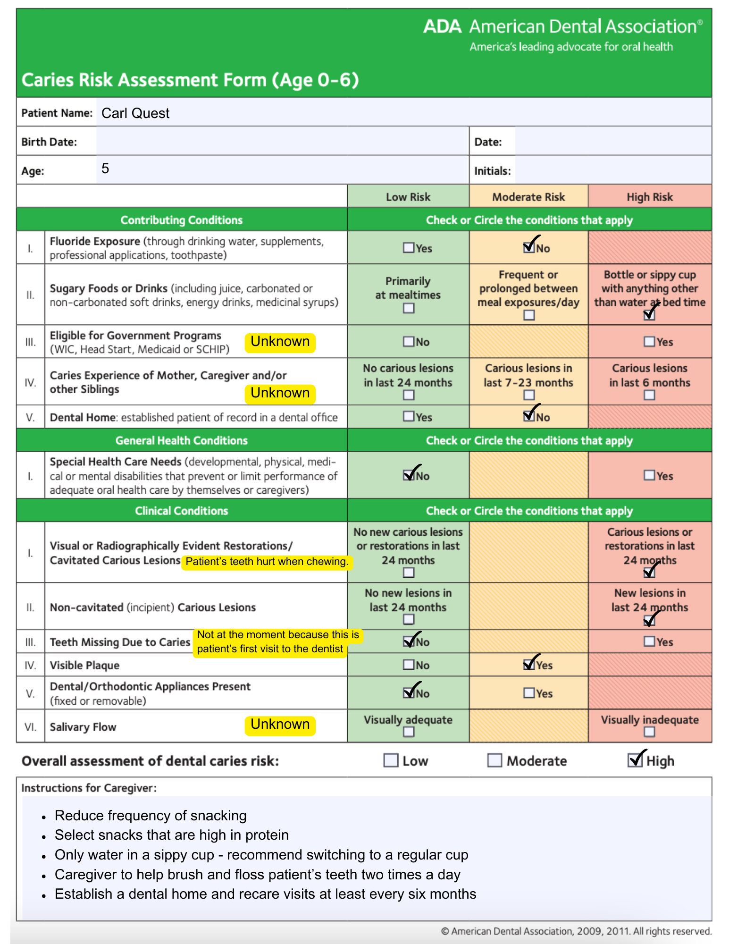
Case 1 – Carl
What is his caries risk?
Notes:
[Go through each line of the completed CRA form on slide.]
What is his caries risk? Extreme high risk. He should seek specialized care at a pediatric dental office, and the completion of treatment may require IV sedation or general anesthesia.

Slide 8

Case 2
Patient Name: Carrie
Notes:
Now on to Clinical Case 2. Take 10 minutes to evaluate the patient's caries risk and address the questions at the end.

Slide 9
Case 2 – Carrie, Age 19
Notes:
We will take 10 minutes to walk through Case 1 as a class.
Pause after each question and allow students to respond. Do not provide answers immediately. Ask follow-up questions to deepen reasoning.
Step 1: Identify What disease indicators do you see?
Prompt: Look for evidence of current or past disease.
What risk factors are present?
Prompt: Think about behaviors, environment, and clinical findings.
What protective factors are present or missing?
Prompt: What is helping this patient? What is not in place that should be?
Step 2: Interpret Which factors matter most in this case?
Prompt: If you had to choose one or two key drivers, what would they be?
What patterns do you notice?
Prompt: Are these short-term exposures or ongoing patterns?
What additional information would help you feel more confident?
Prompt: What would you ask the caregiver? Step 3: Classify What is Carrie’s caries risk level? What evidence supports your decision?
Prompt: Which findings made you decide high, moderate, or low?
If groups disagree: Why are your answers different?

Slide 10
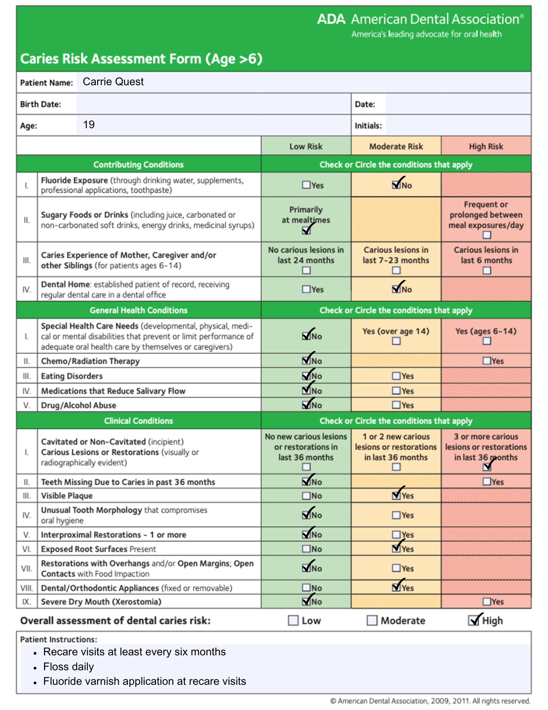
Case 2 – Carrie
What is her caries risk?
Notes:
[Go through each line of the completed CRA form on slide.]
What is her caries risk? Explain your diagnosis. She is high risk and some of the reasons why is because she has active tooth decay, started a new lifestyle, and snacks regularly.

Slide 11
Wrap Up
Were there any aspects of the case studies that you found particularly challenging?
Did the case studies raise any new questions or spark further curiosity that you wanted to ask the patients?
How might the insights gained from these case studies be applicable to your future patients?
Notes:
[Read each question on the slide and give the students an opportunity to respond.]

Slide 12
Caries Management and Prevention: A Risk-Based Approach
To continue learning, explore our other sessions:
Session 1: Foundations of Dental Caries: Disease Process and Epidemiology
Session 2: Understanding the Caries Process: Demineralization, Remineralization, and Biofilm Management
Session 3: Caries as a Disease: Etiology, Risk Factors, and Protective Factors
Session 4: Caries Risk Assessment: Identifying and Interpreting Patient Risk
Session 5: Personalized Caries Prevention: Applying Risk-Based Strategies
Session 6: Levels of Prevention in Dental Caries: From Primordial to Tertiary Care
Session 7: Clinical Decision-Making: Applying Caries Risk Assessment to Patient-Centered Care
Session 8: The Oral Microbiome and Caries: From Dysbiosis to Prevention
Session 9: Saliva and Caries: Function, Composition, and Clinical Implications
Session 10: Caries Risk Modification: Behavioral, Environmental, and Therapeutic Interventions
Session 11: Integrating Caries Management: Case-Based Application and Clinical Planning

