Slide 1
Levels of Prevention in Dental Caries: From Primordial to Tertiary Care
Notes:
During this session, we will go through the levels of prevention, from public health strategies to clinical interventions on the individual and community levels. It will equip you with the knowledge to navigate the phases of prevention, including primordial, primary, secondary, and tertiary, underscoring the shift towards upstream approaches. The aim is to provide you with insights into preventive dentistry, emphasizing the pivotal role of early intervention and a comprehensive understanding of risk factors.

Slide 2
Learning Objectives
Define primary, secondary, and tertiary prevention.
Discuss the CAMBRA protocol and the evidence for CAMBRA.
Examine the evidence for the protocols listed within the CAMBRA framework.
Explain how prevention aligns with disease progression.
Apply prevention strategies based on timing.
Describe how CAMBRA guides clinical decision-making.
Notes:
Our goals for this lesson are to achieve the following learning objectives: [read slide]

Slide 3
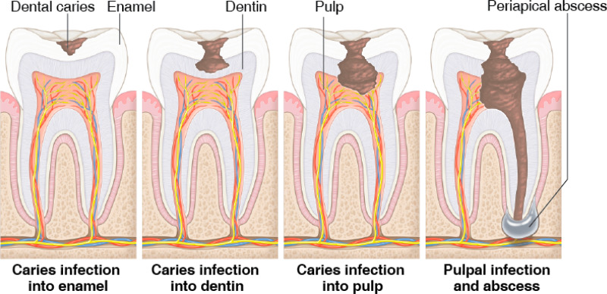
How Caries Develops over Time
Caries begins before it is clinically visible.
Disease progresses over time if untreated.
Early intervention can stop or reverse disease.
Stages: subclinical, early clinical, advanced disease.
Image: “Oral Health in America: Advances and Challenges,” National Institute of Dental and Craniofacial Research (US), 2021, https://www.ncbi.nlm.nih.gov/books/NBK578299/figure/ch3.fig8/.
Notes:
Caries begins before we can see it clinically. What is seen in the mouth is the result of a process that’s already been happening over time.
If nothing changes, the disease will continue to progress from subclinical, to early clinical, to advanced disease.
Early intervention can stop or even reverse that process. The focus shifts from treating to interrupting the disease early.
Image: “Oral Health in America: Advances and Challenges,” National Institute of Dental and Craniofacial Research (US), 2021, https://www.ncbi.nlm.nih.gov/books/NBK578299/figure/ch3.fig8/.

Slide 4
Building on What You Know
Caries is a multifaceted disease process.
Risk factors and protective factors influence disease.
Risk assessment identifies who is at risk.
Now we focus on what to do with that information.
Notes:
Let’s build on what you already know.
We’ve talked about caries as a multifaceted disease process — that it’s not caused by just one thing, but a combination of factors interacting over time.
We also know that risk factors and protective factors are constantly influencing whether disease progresses or stays stable.
And through risk assessment, we’re able to identify who is at higher risk and who may be more stable.
Now we focus on what on what to do with that information.

Slide 5
Biological vs. Clinical Disease
This creates a window for early prevention.
Biological changes occur before we can detect disease.
Clinical detection happens after damage has started.
Notes:
An important concept to keep in mind is that biological changes occur before we can detect disease.
What’s happening at the microscopic level starts long before we see anything clinically. By the time we’re able to detect it, the damage has already started.
This is why early intervention matters because the disease doesn’t begin when we see it, it begins much earlier.

Slide 6
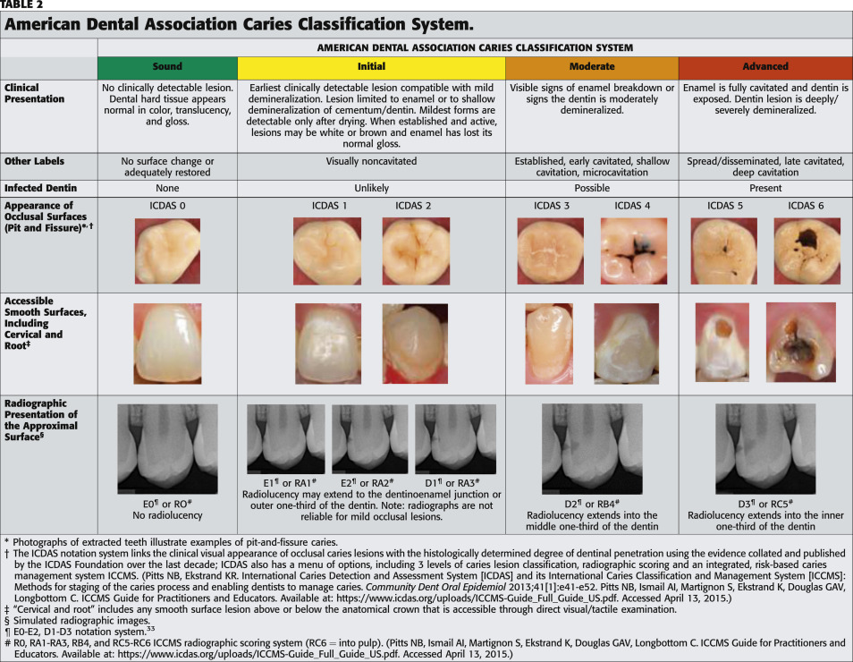
Lesion Severity (D1–D4)
These stages reflect increasing severity of disease.
Douglas Young, Brian Nový, Gregory Zeller, et al., “The American Dental Association Caries Classification System for Clinical Practice,” The Journal of the American Dental Association, 146 (May 25, 2015) 79-86, https://jada.ada.org/article/S0002-8177%2814%2900029-4/fulltext.
Notes:
These stages help us understand how far the disease has progressed.
At D1, there is early enamel demineralization — this is non-cavitated and often still reversible.
At D2, there is enamel cavitation, meaning the surface has broken down.
By D3, the lesion has progressed into the dentin, which typically means more active disease and greater progression.
And at D4, there is pulp involvement, representing advanced disease.
From D1 to D4, there is a progression of increasing severity. And this is important, because where the lesion is on this spectrum helps guide how we manage it.
Reference: Douglas Young, Brian Nový, Gregory Zeller, et al., “The American Dental Association Caries Classification System for Clinical Practice,” The Journal of the American Dental Association, 146 (May 25, 2015) 79-86, https://jada.ada.org/article/S0002-8177%2814%2900029-4/fulltext.

Slide 7
Levels of Prevention
Primordial
Primary
Secondary
Prevent development of risk factors
Prevent disease onset
Detect and manage early disease
Tertiary
Treat established disease and prevent complications
Notes:
There are levels of prevention.
At the primordial level, the focus is on preventing the development of risk factors in the first place.
At the primary level, the goal is to prevent disease from ever starting.
With secondary prevention, it is to detect and manage disease early, before it progresses.
And at the tertiary level, it is treating established disease and preventing complications.
Across these levels, there is movement from prevention to early detection and to treatment. Understanding this spectrum helps guide the type of care provided..

Slide 8
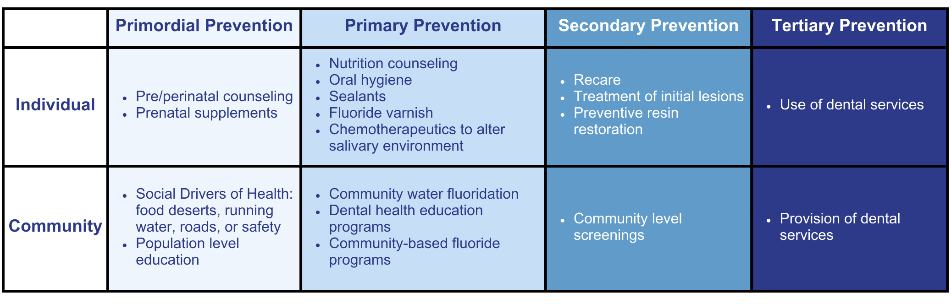
Oral Health Prevention
Notes:
This chart illustrates prevention strategies available at both the individual and population levels. The choice between them depends on what works best for the patient and the specific patient population that is being addressed.

Slide 9
Primordial Prevention
Notes:
Primordial prevention is characterized by the proactive prevention of risk factors at their roots.
This involves initiating changes in the social and environmental conditions where these factors typically emerge.
It is an ongoing process particularly focused on high-risk individuals such as children, adolescents, and young adults.
This approach directly addresses the foundational conditions that contribute to the causation of risk factors.

Slide 10
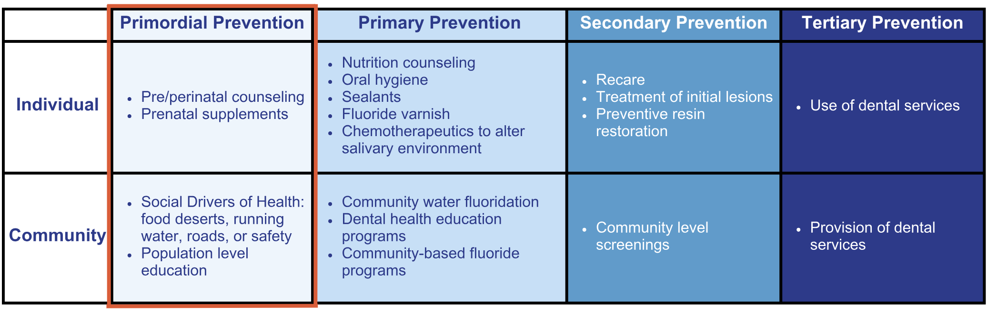
Primordial Prevention
Notes:
Primordial prevention is receiving attention in the prevention of chronic diseases. For example, many adult health problems (e.g., obesity, hypertension) have their early origins in childhood, because this is the time when lifestyles are formed.
The goal is to move upstream by providing resources earlier. Examples of individual-level practices of primordial prevention are taking prenatal supplements or having peri/prenatal. On a broader scale, population-level strategies encompass addressing challenges such as food deserts, implementing fluoridated water systems, and enhancing community infrastructure, including roads and safety measures.

Slide 11
Primary Prevention
Notes:
Primary Prevention involves maintaining health by individual or community initiatives to diminish risks, preventing the onset of the disease process, and consequently reducing the incidence of the disease.
The desired outcome is the absence of the disease.
This approach specifically targets causal factors, including immunizations, regular exercise, avoidance of smoking, water fluoridation, and toothbrushing.

Slide 12
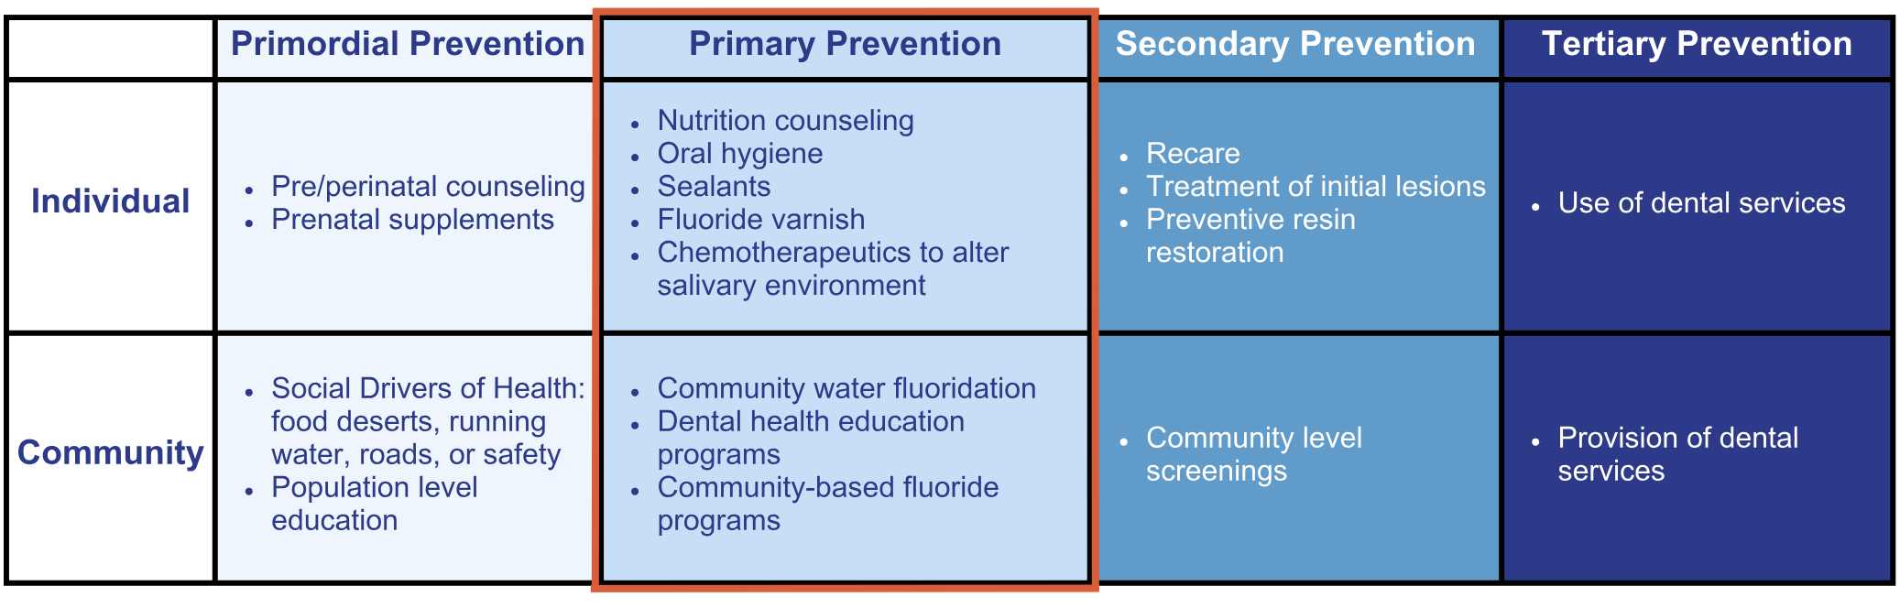
Primary Prevention
Notes:
Examples of primary prevention at the individual level include providing nutrition counseling and oral hygiene instructions, applying sealants and fluoride varnish, and administering chemotherapeutics to modify the salivary environment. These interventions can be tailored based on a caries risk assessment conducted at the individual level to determine specific needs.
At the community level, primary prevention measures involve implementing water fluoridation, conducting dental health education programs, and establishing community-based fluoride initiatives. On the community level, the CAMBRA protocol can be applied to a population, such as through a school-based program.

Slide 13
Secondary Prevention
Notes:
Secondary Prevention involves detecting asymptomatic individuals with the disease to delay onset and mitigate the severity of the condition.
The desired outcome is the absence of symptomatic disease.
For example, early screening, coupled with counseling and drug therapies, can reduce the spread of HIV.

Slide 14
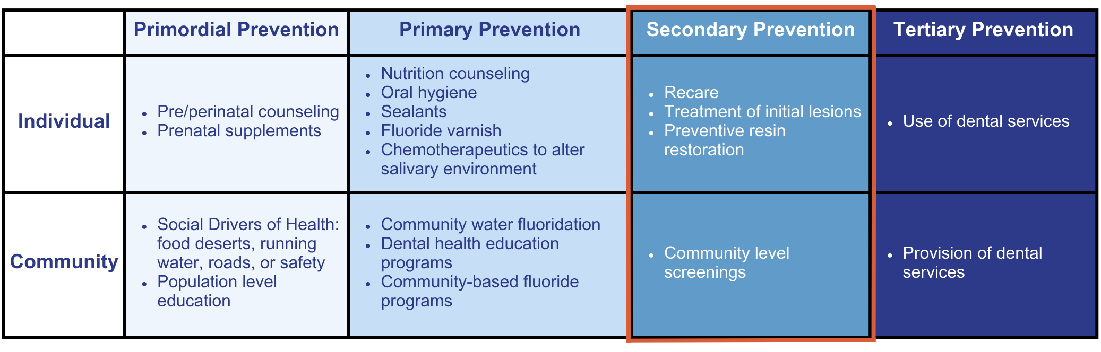
Secondary Prevention
Notes:
In secondary prevention, implementing a school-based program is viable at both the individual and community levels. At the individual level, the focus involves screening and preventive measures, while at the community level, these efforts extend to large groups of children. Individual secondary prevention may also encompass treating initial lesions through demineralization or resin restoration presentations.

Slide 15
Tertiary Prevention
Notes:
Tertiary Prevention aims to impede or halt the progression of a disease, thereby minimizing impairments and disabilities, enhancing the quality of life, and improving survival among individuals affected by the disease.
The desired outcome is a reduction in the complications associated with the disease.
For example, maintaining control over insulin levels serves as a preventive measure against retinopathy among individuals with diabetes.

Slide 16
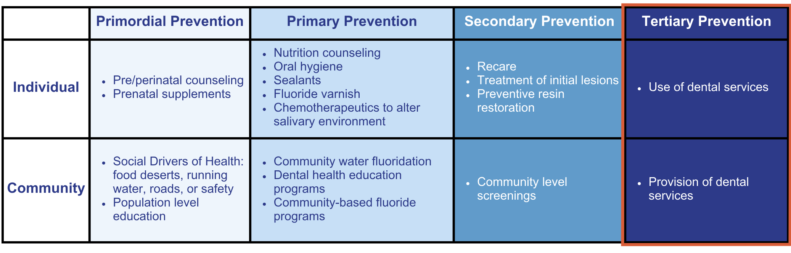
Tertiary Prevention
Notes:
Tertiary prevention is evolving, much like the other levels of prevention in dentistry. Currently, in the realm of restorative procedures, tertiary prevention may involve techniques such as sealants, silver diamine fluoride, glass ionomer, and resin-modified glass ionomer.

Slide 17
Examples of Prevention
Notes:
Here are levels of prevention to some real-world examples.
Fluoridated water is an example of primordial and primary prevention, because it helps reduce risk and prevent disease before it starts — at a population level.
Sealants fall under primary prevention, since they’re placed to protect the tooth and prevent caries from developing.
Radiographs and screening are part of secondary prevention, where the focus is on on detecting disease early and managing it.
And restorations represent tertiary prevention, where it is treating established disease and working to prevent further complications.
This framework helps us understand where they fit and why they matter.

Slide 18
Upstream vs. Downstream
Both are necessary for effective care.
Notes:
Think about care in terms of upstream and downstream.
Upstream focuses on the systems and environments that influence risk — things like prevention, access, and the conditions that shape health.
Downstream is where treatment of disease after it has already occurred.
And it’s important to recognize that both are necessary for effective care.
It’s not one or the other. The goal is to understand how to shift more toward impact upstream while still providing the care patients need downstream.

Slide 19
Where Prevention Happens
Notes:
Prevention happens across multiple levels.
At the public health level, the focus is on policy, regulation, and the environment. These factors shape access and the conditions that influence health. An example of this is community water fluoridation.
At the community and health promotion level, the focus shifts to programs and behavior support. These efforts help build healthy habits and improve access. Examples include oral hygiene education and school-based programs.
At the clinical care level, prevention occurs within healthcare settings. This includes interventions that both prevent and manage disease. Examples include fluoride varnish and sealants.
Together, these levels highlight that prevention is not limited to one setting; it occurs across systems, communities, and clinical care.

Slide 20
Prevention Timeline with Disease Phases
Preclinical Phase
disease begins but is not visible
Clinical Phase
disease becomes detectable
Post-Clinical Phase
disease is managed or treated
Notes:
This concept can be understood as a prevention timeline across disease phases.
In the preclinical phase, disease has already begun, but it is not yet visible or detectable. This is where biological changes are occurring beneath the surface.
In the clinical phase, disease becomes detectable. This is when signs can be identified during an exam or through diagnostic tools.
And in the post-clinical phase, disease is managed or treated.
At this stage, the focus shifts to controlling progression and addressing the damage that has occurred. Understanding where a patient falls along this timeline helps guide both detection and treatment decisions.

Slide 21
Prevention Timeline with Detection
Biological onset of disease occurs first.
Symptoms appear later.
Diagnosis and treatment follow detection.
Notes:
Biological onset of disease occurs first. At this stage, changes are happening at the microscopic level, before anything can be seen or detected clinically.
Symptoms appear later. By the time a patient begins to notice changes, the disease process has already been progressing. Detection happens after that point, when disease becomes identifiable through clinical examination or diagnostic tools.
And finally, diagnosis and treatment follow detection, where care is directed toward managing or addressing the disease.
Recognizing this progression helps guide earlier detection and more effective intervention.

Slide 22
Prevention Timeline with Prevention Levels
Notes:
Primordial and primary prevention occur before disease develops. At this stage, the focus is on reducing risk and preventing disease from starting in the first place.
Secondary prevention occurs during early disease. This is where detection and early management take place, with the goal of stopping progression.
And tertiary prevention occurs after disease is established. At this stage, care is focused on treatment and preventing further complications.

Slide 23
Full Prevention Framework
Public Health
Health Promotion
Clinical Prevention
Social Drivers of Health
Risk and Protective Factors
Post-Clinical Phase
Preclinical Phase
Clinical Phase
Biological Onset of Disease
Symptoms Appear
Diagnosis and Therapy
Primordial Prevention
Primary Prevention
Secondary Prevention
Tertiary
Prevention
Upstream
Downstream
Notes:
This image represents the full prevention framework.
It integrates both disease progression and levels of prevention into one model. By bringing these concepts together, it provides a more complete view of how disease develops and how care can be applied at different stages.
This framework can be used to guide clinical decision-making, helping determine when to focus on prevention, early intervention, or treatment.
It serves as a way to connect what is happening biologically with the appropriate level of care.

Slide 24
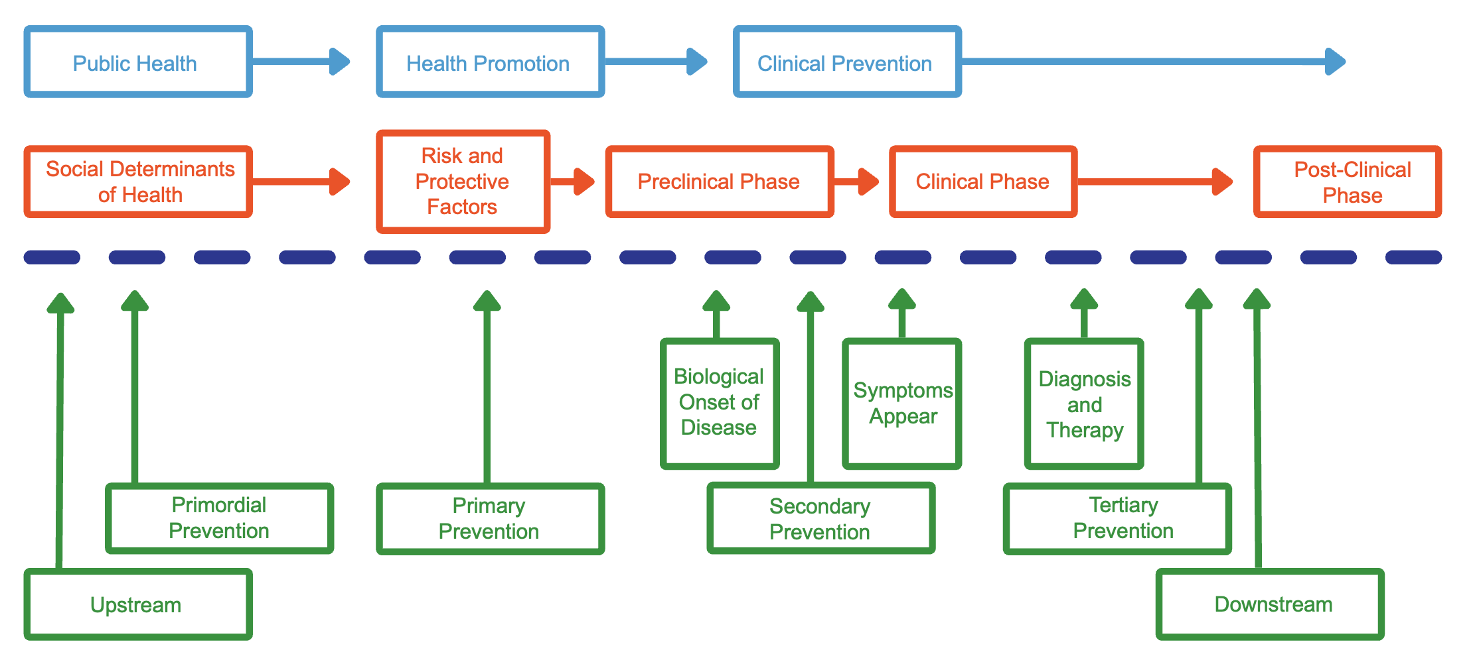
Apply the Framework
Use the timeline to classify prevention strategies.
Consider when and where interventions occur.
Notes:
Use the timeline to classify prevention strategies based on where they fall along disease progression. Then consider when and where interventions occur, whether that is before disease develops, during early stages, or after disease is established.
This approach helps connect prevention strategies to the appropriate point in the disease process. It supports more intentional and informed decision-making in patient care.

Slide 25
Prevention
Notes:
In dentistry, the use of the terms “prevent” or “prevention” goes beyond stopping diseases — it involves disrupting the caries disease process itself. While this might sound straightforward, previous research and intervention approaches are geared towards intervening in the midst of caries disease progression. Today, you will learn about true preventive practices.

Slide 26
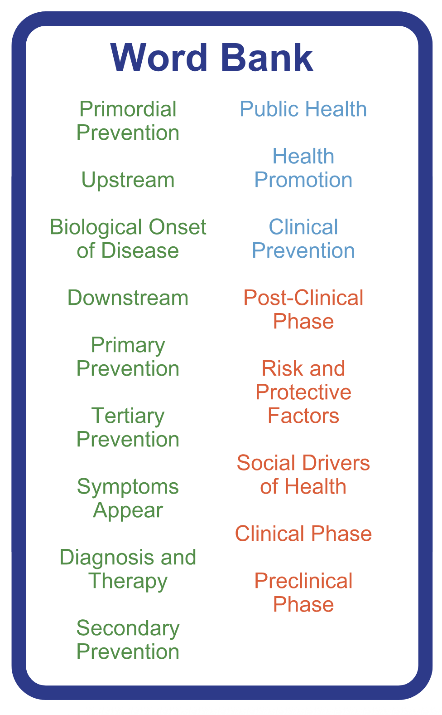
Prevention Timeline
Notes:
The aim of this activity is to become familiar with the terminology commonly used in public health through a prevention timeline.
Form groups of three to four and take about 5 minutes to work through the exercise. The word bank on the left includes the key public health terms.
Each word is color-coded to match the box it belongs to, so use that as a guide as you work through the activity. Focus on placing each term in the correct location along the timeline based on where it fits in the prevention framework.
After 10 minutes, the activity will be reviewed together to assess understanding and discuss any questions.

Slide 27
Environmental Change vs. Disease State
Notes:
Another instance of identifying an environmental change before the onset of disease is evident in periodontal disease. As plaque develops, leading to either gingivitis or periodontitis, there is a shift in the environment preceding the early signs and symptoms of disease states (reversible vs. irreversible).
When assessing oral health, particularly in terms of measuring bleeding within the mouth, a fundamental principle in promoting and maintaining wellness is to detect environmental changes before noticeable signs and symptoms manifest to both the clinician and the patient. Ideally, the earliest indicator of environmental changes can be seen in the saliva.
The concept of environment change versus disease state emphasizes that alterations in the oral environment precede visible signs or symptoms. The primary objective is to determine when this environmental change occurred, enabling the reversal or prevention of disease.

Slide 28
Environmental Change vs. Disease State
Notes:
A caries risk assessment primarily serves as a subjective tool for identifying risk factors associated with disease and subsequently mitigating them. But what if we could pinpoint objective disease risk factors?
Disease prevention goes beyond merely identifying diseases early. Can we detect environmental changes before any signs of disease emerge?
The second aspect involves recognizing these environmental changes and objectively measuring and linking them as risk factors, akin to cholesterol and heart disease.
Our goal is to better understand environmental changes, enabling us to truly address the underlying factors contributing to dental caries.
When examining caries risk labels like ICADAS and ADA, it’s important to note that lesions categorized as D4 lesions into the pulp, and even those labeled as D3, D2, and below, are sometimes mislabeled as caries-free. This misclassification occurs because there may not be a visible hole in the tooth, but that doesn’t mean the tooth is entirely free of caries. There’s an environmental change occurring before subclinical lesions, right below the surface, where a salivary change precedes the subclinical changes in the tooth.

Slide 29
Prevention Timeline
Public Health
Health Promotion
Clinical Prevention
Notes:
[The correct word bank option will appear in sequential order when the mouse is clicked.]
Public Health: CDC states, “Public health is the science of protecting and improving the health of people and their communities.” An example of public health involves community water fluoridation, where individuals may not be aware of its implementation, yet it plays an important role in preventing caries. Public health operates independently of individual participation.
Health Promotion: CDC states health promotion is “the process of enabling people to increase control over, and to improve their health. Environmental and social resources for health can include: peace, economic security, a stable ecosystem, and safe housing. Individual resources for health can include: physical activity, healthful diet, social ties, resiliency, positive emotions, and autonomy. Health promotion activities aimed at strengthening such individual, environmental and social resources may ultimately improve well-being.” An example of health promotion involves engaging in a conversation about proper brushing, flossing, or incorporating probiotics — this actively encourages the development of healthy behaviors. It entails conveying a message that prompts the patient to take specific actions.
Clinical Prevention: If previous preventive measures have proven ineffective, the next step is to take action in the dental office to mitigate the associated risks.

Slide 30
Prevention Timeline
Public Health
Health Promotion
Clinical Prevention
Social Drivers of Health
Risk and Protective Factors
Post-Clinical Phase
Preclinical Phase
Clinical Phase
Notes:
[The correct word bank option will appear in sequential order when the mouse is clicked.]
Social Drivers: Social drivers of health encompass the conditions in the environments where individuals are born, live, learn, work, play, worship, and age, influencing various health, functioning, and quality-of-life outcomes and risks. This aligns with public health strategies, such as altering grocery store offerings to include healthier food options, allowing individuals to seamlessly adopt healthier habits without necessitating additional changes. Similarly, providing access to clean, fluoridated water can naturally influence health behaviors and contribute to overall well-being.
Risk and Protective Factors: CAMBRA serves as a great example in the context of dental caries and the caries balance. It focuses on addressing factors when the environment is suboptimal, necessitating the initiation of behavioral changes.
Preclinical Phase: Items for home use, such as prescription toothpaste, can contribute to enhancing the process of remineralization.
Clinical Phase: This is when there is clinical intervention, which may involve actions like promoting remineralization, applying sealants, or performing dental restorations.
Post-Clinical Phase: The post-clinical phase involves determining the next steps after clinical intervention, including maintaining recare.

Slide 31
Prevention Timeline
Public Health
Health Promotion
Clinical Prevention
Social Drivers of Health
Risk and Protective Factors
Post-Clinical Phase
Preclinical Phase
Clinical Phase
Biological Onset of Disease
Symptoms Appear
Diagnosis and Therapy
Notes:
[The correct word bank option will appear in sequential order when the mouse is clicked.]
By addressing risk factors and protective factors effectively, you can prevent the biological onset of disease before symptoms manifest. For example, saliva may become acidic and pH may drop before visible signs of tooth decay occur, indicating that the disease initiated prior to the appearance of symptoms. Diagnosis and therapy can then occur when symptoms become apparent.

Slide 32
Prevention Timeline
Health Promotion
Clinical Prevention
Public Health
Social Drivers of Health
Risk and Protective Factors
Post-Clinical Phase
Preclinical Phase
Clinical Phase
Biological Onset of Disease
Symptoms Appear
Diagnosis and Therapy
Primordial Prevention
Primary Prevention
Secondary Prevention
Tertiary
Prevention
Notes:
[The correct word bank option will appear in sequential order when the mouse is clicked.]
Primordial Prevention: Involves actions taken during the prenatal phase to ensure the optimal development and health of infants. An instance is the intake of folate, calcium, and vitamin D by expectant mothers, along with the consumption of fluoridated water. This approach aims to establish a foundation for well-being before any disease onset.
Primary Prevention: Occurs preceding the manifestation of any disease. For instance, pregnant mothers ensuring the intake of fluoridated water for their developing child exemplifies primordial prevention. When a child drinks fluoridated water, it’s an example of primary prevention.
Secondary Prevention: Taking proactive measures, such as the application of fluoride or silver diamine fluoride (SDF), during the developmental stage of caries.
Tertiary Prevention: Involves clinical care and addresses the actual onset of diseases.
Traditionally, dentistry has predominantly focused on providing tertiary preventive or clinical care. However, there’s been a shift towards emphasizing primordial prevention. This redirection is important in recognizing and addressing the social drivers of health.

Slide 33
Prevention Timeline
Public Health
Health Promotion
Clinical Prevention
Social Drivers of Health
Risk and Protective Factors
Post-Clinical Phase
Preclinical Phase
Clinical Phase
Biological Onset of Disease
Symptoms Appear
Diagnosis and Therapy
Primordial Prevention
Primary Prevention
Secondary Prevention
Tertiary
Prevention
Upstream
Downstream
Notes:
[The correct word bank option will appear in sequential order when the mouse is clicked.]
In discussions about the social drivers of health, two terms are often used interchangeably, particularly within communities. People commonly express the need to address upstream factors, meaning the need to modify the environment to prevent the need for conversations about risks or protective factors. Downstream factors focus on assisting with access to care. This involves considering how to offer support for tertiary dental care, emphasizing interventions further along the health continuum. The trend in dental public health leans increasingly toward upstream prevention.

Slide 34
Where would a smartwatch be in the timeline?
Notes:
Where would a smartwatch be in the prevention timeline?
[Allow learners the opportunity to answer.]

Slide 35
Prevention Timeline
Public Health
Health Promotion
Clinical Prevention
Social Drivers of Health
Risk and Protective Factors
Post-Clinical Phase
Preclinical Phase
Clinical Phase
Biological Onset of Disease
Symptoms Appear
Diagnosis and Therapy
Primordial Prevention
Primary Prevention
Secondary Prevention
Tertiary
Prevention
Upstream
Downstream
Notes:
A smartwatch has the capability to track your health and offer feedback, functioning as a health promotion tool and serving as a form of primary prevention. Notice how it aligns vertically with primary prevention. This alignment is designed to illustrate the interchangeable nature of these concepts. A smartwatch may promote protective factors by providing feedback and encouraging regular exercise. Simultaneously, it can act as a primary prevention measure by contributing to overall health and preventing the onset of diseases.

Slide 36
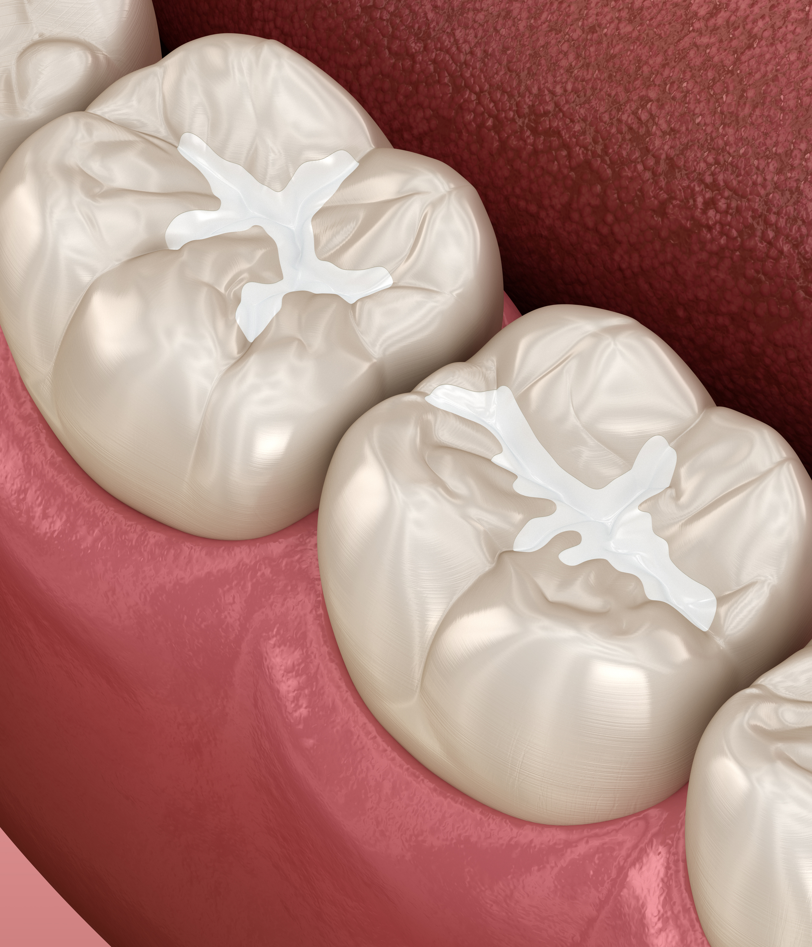
Where would the application of dental sealants be in the timeline?
Notes:
Where would the application of dental sealants be in the timeline?
[Allow learners the opportunity to answer.]

Slide 37
Prevention Timeline
Public Health
Health Promotion
Clinical Prevention
Social Drivers of Health
Risk and Protective Factors
Post-Clinical Phase
Preclinical Phase
Clinical Phase
Biological Onset of Disease
Symptoms Appear
Diagnosis and Therapy
Primordial Prevention
Primary Prevention
Secondary Prevention
Tertiary
Prevention
Upstream
Downstream
Notes:
Dental sealants serve as a clinical intervention that not only offers a protective factor but also serves as a form of primary prevention.

Slide 38
Where would community water fluoridation be in the timeline?
Notes:
Where would community water fluoridation be in the timeline?
[Allow learners the opportunity to answer.]

Slide 39
Prevention Timeline
Public Health
Health Promotion
Clinical Prevention
Social Drivers of Health
Risk and Protective Factors
Post-Clinical Phase
Preclinical Phase
Clinical Phase
Biological Onset of Disease
Symptoms Appear
Diagnosis and Therapy
Primordial Prevention
Primary Prevention
Secondary Prevention
Tertiary
Prevention
Upstream
Downstream
Notes:
Community water fluoridation addresses both risk and protective factors within social drivers of health. Drinking fluoridated water at the community level not only tackles a social driver of health but also operates as an upstream factor, contributing to primordial prevention.

Slide 40
Where would the CAMBRA protocol be in the timeline?
Notes:
Where would the CAMBRA protocol be in the timeline?
[Allow learners the opportunity to answer.]

Slide 41
Prevention Timeline
Public Health
Health Promotion
Clinical Prevention
Social Drivers of Health
Risk and Protective Factors
Post-Clinical Phase
Preclinical Phase
Clinical Phase
Biological Onset of Disease
Symptoms Appear
Diagnosis and Therapy
Primordial Prevention
Primary Prevention
Secondary Prevention
Tertiary
Prevention
Upstream
Downstream
Notes:
The CAMBRA protocol serves a form of clinical prevention and functions as a protective factor. In the preclinical phase, it resides in an intermediate position, emphasizing primary prevention in a comprehensive manner.

Slide 42
What does CAMBRA stand for?
Notes:
What does CAMBRA stand for?

Slide 43
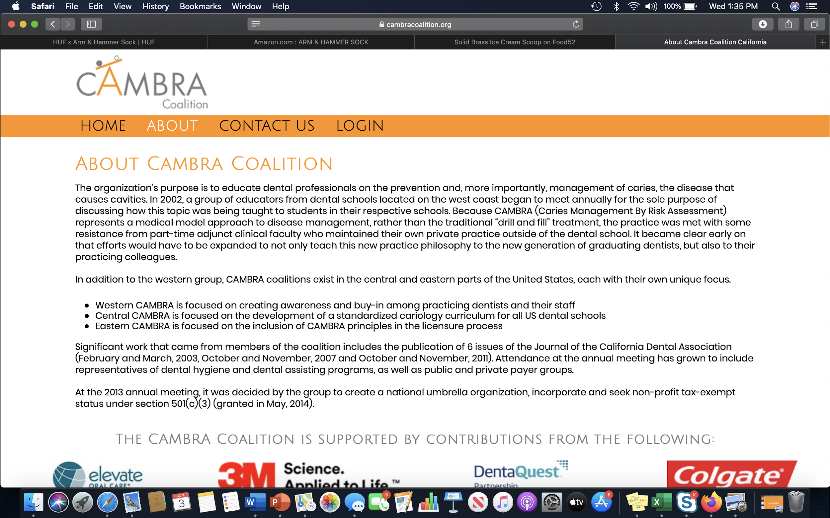
“CAMBRA Coalition,” CAMBRA Coalition, accessed March 28, 2026, www.cambracoalition.org.
Notes:
Our responsibility as dental professionals extends beyond drilling out decay and placing restorations. To effectively treat the disease caries, it is necessary to be able to assess a patient’s risk for developing caries. This allows us to employ preventive measures, including chemical therapy, patient education, and when necessary, minimally invasive restorative treatment.
In 1997, Dr. John Featherstone conducted the first clinical trial focused on this very topic. The end result was a caries risk assessment (CRA) tool that set the national standard for assessing and managing caries known as Caries Management by Risk Assessment (CAMBRA).
Caries risk refers to how likely a patient is to have a new carious lesion in the near future. CAMBRA was shown to be highly effective in predicting future caries development in three clinical studies involving thousands of patients of varying age groups.
Using this system, a patient's caries risk is determined to be low, moderate, high, or extreme. Today, we will review the method by which this risk is determined and the protocol enlisted for each risk level.
Reference: “CAMBRA Coalition,” CAMBRA Coalition, accessed March 28, 2026, www.cambracoalition.org.

Slide 44
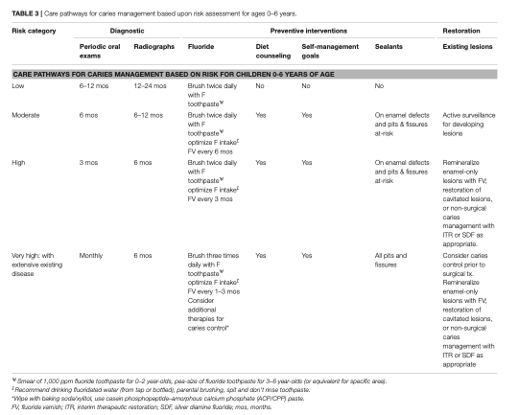
Care Pathways for Caries Management based upon Risk Assessment for Ages 0–6 Years
John Featherstone, Yasmi Crystal, Pamela Alston, et al., “Evidence-Based Caries Management for All Ages—Practical Guidelines,” Frontiers in Oral Health, 2 (April 21, 2021), https://doi.org/10.3389/froh.2021.657518.
Notes:
This chart is a version of the CAMBRA protocol for children 0–6. It illustrates various methods of classifying and categorizing CAMBRA professional and at-home recommendations based on risk level.
Reference: John Featherstone, Yasmi Crystal, Pamela Alston, et al., “Evidence-Based Caries Management for All Ages-Practical Guidelines,” Frontiers in Oral Health, 2 (April 21, 2021), https://doi.org/10.3389/froh.2021.657518.

Slide 45
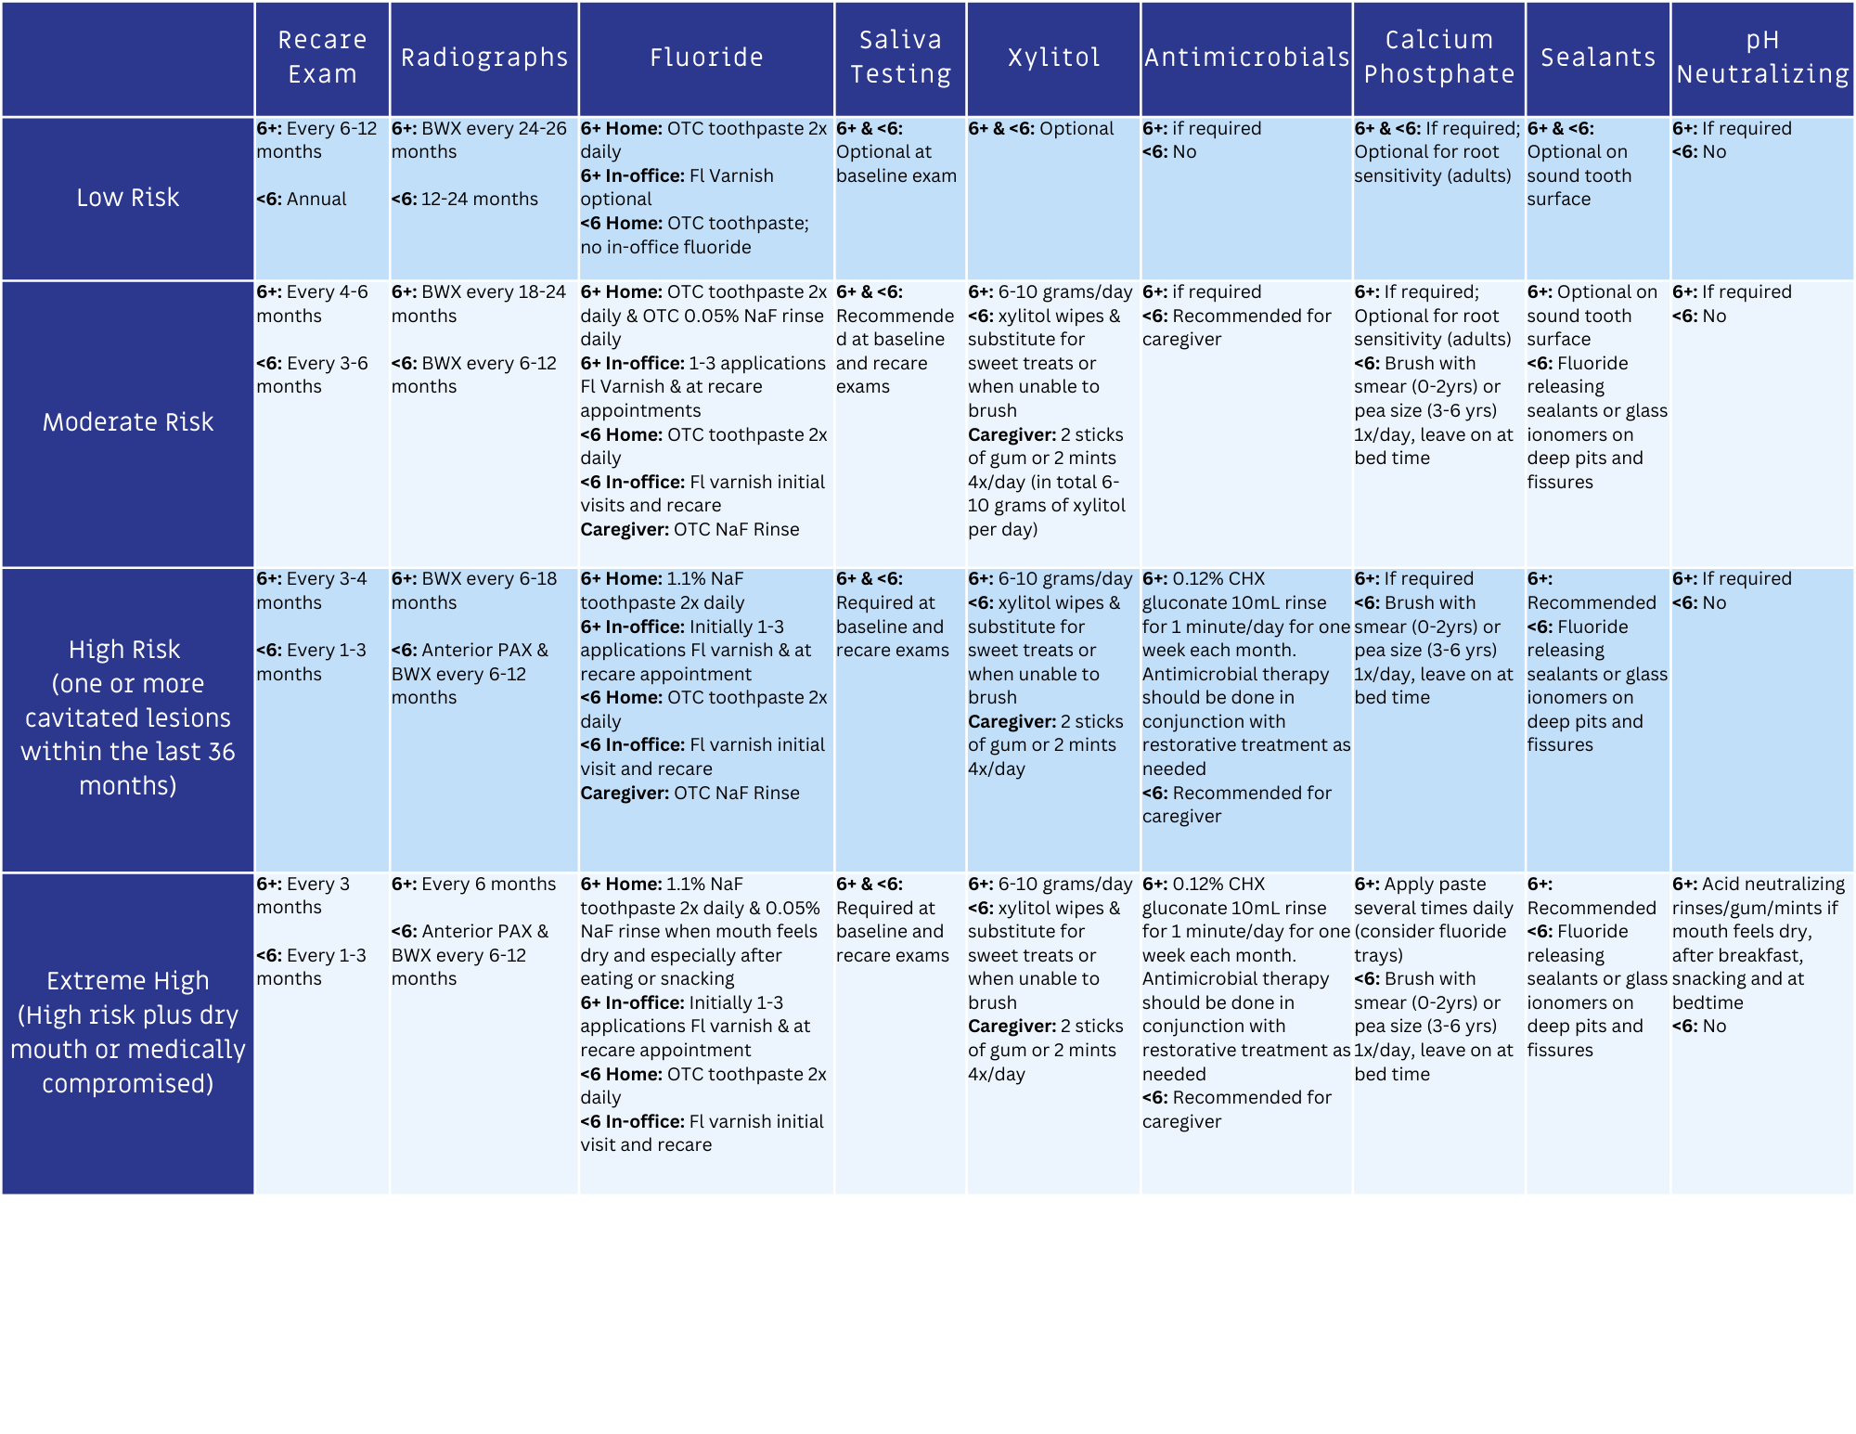
Professional and At-Home Recommendations
Adapted from: Larry Jenson, Alan Budenz, John Featherstone, et al., “Clinical protocols for caries management by risk assessment,” Journal of the California Dental Association, 35(10) (October 2007), 714–723, DOI:10.1080/19424396.2007.12221277.
Francisco Ramos-Gomez, Yasmi Crystal, John Featherstone, et al., “Pediatric dental care: prevention and management protocols based on caries risk assessment,” Journal of the California Dental Association, 38(10) (October 2010), 746–761, https://pmc.ncbi.nlm.nih.gov/articles/PMC3470809/.
Notes:
This is another professional and at-home recommendations list for the different risk levels we went over in the previous sessions. We are going to talk about why the recommendations are different for each risk level.
Adapted from: Larry Jenson, Alan Budenz, John Featherstone, et al., “Clinical protocols for caries management by risk assessment,” Journal of the California Dental Association, 35(10) (October 2007), 714–723, DOI:10.1080/19424396.2007.12221277.
Francisco Ramos-Gomez, Yasmi Crystal, John Featherstone, et al., “Pediatric dental care: prevention and management protocols based on caries risk assessment,” Journal of the California Dental Association, 38(10) (October 2010), 746–761, https://pmc.ncbi.nlm.nih.gov/articles/PMC3470809/.

Slide 46

Diagnostic Exam
Why 1–3 months to 12–24 months?
Detection at early stages with active lesions will require interventions at four to twelve weeks.
When patients are high risk, their lesions may develop more quickly.
In order to catch them early enough to use minimally invasive treatments, they require more frequent treatments.
Notes:
The variability in the timing of diagnostic exams is influenced by the individual's risk level. Recommendations can span from 1–3 to 12–24 months. For those at a higher risk, more frequent diagnostic exams are advised to detect lesions early, providing the chance for remineralization. However, limitations exist due to factors like payment and insurance restrictions on exam frequency, time constraints during appointments, and the absence of a specific CDT coding to differentiate the need for frequent diagnostic exams.

Slide 47

Diagnostic Radiographs
Why 6 months to 12–24 months?
To detect new interproximal lesions quickly for early intervention
To track interproximal remineralization
Notes:
Why is there a range for diagnostic radiographs in relation to dental caries? Concerning the risk level, recommendations can vary from 6 months to 12–24 months. Radiographs are taken to identify new interproximal lesions for early intervention and monitor interproximal remineralization. It's important to note that low-risk patients, who may need less intervention, still benefit from radiographs to detect lesions early. Challenges persist, including insurance coverage not aligning with the patient’s risk level, time constraints, and CDT coding.

Slide 48
Wrap Up
CAMBRA
An evidence-based strategy to prevent and address caries.
Risk and Protective Factors
CAMBRA considers various health and lifestyle factors.
Individual Level
CAMBRA assesses caries risk and tailors strategies, advocating lifestyle changes.
Community Level
Considers factors such as water fluoridation and encourages strategies that promote oral health within populations.
Notes:
In this session, we explored prevention strategies at various levels, including public health and clinical intervention on both individual and community levels. CAMBRA, or caries management by risk assessment, is an evidence-based approach to prevent and address cavities across different prevention stages. This involves assessing a patient’s health and lifestyle risks, formulating a tailored management plan, offering recommendations, and continuous monitoring.

Slide 49
Caries Management and Prevention: A Risk-Based Approach
To continue learning, explore our other sessions:
Session 1: Foundations of Dental Caries: Disease Process and Epidemiology
Session 2: Understanding the Caries Process: Demineralization, Remineralization, and Biofilm Management
Session 3: Caries as a Disease: Etiology, Risk Factors, and Protective Factors
Session 4: Caries Risk Assessment: Identifying and Interpreting Patient Risk
Session 5: Personalized Caries Prevention: Applying Risk-Based Strategies
Session 6: Levels of Prevention in Dental Caries: From Primordial to Tertiary Care
Session 7: Clinical Decision-Making: Applying Caries Risk Assessment to Patient-Centered Care
Session 8: The Oral Microbiome and Caries: From Dysbiosis to Prevention
Session 9: Saliva and Caries: Function, Composition, and Clinical Implications
Session 10: Caries Risk Modification: Behavioral, Environmental, and Therapeutic Interventions
Session 11: Integrating Caries Management: Case-Based Application and Clinical Planning

