Slide 1
Personalized Caries Prevention: Applying Risk-Based Strategies
Notes:
In this session, you will practice applying using the caries risk assessment in clinical decision-making.

Slide 2
Learning Objectives
Apply a caries risk assessment tool in a provider-patient scenario.
Differentiate disease indicators, risk factors, and protective factors.
Assign a caries risk level based on patient findings.
Discuss how risk assessment guides prevention planning.
Notes:
Our goal for this session is to achieve the following learning objectives: [Read slide]

Slide 3
Review: Caries Balance
Dental caries develops when pathological factors outweigh protective factors.
Notes:
As a review, let’s revisit the concept of caries as a balance. Dental caries develops when pathological factors outweigh protective factors.
On the protective side, we have:
Fluoride exposure
Adequate saliva
Good oral hygiene
Preventive care
These are the factors that support remineralization and help maintain a healthy oral environment.
On the pathological side, we have:
Frequent fermentable carbohydrate intake
Cariogenic bacteria
Reduced salivary flow
These are the factors that drive demineralization and push the environment toward disease.
What’s important to recognize is that both sides are always present. But disease occurs when the balance tips.
When patients are frequently snacking, sipping on sugary beverages, or experiencing reduced saliva, those pathological factors begin to outweigh the protective ones.
We are not just identifying disease. We are identifying what is tipping the balance.
We shift to asking:
What factors are increasing this patient’s risk?
What protective factors are missing or inconsistent?

Slide 4
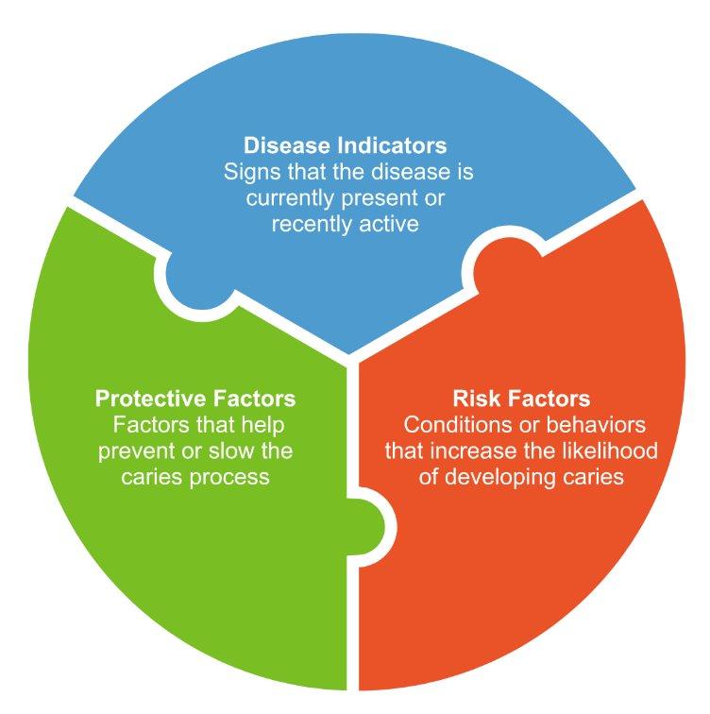
Caries Risk Assessment
Risk assessment considers three key categories:
These elements help clinicians determine a patient’s overall caries risk.
Notes:
As a review, caries risk assessment is based on three key categories:
First, disease indicators: These tell us that disease is already present or has occurred, such as existing restorations or recent caries.
Second, risk factors: These are the behaviors or conditions that increase the likelihood of disease, like frequent sugar intake, poor oral hygiene, or reduced saliva.
Third, protective factors: These help prevent or slow disease, including fluoride exposure, adequate saliva, and consistent oral care.
All three categories work together to give us a full picture of the patient’s risk. This helps us move beyond just treating what we see to making informed decisions about prevention and long-term management.

Slide 5
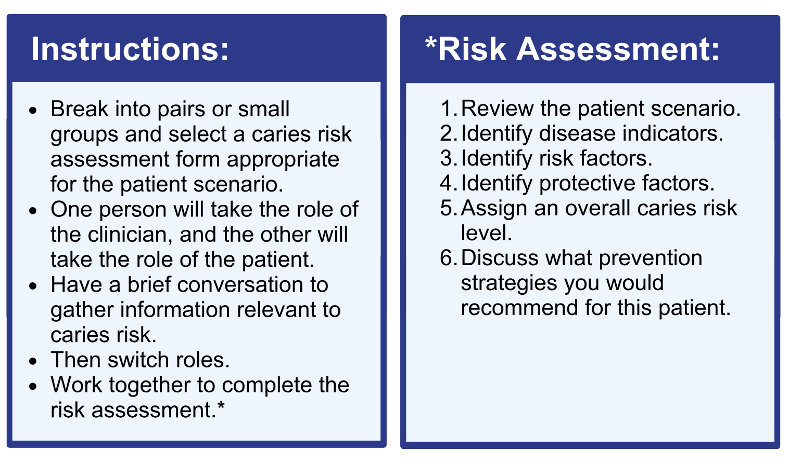
Activity Overview
Notes:
Now we’re going to apply that in a patient scenarios. For this activity, break into pairs or small groups and select a caries risk assessment form that fits the scenario. One person will take on the role of the clinician, and the other will take on the role of the patient. Have a brief conversation to gather information that would help you assess caries risk. Then switch roles so each of you has a chance to practice.
Once you have completed both roles, work together to complete the risk assessment. As you do this, focus on:
Identifying any disease indicators
Recognizing the key risk factors
Noting any protective factors
Then use that information to assign an overall caries risk level.
Finally, discuss what prevention strategies you would recommend for this patient based on their risk.
The goal here is not just to fill out a form, but to practice thinking through how we gather information, assess risk, and make patient-centered recommendations.

Slide 6
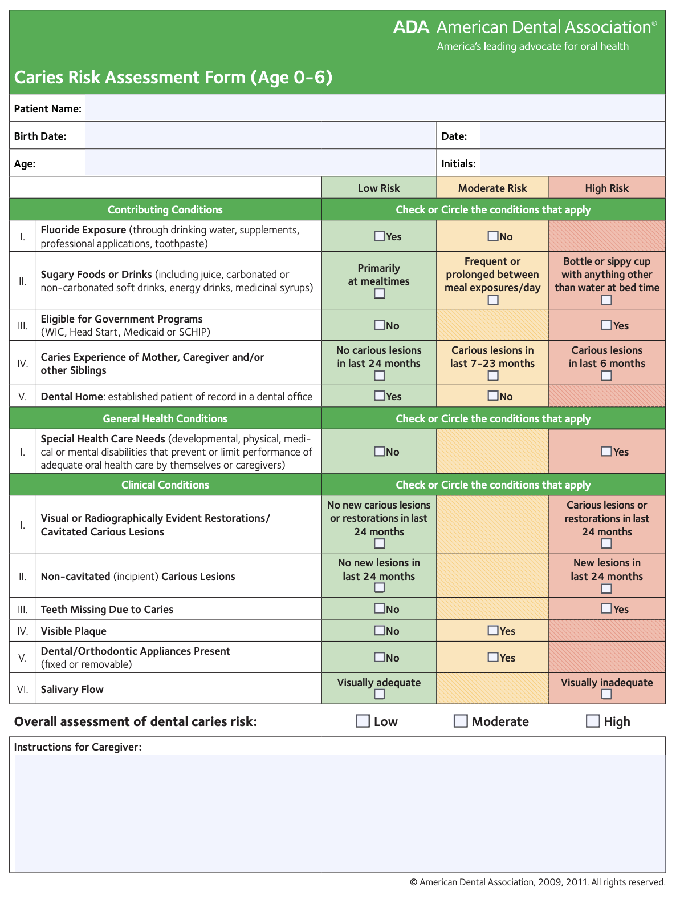

Caries Risk Assessment Form Age 0–6
Notes:
Let’s walk through how to use the Caries Risk Assessment Form for ages 0 to 6.
This form is designed to help us organize our thinking using three key categories: contributing conditions, clinical findings, and an overall risk assessment.
We’ll start with the contributing conditions section. This includes both protective factors and risk factors. On the protective side, you’ll see items like fluoride exposure, having a dental home, and receiving preventive care. These are factors that support oral health. On the risk side, this includes things like frequent exposure to sugary foods or drinks, socioeconomic challenges, and special healthcare needs that may impact oral hygiene or access to care. As you go through this section, you’re identifying what is present in the patient’s environment and daily habits.
Next, we move to clinical findings, which align with disease indicators. This includes things like visible plaque, existing restorations, white spot lesions, cavitated lesions, or teeth missing due to caries. These findings tell us whether disease is already present or has occurred in the past.
As you review both sections, it’s important to remember that we are not just checking boxes. We are looking at patterns.
We are asking: What is increasing this child’s risk? What protective factors are in place? And what might be missing?
At the bottom of the form, you assign an overall caries risk level. This is not based on one single factor, but on the overall picture. In most cases, if disease indicators are present, the child is considered high risk.
Finally, this assessment should guide our next step, which is prevention planning. The goal is not just to categorize risk, but to use that information to individualize care and support the child and caregiver in reducing that risk over time.

Slide 7
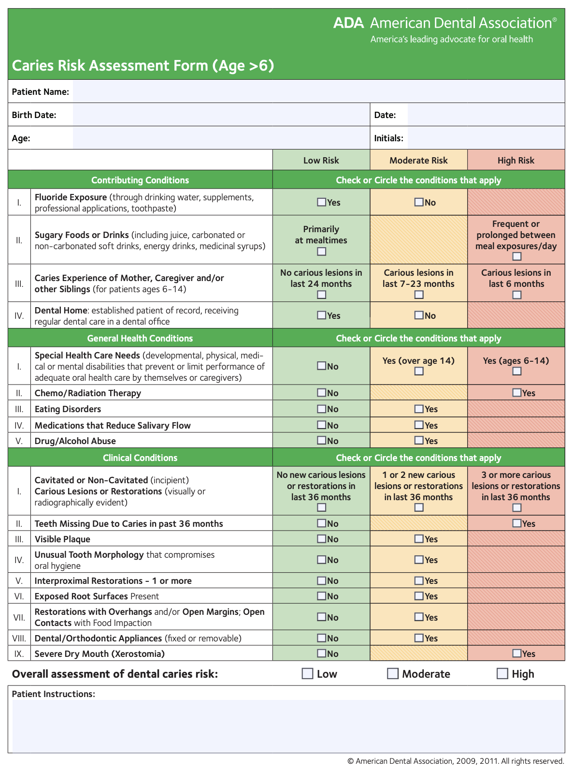

Caries Risk Assessment Form Age > 6
Notes:
Now, let’s walk through how to use the Caries Risk Assessment Form for patients over age 6.
This form helps us organize our assessment into three key areas: contributing conditions, clinical findings, and overall risk.
We’ll start with contributing conditions. This section includes both protective factors and risk factors. On the protective side, we are looking at things like fluoride exposure and access to regular dental care. On the risk side, we are identifying factors such as frequent sugar intake, past caries experience, reduced saliva, orthodontic appliances, and behaviors like drug or alcohol use.
You’ll also notice a section for general health conditions, which may impact a patient’s ability to maintain oral health, such as special healthcare needs or medications that affect salivary flow.
Next, we move to clinical conditions, which reflect disease indicators. This includes findings like cavitated or non-cavitated lesions, restorations placed due to caries, visible plaque, exposed root surfaces, and signs of dry mouth. These findings tell us whether disease is currently active or has occurred recently.
Remember to identify patterns and understand what is driving risk for the patient.
At the bottom, you assign an overall caries risk level based on the full picture. A helpful guideline is, if disease indicators are present, the patient is considered high risk.
Finally, this assessment should guide your prevention strategies.

Slide 8
Example Patient #1 Scenario
Notes:
Let’s take a look at our first patient scenario.
This is a 22-year-old who works full-time and has recently lost dental insurance, which may be impacting their access to care.
The patient reports brushing once daily with a fluoridated toothpaste. From a diet perspective, they have frequent soda consumption between meals and often drink sweet tea during long work shifts.
Moving into clinical findings, there is visible plaque present.
The patient had two restorations placed due to caries about 18 months ago. They have not received fluoride varnish in the past 12 months, and their last dental visit was also about 18 months ago due to cost concerns.
As you review this scenario, start thinking about what is contributing to this patient’s risk and what stands out to you.

Slide 9
Example Patient #2 Scenario
Notes:
Now let’s look at the second patient scenario.
This is a 4-year-old child who lives in a rural community without fluoridated water, which may impact their baseline protection against caries.
Looking at oral health behaviors, the child frequently drinks juice and other sweetened beverages throughout the day. Brushing occurs once daily at the Head Start Center and only occasionally at home when prompted by a caregiver.
Moving into clinical findings, there is visible plaque present.
They have two untreated cavities were identified during a Head Start screening program. The child has not seen a dentist in over two years due to transportation challenges and lack of dental coverage. They have also never received fluoride varnish or dental sealants.
As you review this scenario, think about what factors are contributing to this child’s risk and what opportunities exist for prevention and intervention.

Slide 10
Example Patient #3 Scenario
Notes:
Let’s take a look at the last patient scenario.
This is a 68-year-old patient. The patient reports frequent dry mouth, especially at night.
The patient brushes twice daily with a fluoridated toothpaste but does not floss regularly. To manage dry mouth, they frequently use cough drops or hard candies throughout the day.
For clinical findings, there is visible plaque along the gumline, and exposed root surfaces are present.
The patient has high blood pressure and allergies and is taking medications including hydrochlorothiazide and diphenhydramine, both of which can contribute to reduced salivary flow.
And then, looking at their dental history, a new root surface cavity was diagnosed at their last dental visit six months ago, and fluoride varnish was applied at that visit.
As you review this scenario, think about how symptoms, behaviors, and medical history are interacting to influence this patient’s overall caries risk and what targeted prevention strategies would be most effective.

Slide 11
Group Discussion
After the conversation, work together to complete the risk assessment.
Review the patient scenario.
Identify disease indicators.
Identify risk factors.
Identify protective factors.
Assign an overall caries risk level.
Discuss what prevention strategies you would recommend for this patient.
Notes:
Work with your partner or group to complete the caries risk assessment based on the patient scenario. Start by briefly reviewing the scenario again.
Then, identify any disease indicators. What evidence do you see that disease is present or has occurred?
Next, identify the risk factors. Think about behaviors, environment, and conditions that are increasing this patient’s risk.
Then, look for any protective factors that may help support oral health.
Once you’ve identified all three categories, use that information to assign an overall caries risk level.
After that, discuss what prevention strategies you would recommend for this patient.

Slide 12
Assigning Risk Level
Patients are generally classified as:
• Low risk
• Moderate risk
• High risk
The presence of disease indicators typically places a patient in a higher risk category.
Notes:
Patients are generally classified as:
• Low risk
• Moderate risk
• High risk
The presence of disease indicators typically places a patient in a higher risk category.

Slide 13
Caries Risk Assessment Sample
Notes:
Here is a sample of a completed form for a high-risk patient. [Option to review form line-by-line]

Slide 14


Conversational Approach: Integrating Caries Risk Assessment in Patient Interactions
Notes:
Remember that the structure of a caries risk assessment resembles a checklist, yet its purpose is to facilitate conversational dialogue with the patient. We are going to practice conducting a caries risk assessment Take your time to take notes, highlight key aspects, and ask relevant questions.

Slide 15
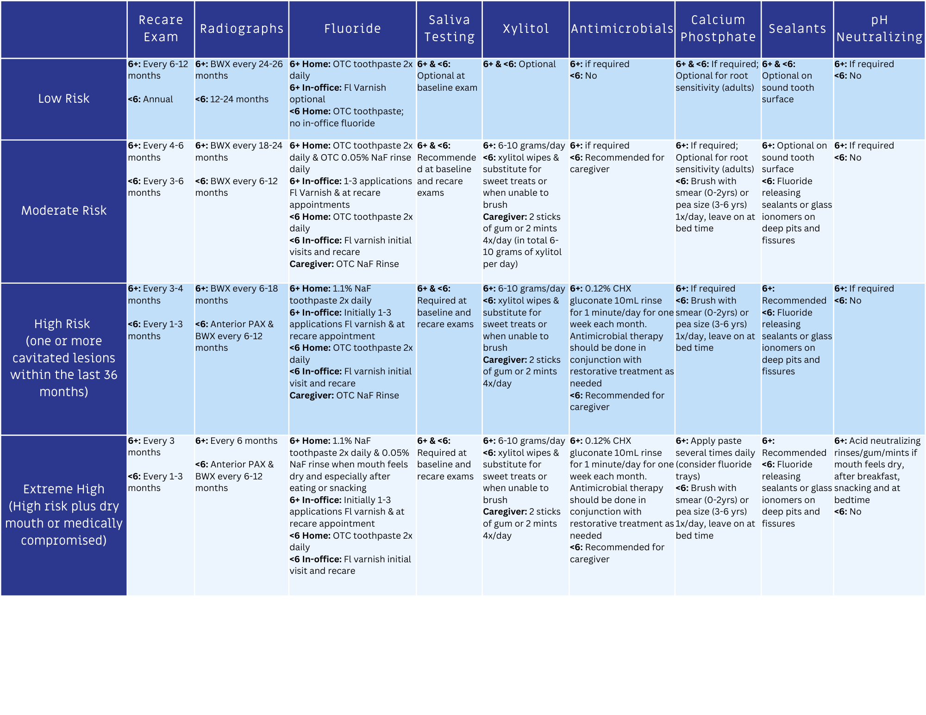
Prevention Strategies Based on Caries Risk
Once the risk level is determined, prevention strategies should be tailored to the patient.
Notes:
Once risk level is determined, prevention strategies should be tailored to the patient.
Examples:
• Professional fluoride varnish applications at more frequent preventive visits • Prescription-strength fluoride toothpaste for high-risk patients • Dental sealants on newly erupted or susceptible teeth • Oral hygiene instruction and plaque control strategies • Diet counseling to reduce the frequency of sugary beverages and snacks • Encourage drinking fluoridated tap water instead of sugary drinks • Xylitol gum or lozenges to reduce cariogenic bacteria • Saliva management for patients with dry mouth (saliva substitutes, sugar-free gum) • Medication review and counseling for xerostomia risk • Referral to community or school-based programs when access to care is limited • Caregiver education to support daily brushing for young children

Slide 16
Wrap Up
How did that conversation feel?
What worked well? What could there been better?
How can you apply this to clinical practice?
Caries risk assessment helps clinicians move from a surgical model to a preventive, patient-centered approach to caries management.
Notes:
[Go through each question the slide to prompt 2 share-outs for each question.]

Slide 17
Caries Management and Prevention: A Risk-Based Approach
To continue learning, explore our other sessions:
Session 1: Foundations of Dental Caries: Disease Process and Epidemiology
Session 2: Understanding the Caries Process: Demineralization, Remineralization, and Biofilm Management
Session 3: Caries as a Disease: Etiology, Risk Factors, and Protective Factors
Session 4: Caries Risk Assessment: Identifying and Interpreting Patient Risk
Session 5: Personalized Caries Prevention: Applying Risk-Based Strategies
Session 6: Levels of Prevention in Dental Caries: From Primordial to Tertiary Care
Session 7: Clinical Decision-Making: Applying Caries Risk Assessment to Patient-Centered Care
Session 8: The Oral Microbiome and Caries: From Dysbiosis to Prevention
Session 9: Saliva and Caries: Function, Composition, and Clinical Implications
Session 10: Caries Risk Modification: Behavioral, Environmental, and Therapeutic Interventions
Session 11: Integrating Caries Management: Case-Based Application and Clinical Planning

