Slide 1
Caries Risk Assessment: Identifying and Interpreting Patient Risk
Notes:
In this session, you will learn how to conduct a caries risk assessment and explore the factors that promote caries risk or caries balance. After practicing, you will be introduced to the foundation of habit change, and how this might impact Caries Management by Risk Assessment (CAMBRA).

Slide 2
Learning Objectives
Compare approaches used to assess caries risk.
Identify disease indicators, risk factors, and protective factors associated with dental caries.
Explain how caries risk assessment informs patient conversations and prevention planning.
Notes:
Our goals for this lesson are to achieve the following learning objectives:

Slide 3
K-W-L Chart
Discuss briefly with a neighbor.
What factors must be present for dental caries to develop?
K | W | L
What You Know | What You Want to Know | What You Learned
Notes:
Ask students to spend about 2 minutes discussing with a neighbor, and under “What You Know,” ask them to note the factors they believe must be present for dental caries to develop. Under “What You Want to Know,” ask them to write any questions they have about the caries process or how clinicians assess caries risk.
After two minutes, invite participants to share their responses with the class. Ask a few volunteers to describe what factors they listed and what questions they have about caries development.
As responses are shared, guide the discussion toward the key components of the caries process:
• cariogenic bacteria in dental biofilm • fermentable carbohydrates that serve as a substrate • a susceptible tooth surface • time, which allows repeated acid exposure and demineralization
Explain that dental caries is a multifactorial disease process that occurs when these factors interact over time. Emphasize that the balance between disease drivers and protective factors determines whether demineralization progresses to a carious lesion.
Transition to the next section by explaining that clinicians assess these factors during a caries risk assessment, which helps guide prevention and management strategies.

Slide 4
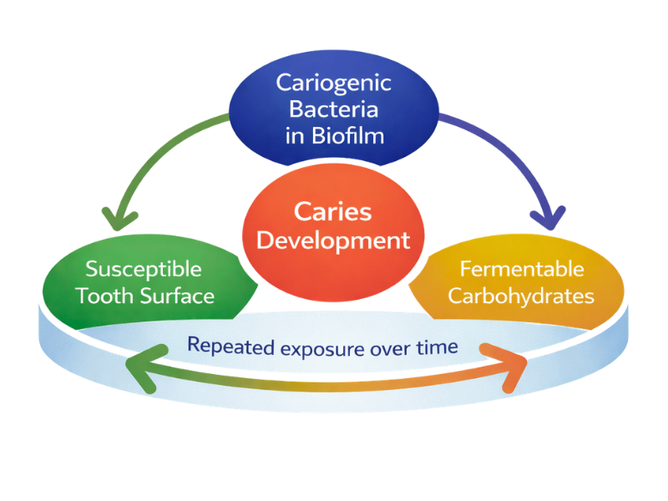
What do you need to develop caries?
Dental caries develops when bacteria metabolize fermentable carbohydrates on a susceptible tooth surface, producing acids that demineralize the tooth.
Notes:
Caries is not caused by a single factor. It occurs when several factors interact over time.
First, cariogenic bacteria must be present in dental biofilm. These bacteria, such as Streptococcus mutans and Lactobacillus species, metabolize sugars in the diet.
Second, fermentable carbohydrates must be available. These carbohydrates serve as the substrate for bacterial metabolism. When bacteria metabolize these sugars, they produce acids as a byproduct.
Third, there must be a susceptible tooth surface. This refers to tooth enamel or dentin that can undergo demineralization when exposed to acid.
Fourth, time is an important factor. The body can often recover from occasional acid exposure through saliva and remineralization. However, when acid attacks occur frequently or persist over time, the balance shifts toward demineralization and the development of carious lesions.
Understanding how these factors interact helps clinicians recognize that dental caries is a dynamic disease process. This concept forms the foundation for caries risk assessment and for identifying opportunities to intervene before cavitation occurs.

Slide 5
From Surgical Model to Medical Model
Notes:
Historically, dental caries was managed using a surgical model of care.
In the traditional model, the focus was on removing infected tooth structure and restoring the tooth. Treatment was centered on the outcome of the disease rather than the disease process itself.
Over time, this approach has evolved into a medical model of care.
The medical model focuses on understanding and managing the disease. This includes identifying the underlying disease drivers, managing bacterial activity, and promoting remineralization and prevention.
Instead of only treating cavitated lesions, the goal is to intervene earlier in the disease process and support long-term oral health. This shift allows for more personalized care, where prevention and disease control are prioritized alongside restorative treatment when needed.

Slide 6
What does CAMBRA stand for?
Notes:
What does CAMBRA stand for?

Slide 7
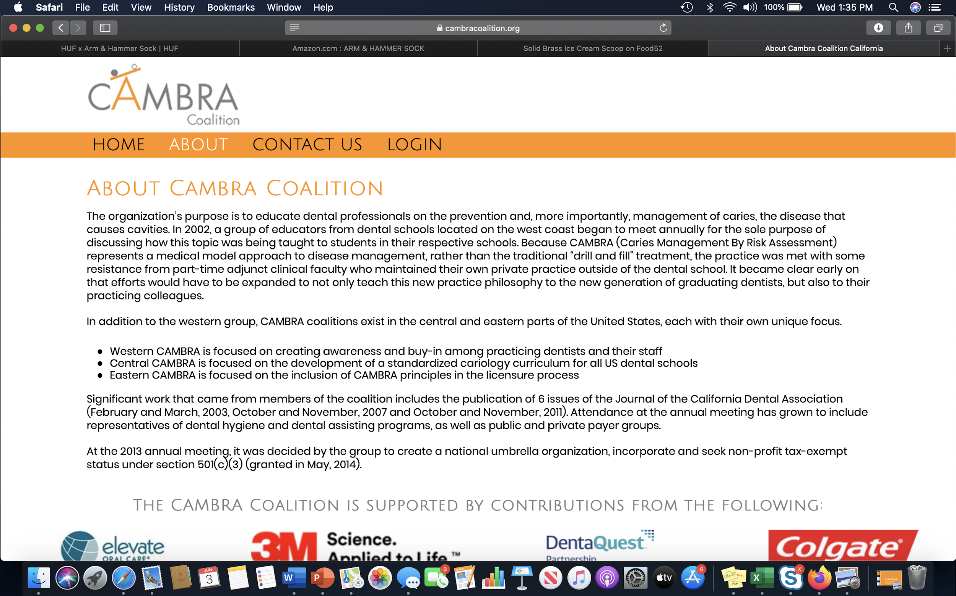
“CAMBRA Coalition,” CAMBRA Coalition, accessed March 28, 2026, www.cambracoalition.org.
Notes:
Our responsibility as dental professionals extends beyond drilling out decay and placing restorations. To effectively treat the disease caries, it is necessary to be able to assess a patient’s risk for developing caries. This allows us to employ preventive measures, including chemical therapy, patient education, and when necessary, minimally invasive restorative treatment.
In 1997, Dr. John Featherstone conducted the first clinical trial focused on this very topic. The end result was a caries risk assessment (CRA) tool that set the national standard for assessing and managing caries, known as Caries Management by Risk Assessment (CAMBRA).
Caries risk refers to how likely a patient is to have a new carious lesion in the near future. CAMBRA was shown to be highly effective in predicting future caries development in three clinical studies involving thousands of patients of varying age groups.
Using this system, a patient’s caries risk is determined to be low, moderate, high, or extreme. Today, we will review the method by which this risk is determined and the protocol enlisted for each risk level.
Reference: “CAMBRA Coalition,” CAMBRA Coalition, accessed March 28, 2026, www.cambracoalition.org.

Slide 8
Understanding Caries Risk Assessment Approaches
Disease Model → Clinical Framework → Clinical Tool
Notes:
These three concepts are related but serve different purposes.
Featherstone’s model explains the biology of the disease process.
CAMBRA applies that biological understanding to guide clinical management using risk assessment.
The ADA caries risk assessment form is a practical tool clinicians use to collect information and determine a patient’s caries risk level.

Slide 9
Caries Balance Model: Featherstone’s Caries Balance Model*
* This biological model informed later clinical frameworks such as CAMBRA.
Image modified from: John Featherstone, “Dental caries: A dynamic disease process,” Australian Dental Journal, 53(3), (2018) 286–291, https://doi.org/10.1111/j.1834-7819.2008.00064.x.
Notes:
Balance is key — preventing disease requires an abundance of protective factors compared to pathological or risk factors. Protective factors encompass the host’s salivary flow and components, proteins, antibacterial agents, as well as fluoride, calcium, phosphate, and beneficial dietary components. On the other hand, pathological or risk factors involve a decrease in salivary flow, bacteria like mutans streptococci and lactobacilli, and dietary components like frequent carbohydrates.
Image modified from: John Featherstone, “Dental caries: A dynamic disease process,” Australian Dental Journal, 53(3), (2018) 286–291, https://doi.org/10.1111/j.1834-7819.2008.00064.x.

Slide 10
High Protective Factors and Low Risk Factors
Notes:
In instances of moderate or low caries risk, the presence of risk factors lower than protective factors is observed, aligning with our aim, given that most individuals are prone to caries.

Slide 11
Risk Factors for Dental Caries
Examples include:
Notes:
Here are some examples of risk factors for dental caries.
First, there is sugar exposure. Frequent consumption of fermentable carbohydrates provides a constant fuel source for bacteria. It’s not just how much sugar, but how often it’s consumed that drives risk.
Next is biofilm imbalance. Poor plaque control allows biofilm to mature, and when you have high levels of cariogenic bacteria, that increases acid production and the risk for demineralization.
Then we have saliva protection. Saliva plays a major protective role, so when someone has reduced saliva flow, they lose that natural buffering and remineralization support.
And finally, disease history. Past caries experience is one of the strongest predictors of future disease. If a patient has had caries before, they are at higher risk of developing it again.
So, when you’re assessing a patient, you’re really looking at how these factors come together and the overall pattern and frequency over time.

Slide 12
Low Protective Factors and High Risk Factors
Notes:
Achieving greater clinical effectiveness necessitates emphasizing an increase in protective factors over a patient’s pathological or risk factors in the prevention of caries disease. A patient identified as having a high caries risk often signifies an imbalance, with protective factors notably lower and risk factors higher.

Slide 13
Evidence-Based Protective Factors for Dental Caries
Examples include:
Notes:
Now let’s look at evidence-based protective factors for dental caries.
First is exposure to fluoride, which is one of the most effective protective factors we have. This includes patients who:
Use fluoride toothpaste twice daily
Live, work, or attend school in a fluoridated community
Receive professional topical fluoride, such as fluoride varnish
Use prescription fluoride toothpaste when indicated
Use fluoride mouthrinse when indicated
Look for consistent fluoride exposure across multiple sources.
Next is adequate saliva flow and function. Look for:
Adequate stimulated saliva flow
No conditions or medications causing significant xerostomia
Saliva plays a major role in buffering acids, clearing sugars, and supporting remineralization.
Next is remineralization support. This includes:
Calcium and phosphate exposure from saliva and remineralizing agents
The use of products containing calcium-phosphate technologies when indicated
So here, there is repair to early damage of the tooth and strengthening over time.
Next are bacterial control strategies, which focus on managing the biofilm. Examples include:
Use of xylitol gum or lozenges several times daily
Good plaque control through effective toothbrushing and interdental cleaning
The goal is to reduce cariogenic bacteria and maintain a microbiome balance.
We also want to consider professional preventive care. This includes things like:
Professional fluoride treatments, such as fluoride varnish
Dental sealants
And finally, diet patterns that reduce frequent sugar exposure. This includes:
Reducing the frequency of fermentable carbohydrate intake
Choosing sugar-free alternatives
Drinking fluoridated water instead of sugary beverages
This reduces how often bacteria have the fuel to produce acid.
When you look at protective factors, it’s the combination of fluoride, saliva, biofilm control, remineralization, professional care, and diet that shifts the balance toward optimal oral health.

Slide 14
Preventive and Therapeutic Strategies for Caries Management
Mechanism | Examples of Interventions | Purpose
Antibacterial / Biofilm Control | Stannous fluoride toothpaste or rinse Chlorhexidine (short-term use in high-risk patients) Xylitol gum or lozenges Effective toothbrushing and interdental cleaning | Reduce cariogenic bacteria and biofilm activity
Neutralize Acid / Support Salivary Function | Baking soda toothpaste Saliva stimulants (sugar-free gum, lozenges) Adequate hydration Saliva substitutes for xerostomia | Buffer acids and improve oral pH balance
Remineralization / Strengthen Enamel | Fluoride toothpaste (1000–1450 ppm) High-fluoride toothpaste (5000 ppm) Fluoride varnish Calcium-phosphate technologies (CPP-ACP or other remineralizing agents) Fluoridated mouth rinse | Promote remineralization and strengthen enamel
Improve Salivary Environment | Saliva substitutes Salivary stimulants (xylitol gum/lozenges) Management of xerostomia-related medications or conditions | Improve salivary flow and buffering capacity
Dietary Strategies | Reduce frequency of fermentable carbohydrate intake Substitute sugar-free snacks Drink fluoridated water instead of sugary beverages | Reduce acid production by oral bacteria
Notes:
This chart illustrates common preventive strategies used to address different biological mechanisms in the caries process. These interventions help shift the balance toward remineralization by reducing cariogenic bacteria, buffering acids, strengthening enamel, and improving salivary function. Specific product selections may vary based on patient risk level and clinical judgment.

Slide 15
The absence of protective factors increases a patient’s risk for caries.
Notes:
When protective factors are absent, the balance shifts toward conditions that favor caries development.

Slide 16
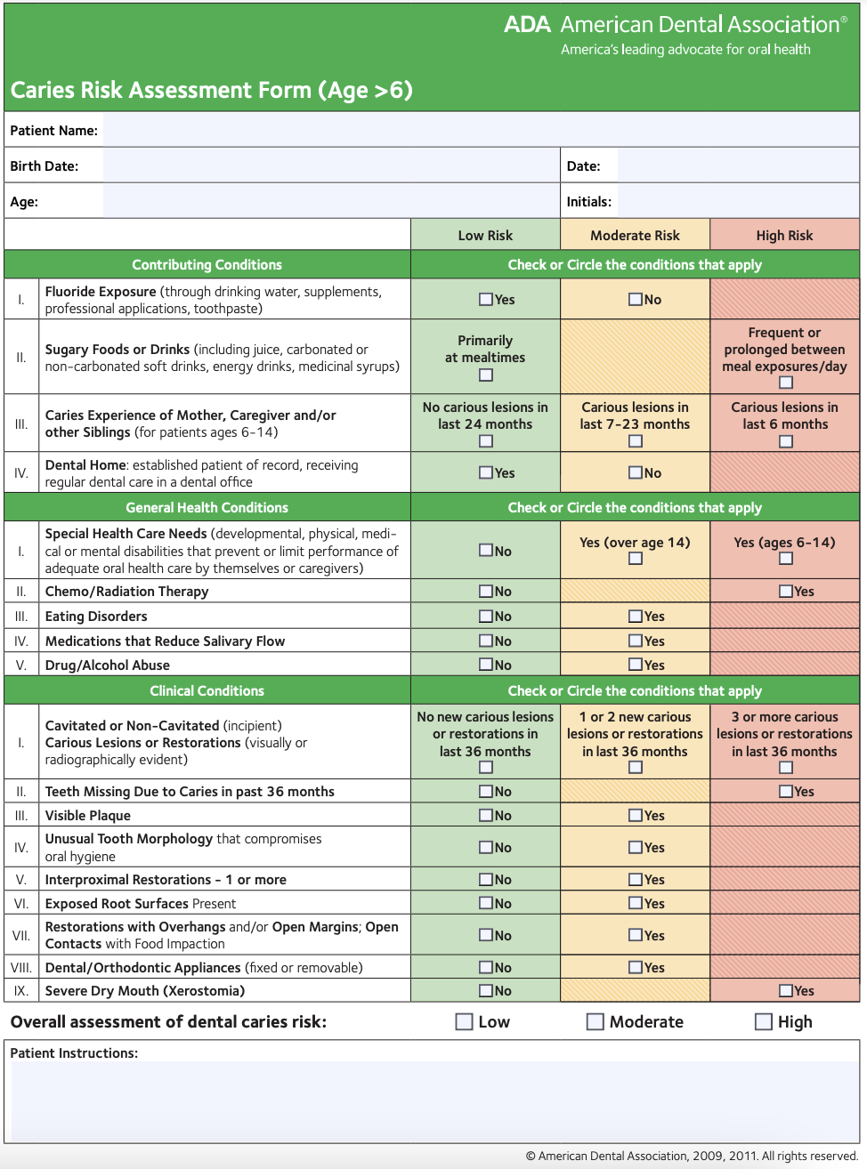
Caries Risk Assessment Form
Low Risk
Moderate Risk
High Risk
Notes:
The first section of the CAMBRA form assesses a patient’s disease indicators by observing previous and/or current caries presence. As outlined in the Final Score section of the bottom of the page, a “yes” to any question in the Disease Indicators section automatically places a patient in the “high caries risk” category. If dry mouth/hyposalivation accompanies a “yes” in the Disease Indicators category, the patient automatically becomes at an “extreme risk” for developing dental caries. Can you recall why this is?
Next is the Biological or Environmental Risk Factors section, which includes only those factors that studies have shown have a statistically significant impact on caries risk. Every “yes” in this section increases the risk level of a patient developing caries. Heavy plaque on teeth and frequent snacking are modifiable factors that can be improved with patient education and motivation. Deep pits and fissures can be addressed with preventive measures called sealants, which will be discussed later in this lecture. Recreational drug use is associated with dry mouth. Patients with orthodontic appliances are automatically considered at least "moderate risk" — can you infer why?
Protective factors are then recorded, and the patient's caries risk is determined by comparing the number of “yes” answers between protective and pathologic factors.
Once oral hygiene instructions, preventive oral products, and patient motivation are given and used correctly, evidenced by a decrease in modifiable pathologic factors, the patient’s caries risk should be adjusted accordingly.
Instructor Review Article: Featherstone, J. D., Crystal, Y. O., Alston, P., Chaffee, B. W., Doméjean, S., Rechmann, P., & Zhan, L. (2021). A Comparison of Four Caries Risk Assessment Methods. Frontiers in Oral Health, 2, 656558. https://doi.org/10.3389/froh.2021.656558
ADA Caries Risk Assessment Form: https://www.ada.org/-/media/project/ada-organization/ada/ada-org/files/resources/public-programs/give-kids-a-smile/gkas_caries_risk_assessment_forms.pdf

Slide 17
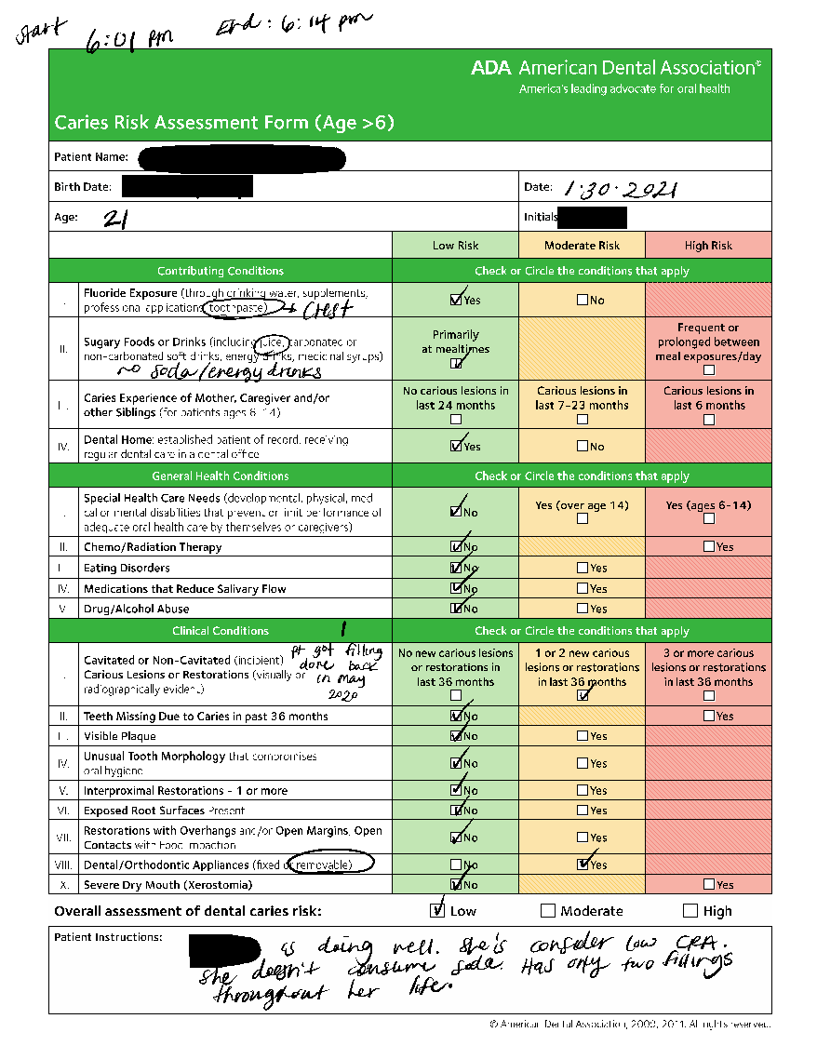
Caries Risk Assessment Sample #1
Notes:
The sample team would take notes as well. Noted at the top are the start and stop times to see how much time needs to be allotted during appointments. Note that although they are going down the list and checking low, moderate, or high risk, they are making additional notes as well, getting details of each contributing condition they are discussing. There are additional notes at the bottom of items that were discussed that do not fall into one of the conditions listed but still contribute to the overall assessment of dental caries risk.

Slide 18
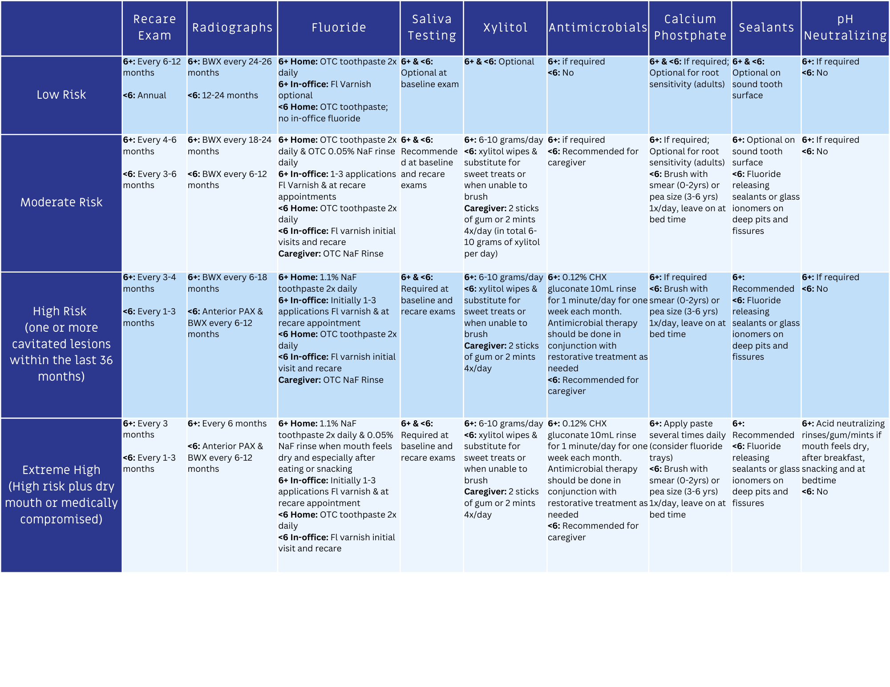
CAMBRA Suggested Treatment Protocols
Adapted from: Larry Jenson, Alan Budenz, John Featherstone, et al., “Clinical protocols for caries management by risk assessment,” Journal of the California Dental Association, 35(10), (October 2007) 714–723, DOI:10.1080/19424396.2007.12221277.
Francisco Ramos-Gomez, Yasmi Crystal, John Featherstone, et al., “Pediatric dental care: prevention and management protocols based on caries risk assessment,” Journal of the California Dental Association, 38(10), (October 2010) 746–761, https://pmc.ncbi.nlm.nih.gov/articles/PMC3470809/.
Notes:
This chart provides professional guidelines corresponding to various risk levels and different categories. It’s essential to note that these are recommendations, and clinical judgment should be exercised. The provided categories are meant for guidance.
After completing a patient’s caries risk assessment and categorizing it as low, moderate, high, or extreme, a comprehensive treatment plan is developed to cater to their unique oral care requirements. This plan aligns with the CAMBRA protocol for caries management and prevention, emphasizing minimally invasive dental treatments when needed.
Adapted from: Larry Jenson, Alan Budenz, John Featherstone, et al., “Clinical protocols for caries management by risk assessment,” Journal of the California Dental Association, 35(10), (October 2007) 714–723, DOI:10.1080/19424396.2007.12221277.
Francisco Ramos-Gomez, Yasmi Crystal, John Featherstone, et al., “Pediatric dental care: prevention and management protocols based on caries risk assessment,” Journal of the California Dental Association, 38(10), (October 2010) 746–761, https://pmc.ncbi.nlm.nih.gov/articles/PMC3470809/.

Slide 19
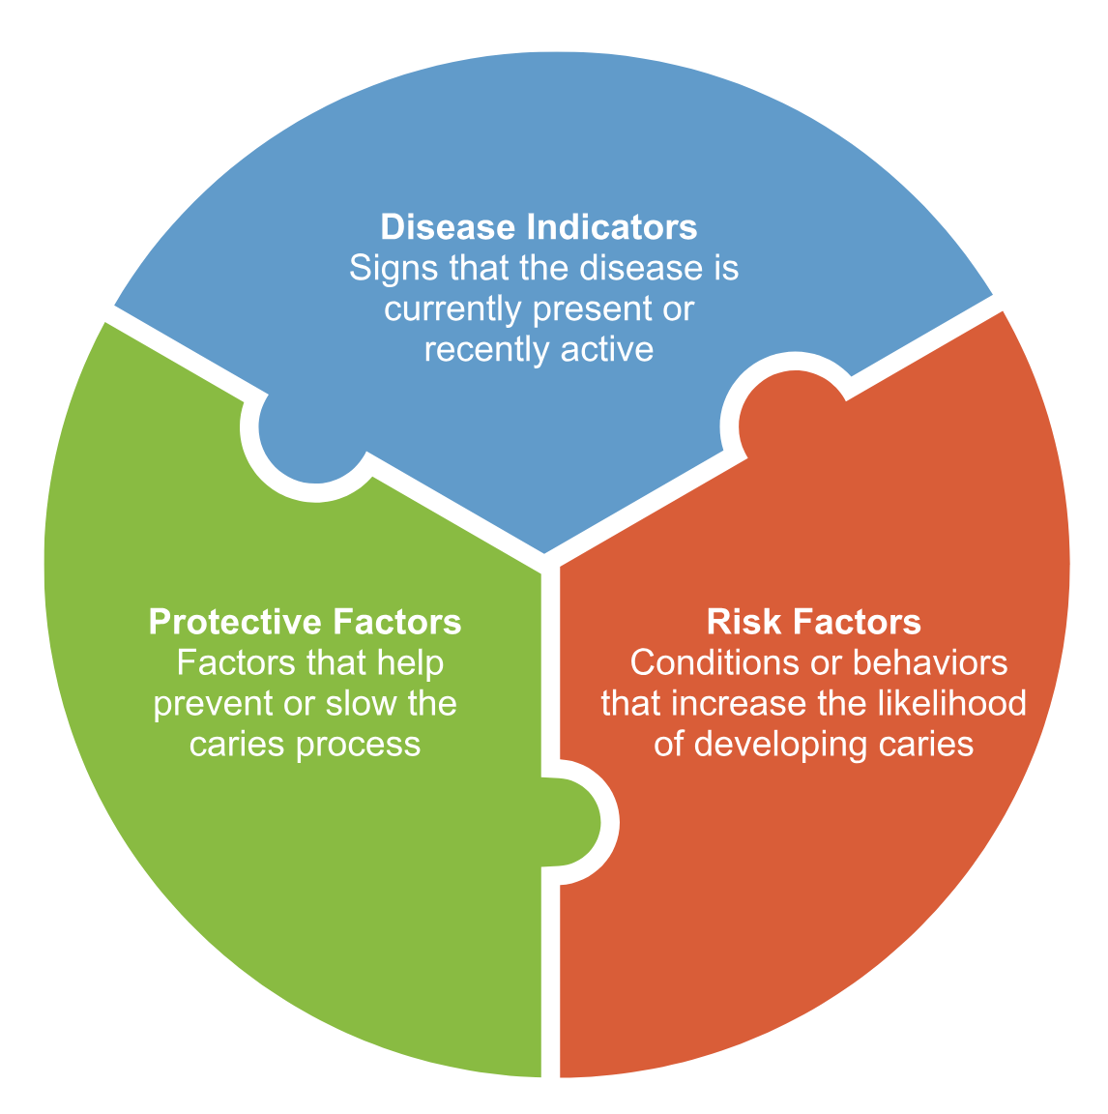
Caries Risk Assessment
Caries risk assessment considers three types of information:
Notes:
When discussing caries risk assessment, three types of information are considered. Clinicians evaluate all three categories together to understand a patient’s overall risk for developing dental caries.
The first category is disease indicators. These are signs that the disease is currently present or has been recently active. Because they reflect active disease, they are often the strongest predictors of future caries.
The second category is risk factors. These are conditions or behaviors that increase the likelihood of developing caries, such as diet, biofilm, or reduced saliva.
The third category is protective factors. These are factors that help prevent or slow the caries process, such as fluoride exposure, saliva, and effective oral hygiene.
Rather than focusing on a single factor, the combination of these three categories helps determine a patient’s overall caries risk.

Slide 20
Activity: Classifying Caries Factors
Notes:
For this activity, work in small groups to classify each factor into one of three categories: disease indicator, risk factor, or protective factor.
Take a look at the list on the slide. Discuss within your group and decide where each one belongs and add factors you can think of that are not on this list.
As a reminder:
Disease indicators show that the disease is already present or recently active. Risk factors increase the likelihood of developing caries. Protective factors help prevent or slow the process.
After discussion, be prepared to share your reasoning.

Slide 21
Assigning a Risk Level
Based on the balance of risk and protective factors, clinicians determine a patient’s overall caries risk category.
 | Low | Moderate | High | Extreme
Disease Indicators | None | None | One or more | One or more
Risk Factors | None | One or more | Two or more | Low saliva flow
Protective Factors | One or more | Need to increase | Need to increase | Need to increase
Notes:
Once a patient’s caries risk is assessed and determined to be either low, moderate, high, or extreme, CAMBRA protocol is initiated.
[Consider pausing the lecture here and take your time comparing and contrasting the protocol for each level of caries risk. Here ae some questions to prompt the class with discussion:
What do high and extreme risk patients receive that low and moderate risk patients do not?
When is antimicrobial therapy necessary?
Is fluoride alone enough to manage a patient with extreme caries risk?
What is the purpose of pH control and which level of caries risk patients will benefit from it (think back to the previous cariology lecture)?]

Slide 22
Conversational Approach
Integrating Caries Risk Assessment in Patient Interactions
Notes:
The structure of a caries risk assessment resembles a checklist, yet its purpose is to facilitate conversational dialogue with the patient. Much like studying a subject, it involves note-taking, highlighting key aspects, and a genuine curiosity for information. A similar approach is taken when discussing the patient’s oral health and habits. By asking relevant questions, observing their habits, and gathering data, the goal is to foster a meaningful conversation.

Slide 23
Notes:
Here’s an instance highlighting the importance of adopting a conversational approach when discussing caries risk. Suppose you inquire about a patient’s primary beverage choice and they respond with “water.” However, upon conducting the caries risk assessment, disparities between the clinical examination and the patient’s statements become evident, necessitating further investigation through questioning. In such cases, it is essential to specifically inquire about the exact type of water consumed and request the patient to present the product. It is important to note that certain seltzers labeled as “water” may contain “no sugar,” yet they can still trigger an acid attack every 15–30 minutes, unbeknownst to the consumer.

Slide 24
Self-Management Menu of Options
Image adapted from: John Featherstone, Yasmi O. Crystal, and Francisco Ramos Gomez, “CAMBRA® Caries Management by Risk Assessment A Comprehensive Caries Management Guide for Dental Professionals,” Journal of the California Dental Association (July 2019), https://www.researchgate.net/publication/334401386_CAMBRAR_Caries_Management_by_Risk_Assessment_A_Comprehensive_Caries_Management_Guide_for_Dental_Professionals.
Notes:
Adapting the communication of information to match patients’ oral health literacy levels enhances their comprehension. A brief written overview of patients’ self-management objectives aids in better recall after the visit. The provided chart serves as a sample checklist to support patients in identifying their specific goals.
[Option to take time to go through each of the selections.]
Image adapted from: John Featherstone, Yasmi O. Crystal, and Francisco Ramos Gomez, “CAMBRA® Caries Management by Risk Assessment A Comprehensive Caries Management Guide for Dental Professionals,” Journal of the California Dental Association (July 2019), https://www.researchgate.net/publication/334401386_CAMBRAR_Caries_Management_by_Risk_Assessment_A_Comprehensive_Caries_Management_Guide_for_Dental_Professionals.

Slide 25
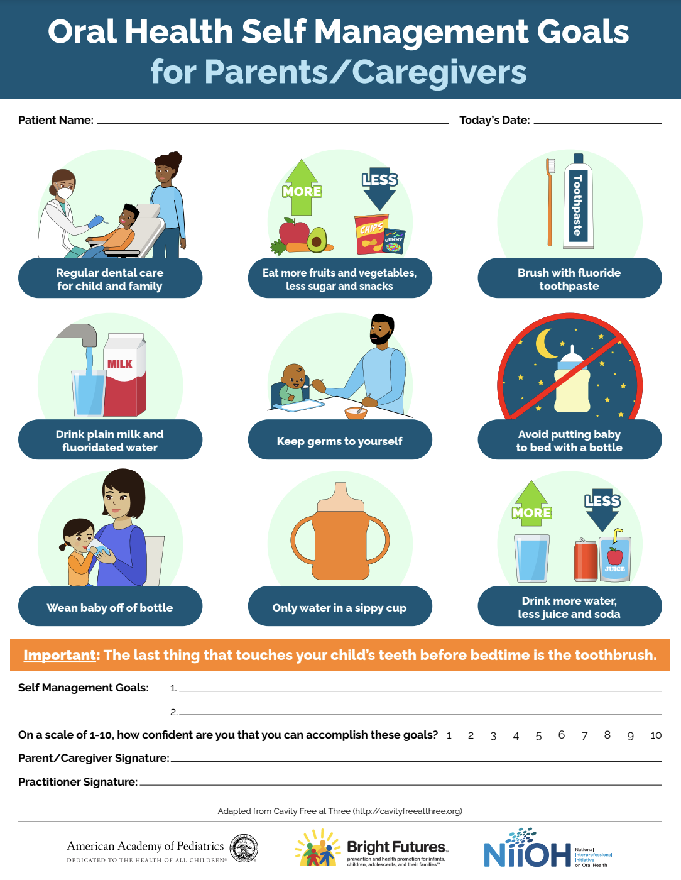
“Oral Health Self Management Goals,” American Academy of Pediatrics, accessed on March 26, 2026, https://downloads.aap.org/AAP/PDF/oralhealth_GoalSheetEnglish.pdf.
Notes:
One key goal in patient care is to support patients in having agency over the products and habits they choose to improve their oral health.
One way to do this is by asking a simple question: “If you were going to do anything to improve your oral health, what would it be?”
Patients may respond with things like, “Just give me a new toothpaste,” or “I honestly can’t brush my teeth any more—what else can I do?” or “I chew gum all day—can that be helpful?”
The goal is to create space for patients to identify and choose changes that feel realistic and achievable for them.
Reference: “Oral Health Self Management Goals,” American Academy of Pediatrics, accessed on March 26, 2026, https://downloads.aap.org/AAP/PDF/oralhealth_GoalSheetEnglish.pdf.

Slide 26
Caries Risk Conversations
Risk assessment should be part of a patient conversation.
Notes:
Caries risk assessment should be part of an ongoing patient conversation. The goal is to understand the patient’s individual risk by asking questions and listening to their responses.
This includes discussing oral hygiene habits, such as how often and how effectively the patient is brushing and cleaning between their teeth.
It also involves exploring diet behaviors, especially the frequency of fermentable carbohydrate intake.
Fluoride exposure is another important area to assess, including the use of fluoride toothpaste, rinses, and any professional applications.
By integrating these topics into a conversation, clinicians can gather more accurate information and better understand the patient’s risk profile. This approach supports more personalized recommendations and helps engage patients in their own oral health.

Slide 27
Key Takeaway
There is no “one size fits all.”
Work with patients to identify achievable prevention strategies.
Notes:
Each patient possesses unique protective and pathological factors, suggesting that a singular, universal preventative treatment plan is not feasible. While a particular plan might be effective for one person, it may not yield the same results for another. The focus should be on developing personalized preventative treatment plans tailored to their specific needs.

Slide 28
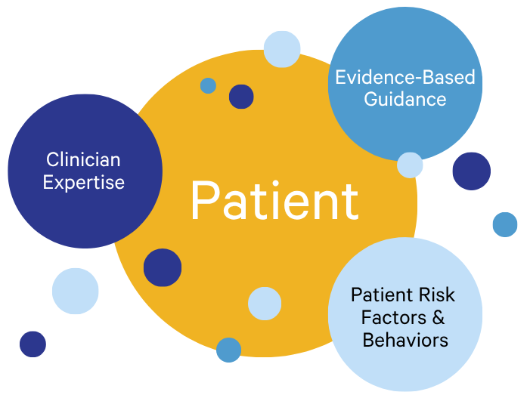
Shared Decision-Making
Notes:
Caries management should not follow a one-size-fits-all approach. Instead, clinicians use shared decision-making with the patient. The patient remains at the center of the process. Treatment decisions are informed by three key elements: the clinician’s expertise, the best available evidence, and the patient’s individual risk factors and behaviors

Slide 29
What Is the Goal?
Caries control by achieving a balance.
Notes:
Conducting a caries risk assessment and discussing self-management goals with patients aims to induce behavioral changes in response to your recommendations. The ultimate goal is to achieve caries control through achieving a balance of protective and pathological factors.

Slide 30
K-W-L Chart
Discuss briefly with a neighbor.
K | W | L
What You Know | What You Want to Know | What You Learned
Notes:
Ask students to discuss the “What You Learned.” Encourage them to think about how their understanding of caries risk assessment may have changed during the session.
After a minute or two, invite a few volunteers to share one key takeaway. You may prompt discussion with questions such as:
• What new concept about caries risk assessment stood out to you? • How does understanding risk and protective factors influence patient care? • How might this change the way you talk with patients about caries prevention?

Slide 31
Caries Management and Prevention: A Risk-Based Approach
To continue learning, explore our other sessions:
Session 1: Foundations of Dental Caries: Disease Process and Epidemiology
Session 2: Understanding the Caries Process: Demineralization, Remineralization, and Biofilm Management
Session 3: Caries as a Disease: Etiology, Risk Factors, and Protective Factors
Session 4: Caries Risk Assessment: Identifying and Interpreting Patient Risk
Session 5: Personalized Caries Prevention: Applying Risk-Based Strategies
Session 6: Levels of Prevention in Dental Caries: From Primordial to Tertiary Care
Session 7: Clinical Decision-Making: Applying Caries Risk Assessment to Patient-Centered Care
Session 8: The Oral Microbiome and Caries: From Dysbiosis to Prevention
Session 9: Saliva and Caries: Function, Composition, and Clinical Implications
Session 10: Caries Risk Modification: Behavioral, Environmental, and Therapeutic Interventions
Session 11: Integrating Caries Management: Case-Based Application and Clinical Planning

