Slide 1
Caries
Transmission
Notes:
In this session, we will discuss the transmission of the bacteria that cause caries and how this effects saliva and, ultimately, the risk for oral disease.

Slide 2
Learning Objectives
  Discuss the evidence on vertical and horizontal transmission of cariogenic bacteria associated with dental caries.
  Interpret a case review of saliva data from two families with similar saliva and disease presentations.
  Select strategies for families to reduce their risk for dental caries.
Notes:
[Read slide]

Slide 3

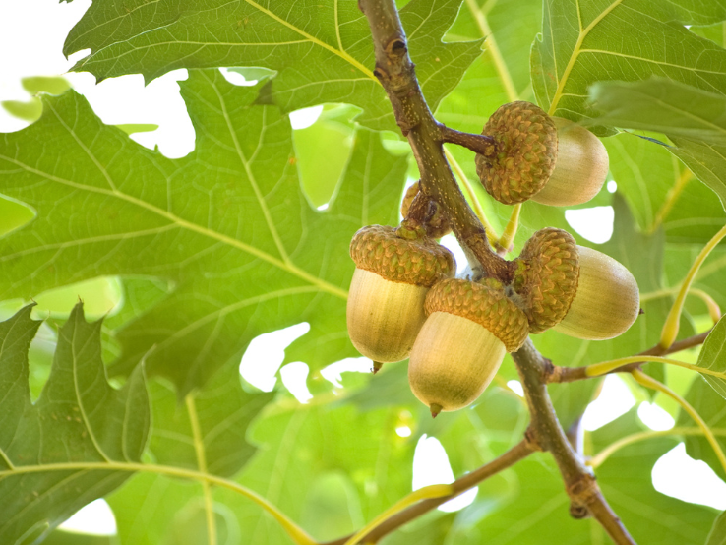
The nut doesn’t fall far from the tree.
Notes:
Have you ever gone on an adventure to gather acorns?
The thing about oak trees is that you would not look for acorns 50 feet away from the tree. You would look for all the baby acorns, brothers and sisters if you will, close to the tree and right underneath the tree.
Consider the same approach when you think about the transmission of bacteria that result in caries. Children first receive bacteria from the family members that are closest to them, often meaning the oral health of family members directly affect the parent and their children.
When it comes to families, we often see a pattern of oral disease. It can show up in different ways:
Perhaps someone comes into your office and says, “My grandmother always told me that we have ‘soft teeth.’”
Or “Everyone in my family has dentures before they are 40 years old.”
Or maybe it is a series of kids, and you see a progression and/or severity of disease that is very similar among all the children, from three to five to seven years old.

Slide 4
One Content
Fisher-Owens Conceptual Model
Optional Subhead
This is an example of how body copy should be treated in template. Starting body copy will default to Arial 24pt font. Keep the messaging clear, concise and to the point. Text can be sized up or down as the need should arise, but the best bet is to keep primary copy at this size.
  First level bullet
    Second level bullet
      Third level bullet
        Fourth level bullet
Image modified from: Susan Fisher-Owens, Stuart Gansky, Larry Platt, Jane Weintraub, Mah-J Soobader, Matthew Bramlett, and Paul Newacheck, “Influences on Children's Oral Health: A Conceptual Model,” Pediatrics, 120(3):e510–20 (September 2007), doi: 10.1542/peds.2006-3084.
Notes:
The Fisher-Owens conceptual model shows the big picture and how a variety of elements make an impact on the oral health of a child. When it comes to looking at caries in the population, and more specifically children (since we are all children at some point), there are influences for caries at multiple levels, including the personal level, child level, family level, and community level.
The Fisher-Owens conceptual model shows that there are many influences on a child’s oral health, with the oral microbiome being one of them. However, infants are not born with tooth decay or tooth decay–causing bacteria in their oral cavities. This raises questions: Where do these bacteria come from? Do we transmit the bacteria that cause tooth decay? If so, when? With whom? And how?
Image modified from: Susan Fisher-Owens, Stuart Gansky, Larry Platt, Jane Weintraub, Mah-J Soobader, Matthew Bramlett, and Paul Newacheck, “Influences on Children's Oral Health: A Conceptual Model,” Pediatrics, 120(3):e510–20 (September 2007), doi: 10.1542/peds.2006-3084.

Slide 5

One Content
Pre-Class Case Review: Will You Marry Me?
Social/Population/Research Topic
How important is the oral health system to individual oral health?
How does caries affect quality of life?
What are some cultural influences on the development of caries?
Optional Subhead
This is an example of how body copy should be treated in template. Starting body copy will default to Arial 24pt font. Keep the messaging clear, concise and to the point. Text can be sized up or down as the need should arise, but the best bet is to keep primary copy at this size.
  First level bullet
    Second level bullet
      Third level bullet
        Fourth level bullet
Notes:
You received a case called “Will you marry me?” We are going to review the questions from the case.
[After reading each question, allow the students a couple of minutes to answer. Here are answers for the questions. The answers are not limited to the ones below.]
How important is the oral health system to individual oral health? The patient mentioned in Ukraine he did not have access to a system for oral health care. From the image and the description provided in the case, it is evident that this lack of access is adversely affecting his individual oral health. This emphasizes the significant role played by the environment, as we discussed how the surroundings one is in can influence and promote specific behaviors.
How does caries affect quality of life? It’s likely the patient has sensitivities to both hot and cold beverages. Additionally, he might feel self-conscious about his smile, potentially causing him to come across as less warm to others than he would prefer.
What are some cultural influences of the development of caries? Various cultures adhere to distinct dietary patterns, and in some cases, oral health may not be common practice. Misinformation about oral health practices may also contribute to the practice of oral hygiene and nutrition factors that influences caries development. It's worth noting that a significant portion of Ukraine lacks fluoridation, which can impact overall oral health in the region.

Slide 6
One Content
Pre-Class Case Review: Will You Marry Me?
Dentistry Topic
What should be considered when the patient has multiple locations of carious lesions?
What is the caries management and caries lesion management plan of this patient?
What are ways to improve the dental hard tissue remineralization?
Optional Subhead
This is an example of how body copy should be treated in template. Starting body copy will default to Arial 24pt font. Keep the messaging clear, concise and to the point. Text can be sized up or down as the need should arise, but the best bet is to keep primary copy at this size.
  First level bullet
    Second level bullet
      Third level bullet
        Fourth level bullet
Notes:
[After reading each question, allow the students a couple of minutes to answer. Here are answers for the questions. The answers are not limited to the ones below.]
What should be considered when the patient has multiple locations of carious lesions? Implement caries control in stages, starting with the initial step of arresting decay and preventing pulpal involvement and exposure. Following this, a systematic repair approach is undertaken, where priority is placed on preventive measures alongside the restoration of affected areas.
What is the caries management and caries lesion management plan of this patient? Since his wedding is approaching within the year, it’s recommended that he comes in for appointments either once a month or every 6–8 weeks. Although addressing his smoking habit of 2 to 3 packs a day may be challenging, consider suggesting a gradual reduction strategy, like reducing one cigarette at a time. For smoking cessation, recommend nicotine gum and delve into the reasons behind his smoking habit — is it social, stress-related, or anxiety-driven? Encourage the use of xylitol water or gum as an alternative. Conduct a saliva test to assess his caries risk and implement all the necessary CAMBRA protocols. Adjust the treatment plan and switch to different oral care products as needed.
What are ways to improve the dental hard tissue mineralization? Calcium, phosphate, and Vitamin D.

Slide 7
One Content
Pre-Class Case Review: Will You Marry Me?
Basic Science Topic
What type of bacteria are mostly found in dental caries?
What factors influence the growth of a healthy layer of plaque in a patient?
How is saliva important to caries development?
How to differentiate white spot caries lesion from abnormalities of dental hard tissues?
Optional Subhead
This is an example of how body copy should be treated in template. Starting body copy will default to Arial 24pt font. Keep the messaging clear, concise and to the point. Text can be sized up or down as the need should arise, but the best bet is to keep primary copy at this size.
  First level bullet
    Second level bullet
      Third level bullet
        Fourth level bullet
Notes:
[After reading each question, allow the students a couple of minutes to answer. Here are answers for the questions. The answers are not limited to the ones below.]
What type of bacteria are mostly found in dental caries? S. mutans and lactobacilli
What factors influence the growth of a healthy layer of plaque in a patient?
Inorganic components: Calcium, phosphate, fluoride
Organic: Glycoproteins, lipids, and pH
How is saliva important to caries development? Saliva is a buffer and has cleansing action for carbohydrates. Saliva alters pH and delivers calcium and phosphate to teeth.
How to differentiate white spot caries lesion from abnormalities of dental hard tissues? White spot caries are rough and dull in appearance.

Slide 8
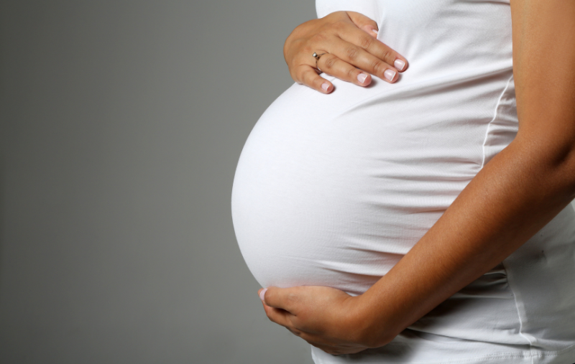
Transmission and Ecological Dysbiosis in Dental Caries
Notes:
Often, when we think of the first mode of transmission, we think of the relationship between a mother and child. During pregnancy and the perinatal period, there is a close relationship with a mother and her child.
For one, when the child is in utero, and a mother and child share a blood system, and excretory system, the child is completely dependent on that mother. During birth (especially vaginal deliveries) is a major exchange of bacteria/information between the mother and child.
However, that exchange of material, whether it be blood or bacteria, doesn’t stop at delivery most of the time. During the perinatal period after birth where the child is still dependent on that mother/caregiver, often through breast feeding.

Slide 9



One Content
Transmission of Oral Bacteria in Early Life
Oral bacteria can be shared between people through saliva contact. Children may acquire cariogenic bacteria such as Streptococcus mutans from close caregivers and other family members.
Optional Subhead
This is an example of how body copy should be treated in template. Starting body copy will default to Arial 24pt font. Keep the messaging clear, concise and to the point. Text can be sized up or down as the need should arise, but the best bet is to keep primary copy at this size.
  First level bullet
    Second level bullet
      Third level bullet
        Fourth level bullet
Common routes include:
Sharing utensils or cups
Cleaning a pacifier with a caregiver’s mouth
Kissing a child on the mouth
Tasting food with the same spoon
A.L. Davey, A.H. Rogers, “Multiple types of the bacterium Streptococcus mutans in the human mouth and their intra-family transmission,” Arch Oral Biol, 29(6):453–60 (1984), doi: 10.1016/0003-9969(84)90026-8.
Notes:
The mother is often a major source of S. mutans for the child, and mother and children have biotypes in common. (Davey et al. 1984, Masuda et al. 1985)
In the early 1980s, Davey studied the saliva and plaque bacteria of mothers, children, and fathers through 10 families, 5 of which were studied 6 months later. Of the 46 subjects, 93% had S. mutans; of the biotypes, all mouths had c/e/f. 46% had d/g biotypes. Serotyping or bacteriocin looks at the different biotypes of S. mutans and whether or not they are similar.
Overall, most fathers did not share strains with children, but all the infected children had at least one strain in common with their mother.
Reference: A.L. Davey, A.H. Rogers, “Multiple types of the bacterium Streptococcus mutans in the human mouth and their intra-family transmission,” Arch Oral Biol, 29(6):453–60 (1984), doi: 10.1016/0003-9969(84)90026-8.

Slide 10
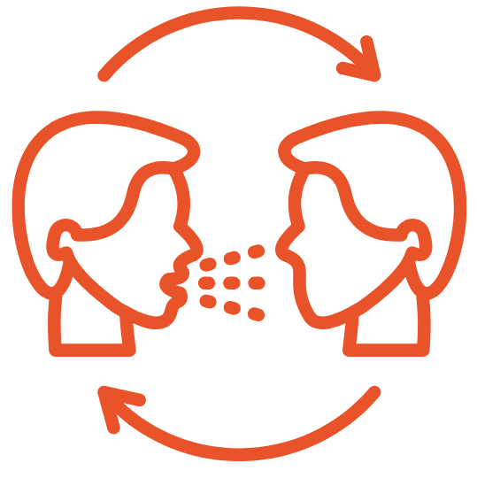
One Content
Vertical vs. Horizontal Transmission of Oral Bacteria
Horizontal transmission
Transfer of oral bacteria between other children or others in the child’s environment
Siblings sharing drinks or utensils Children sharing food or cups at school or daycare
Optional Subhead
This is an example of how body copy should be treated in template. Starting body copy will default to Arial 24pt font. Keep the messaging clear, concise and to the point. Text can be sized up or down as the need should arise, but the best bet is to keep primary copy at this size.
  First level bullet
    Second level bullet
      Third level bullet
        Fourth level bullet
Vertical transmission
Transfer of oral bacteria from a caregiver to a child, usually early in life through saliva contact
Parent or grandparent sharing utensils with a child Caregiver tasting food before feeding a child
C. Bedos, J.M. Brodeur, S. Arpin, and B. Nicolau, “Dental Caries Experience: A Two-generation Study,” Journal of Dent Research. 84(10), 931–936 (2005), doi:10.1177/154405910508401011.
Notes:
Children acquire oral bacteria from multiple caregivers, family members, and environmental exposures.
Among families in Quebec, Canada, they studied 9,903 children and their families. With an 85% completion rate of the survey, researchers found that the association between mother’s dental status and their children's dental status remained after adjusting to confounding variables.
“To our knowledge, our study is the first to show that edentulous mothers’ children have more caries than do dentate mothers’ children. This occurs on primary as well as on permanent teeth, even when adjusted for important determinants such as socioeconomic status, age, gender, and children's dental-care-related behaviors.”
Reference: C. Bedos, J.M. Brodeur, S. Arpin, and B. Nicolau, “Dental Caries Experience: A Two-Generation Study,” Journal of Dent Research. 84(10), 931–936 (2005), doi:10.1177/154405910508401011.

Slide 11
One Content
Transmission of Oral Bacteria in Early Life
Optional Subhead
This is an example of how body copy should be treated in template. Starting body copy will default to Arial 24pt font. Keep the messaging clear, concise and to the point. Text can be sized up or down as the need should arise, but the best bet is to keep primary copy at this size.
  First level bullet
    Second level bullet
      Third level bullet
        Fourth level bullet
Higher levels of Streptococcus mutans in a caregiver’s saliva increase the likelihood that a child will acquire the bacteria.
Transmission involves bacteria, not the disease itself.
A.L. Davey and A.H. Rogers, “Multiple types of the bacterium Streptococcus mutans in the human mouth and their intra-family transmission,” Arch Oral Biol, (1984), doi: 10.1016/0003-9969(84)90026-8.
Notes:
The mother is often a major source of S. mutans for the child, and mother and children have biotypes in common. (Davey et al. 1984, Masuda et al. 1985)
In the early 1980s, Davey studied the saliva and plaque bacteria of mothers, children, and fathers through 10 families, 5 of which were studied 6 months later. Of the 46 subjects, 93% had S. mutans; of the biotypes, all mouths had c/e/f. 46% had d/g biotypes. Serotyping or bacteriocin looks at the different biotypes of S. mutans and whether or not they are similar.
Overall, most fathers did not share strains with children, but all the infected children had at least one strain in common with their mother.
Reference: A.L. Davey, A.H. Rogers, “Multiple types of the bacterium Streptococcus mutans in the human mouth and their intra-family transmission,” Arch Oral Biol, 29(6):453–60 (1984), doi: 10.1016/0003-9969(84)90026-8.

Slide 12
One Content
Vertical Transmission
The mother/caregiver is often a major source of Streptococcus mutans for infants, and early studies found that mothers and children frequently share bacterial strains.
Optional Subhead
This is an example of how body copy should be treated in template. Starting body copy will default to Arial 24pt font. Keep the messaging clear, concise and to the point. Text can be sized up or down as the need should arise, but the best bet is to keep primary copy at this size.
  First level bullet
    Second level bullet
      Third level bullet
        Fourth level bullet
R.J. Berkowitz, J. Turner, and P. Green, “Maternal salivary levels of Streptococcus mutans: The primary oral infection in infants,” Archives of Oral Biology, 26(2), 147–149 (1981), https://doi.org/10.1016/0003-9969(81)90086-8.
Notes:
Let’s review some of the early research about “vertical transmission” of bacteria that cause dental caries and when it started in the 1980s.
The density of S. mutans in the mother's saliva affects the frequency of infant infection. (Berkowitz et al. 1981)
This finding was echoed nearly a decade earlier when Berkowitz et al. found that if a mother had 10⁵ colony-forming units (CFU) of S. mutans, the frequency of infant infection was 58%. When mothers had 10³ CFU, their frequency of infant infection was 6%. This demonstrates the idea that the quantity of bacteria during the inoculation or saliva transfer affects the infectivity of the infant, and that the denser the saliva is with bacteria that cause tooth decay, the more likely they are to pass it on to their children or inoculate them.
The quantity of S. mutans in the mother's saliva is like the quantity found in her child. (Berkowitz et al. 1981, Caufield et al. 1985)
Now researchers started to show that density of bacteria in the mother’s saliva not only made a difference in inoculation, but it also affected the density of these bacteria in the child’s saliva.
References:
R.J. Berkowitz, J. Turner, and P. Green, “Maternal salivary levels of Streptococcus mutans: The primary oral infection in infants,” Archives of Oral Biology, 26(2), 147–149 (1981), https://doi.org/10.1016/0003-9969(81)90086-8.
P.W. Caufield, N.K. Childers, D.N. Allen, and J.B. Hansen, “Distinct bacteriocin groups correlate with different groups of Streptococcus mutans plasmids,” Infection and immunity, 48(1), 51–56 (1985), https://doi.org/10.1128/iai.48.1.51-56.1985.

Slide 13
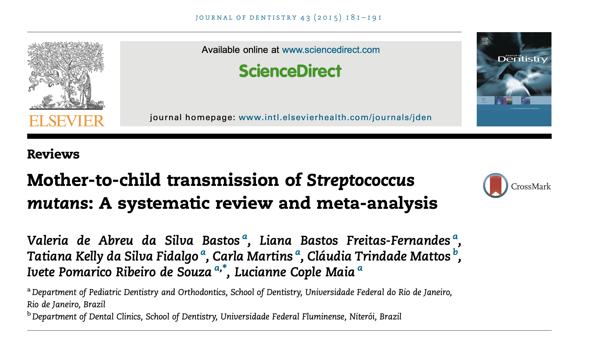
One Content
Optional Subhead
This is an example of how body copy should be treated in template. Starting body copy will default to Arial 24pt font. Keep the messaging clear, concise and to the point. Text can be sized up or down as the need should arise, but the best bet is to keep primary copy at this size.
  First level bullet
    Second level bullet
      Third level bullet
        Fourth level bullet
Valeria de Abreu da Silva Bastos, Liana Bastos Freitas-Fernandez, et al., “Mother-to-child transmission of Streptococcus mutans: A systematic review and meta-analysis,” Journal of Dentistry. 43(2):181-191 (February 2015), doi:10.1016/j.jdent.2014.12.001.
Notes:
In 2000, a systematic review and meta-analysis was released looking at the transmission of one bacterium associated with caries — S. mutans — from mothers to their children regardless of age. However, the exact percentage varied because of the different techniques used to collect genetic data.
The effect the mode of delivery has on S. mutans colonization has not been confirmed. They found that breastfeeding influenced S. mutans colonization, likely due to intimate contact.
Also, young girls were more likely to be colonized than boys likely due to the earlier eruption of teeth and girls having a place for the bacteria to colonize. However, some research shows that infants can be colonized with S. mutans without teeth, a non-shedding surface.
Reference: Valeria de Abreu da Silva Bastos, Liana Bastos Freitas-Fernandez, et al., “Mother-to-child transmission of Streptococcus mutans: A systematic review and meta-analysis,” Journal of Dentistry. 43(2):181–191 (February 2015), doi:10.1016/j.jdent.2014.12.001.

Slide 14
One Content
Vertical Transmission
Optional Subhead
This is an example of how body copy should be treated in template. Starting body copy will default to Arial 24pt font. Keep the messaging clear, concise and to the point. Text can be sized up or down as the need should arise, but the best bet is to keep primary copy at this size.
  First level bullet
    Second level bullet
      Third level bullet
        Fourth level bullet
Notes:
Birth affects when inoculation of S. mutans happens. When a child is born via caesarian section, they were likely to be inoculated 11.7 months earlier, raising the question of the effect and benefit of commensal bacteria exposure during natural birth.
Vertical transmission of S. mutans was earlier among patients delivered via cesarean vs. natural birth.
Reference: Y. Li, P.W. Caufield, et al., “Mode of delivery and other maternal factors influence the acquisition of Streptococcus mutans in infants,” Journal of dental research, 84(9), 806–811 (2005) https://doi.org/10.1177/154405910508400905.

Slide 15
One Content
Optional Subhead
This is an example of how body copy should be treated in template. Starting body copy will default to Arial 24pt font. Keep the messaging clear, concise and to the point. Text can be sized up or down as the need should arise, but the best bet is to keep primary copy at this size.
  First level bullet
    Second level bullet
      Third level bullet
        Fourth level bullet
The median age of infectivity for S. sanguinis:
  Plaque: 9 months
  Saliva: 12.7 months
The median age of the first tooth eruption was 7.1 months.
Page Caufield, Ananda Dasanayake, et al., “Natural history of Streptococcus sanguinis in the oral cavity of infants: evidence for a discrete window of infectivity,” Infection and immunity, 68(7), 4018–4023 (July 2000), https://doi.org/10.1128/IAI.68.7.4018-4023.2000.
Notes:
Teeth provide surfaces for bacterial colonization. After tooth eruption, infants begin to acquire oral bacteria through saliva contact with caregivers. Early colonizers such as Streptococcus sanguinis may compete with cariogenic bacteria such as Streptococcus mutans. Early colonizers such as Streptococcus sanguinis are associated with a healthy biofilm, while mutans streptococci are acid-producing bacteria that thrive in acidic environments and contribute to dental caries.
About the same time the systemic review on transmission was released, so was this seminal paper by Caufield. Researchers looked at the “window of infectivity” of an infant for specific oral bacteria, S. mutans and S. sanguinis.
They found:
The median age of infectivity for S. sanguinis:
Plaque: 9 months
Saliva: 12.7 months
The median age of the first tooth eruption was 7.1 months.
Additionally, they found that if S. sanguinis colonized early, then you were not colonized with S. mutans as early. This connects to the idea of other researchers at that time and today to the idea that probiotic therapy can help prevent with tooth decay.
Reference: Page Caufield, Ananda Dasanayake, et al., “Natural history of Streptococcus sanguinis in the oral cavity of infants: evidence for a discrete window of infectivity,” Infection and immunity, 68(7), 4018–4023 (July 2000), https://doi.org/10.1128/IAI.68.7.4018-4023.2000.

Slide 16

One Content
Horizontal Transmission
Optional Subhead
This is an example of how body copy should be treated in template. Starting body copy will default to Arial 24pt font. Keep the messaging clear, concise and to the point. Text can be sized up or down as the need should arise, but the best bet is to keep primary copy at this size.
  First level bullet
    Second level bullet
      Third level bullet
        Fourth level bullet
Notes:
Horizontal transmission is typically transmission from other family members to the child, e.g., grandparents, siblings, friends at school, and between couples.
In the late 1970s, research reports from the US, Australia, etc. were reporting on the idea that families do in fact share oral bacteria, and that the the primary caregiver (at that time, the mother) had the most in common. However, it is important to recognize how families are changing:
Stay-at-home mothers are now stay-at-home fathers.
Grandparents are helping with children.
Nannies and au pairs are more and more common.

Slide 17
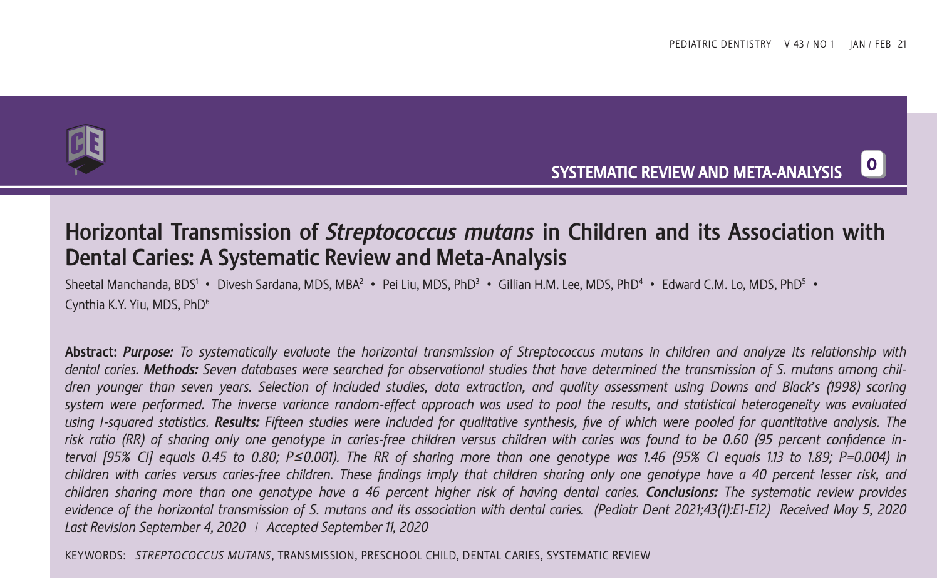
One Content
Horizontal Transmission of Streptococcus mutans in Children and its Association with Dental Caries: A Systematic Review and Meta-Analysis
Optional Subhead
This is an example of how body copy should be treated in template. Starting body copy will default to Arial 24pt font. Keep the messaging clear, concise and to the point. Text can be sized up or down as the need should arise, but the best bet is to keep primary copy at this size.
  First level bullet
    Second level bullet
      Third level bullet
        Fourth level bullet
Sheetal Manchanda, Divesh Sardana, et al., “Horizontal Transmission of Streptococcus mutans in Children and its Association with Dental Caries: A Systematic Review and Meta-Analysis,” Pediatric dentistry, 43(1), 1E–12E (January 15, 2021), https://pubmed.ncbi.nlm.nih.gov/33662253/.
Notes:
The systematic review provides evidence of the horizontal transmission of S. mutans and its association with dental caries.
Reference: Sheetal Manchanda, Divesh Sardana, et al., “Horizontal Transmission of Streptococcus mutans in Children and its Association with Dental Caries: A Systematic Review and Meta-Analysis,” Pediatric dentistry, 43(1), 1E–12E (January 15, 2021), https://pubmed.ncbi.nlm.nih.gov/33662253/.

Slide 18
One Content
Family Matters
Optional Subhead
This is an example of how body copy should be treated in template. Starting body copy will default to Arial 24pt font. Keep the messaging clear, concise and to the point. Text can be sized up or down as the need should arise, but the best bet is to keep primary copy at this size.
  First level bullet
    Second level bullet
      Third level bullet
        Fourth level bullet
Reference: C. Bedos, J.M. Brodeur, S. Arpin, and B. Nicolau, “Dental Caries Experience: A Two-generation Study,” Journal of Dent Research. 84(10), 931–936 (2005), doi:10.1177/154405910508401011.
Notes:
Children acquire oral bacteria from multiple caregivers, family members, and environmental exposures.
Among families in Quebec, Canada, they studied 9,903 children and their families. With an 85% completion rate of the survey, researchers found that the association between mother’s dental status and their children's dental status remained after adjusting to confounding variables.
“To our knowledge, our study is the first to show that edentulous mothers’ children have more caries than do dentate mothers’ children. This occurs on primary as well as on permanent teeth, even when adjusted for important determinants such as socioeconomic status, age, gender, and children's dental-care-related behaviors.”
Reference: C. Bedos, J.M. Brodeur, S. Arpin, and B. Nicolau, “Dental Caries Experience: A Two-Generation Study,” Journal of Dent Research. 84(10), 931–936 (2005), doi:10.1177/154405910508401011.

Slide 19
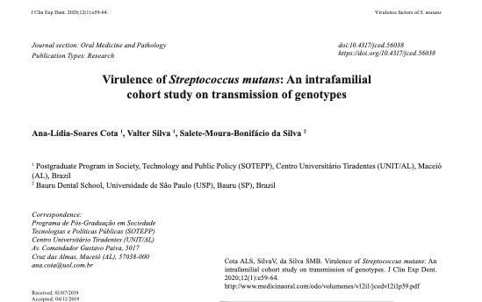
One Content
Optional Subhead
This is an example of how body copy should be treated in template. Starting body copy will default to Arial 24pt font. Keep the messaging clear, concise and to the point. Text can be sized up or down as the need should arise, but the best bet is to keep primary copy at this size.
  First level bullet
    Second level bullet
      Third level bullet
        Fourth level bullet
Ana-Lidia-Soares Cota, Valter Silva, and Salete-Moura-Bonifácio da Silva, “Virulence of Streptococcus mutans: An intrafamilial cohort study on transmission of genotypes,” Journal of clinical and experimental dentistry, 12(1), e59–e64 (January 1, 2020), https://doi.org/10.4317/medoral.56038.
Notes:
They looked at the transmission of S. mutans between mothers, fathers, grandparents, and children in families.
They found that the virulence factor for S. mutans was associated with transmission and stability but not with sharing. They found evidence of transmission between mother and child, as well as between father and child and grandparents and child.
Reference: Ana-Lidia-Soares Cota, Valter Silva, and Salete-Moura-Bonifácio da Silva, “Virulence of Streptococcus mutans: An intrafamilial cohort study on transmission of genotypes,” Journal of clinical and experimental dentistry, 12(1), e59–e64 (January 1, 2020), https://doi.org/10.4317/medoral.56038.

Slide 20

Bacteria and
Oral Health
Notes:
But is it all about the bacteria alone? No, we know in oral health and dentistry the environment has a role.

Slide 21
One Content
Ecological Plaque Hypothesis
Optional Subhead
This is an example of how body copy should be treated in template. Starting body copy will default to Arial 24pt font. Keep the messaging clear, concise and to the point. Text can be sized up or down as the need should arise, but the best bet is to keep primary copy at this size.
  First level bullet
    Second level bullet
      Third level bullet
        Fourth level bullet
Image modified from: Carounanidy Usha and Sathyanarayanan R., “Dental caries - A complete changeover (Part I),” Journal of conservative dentistry, 12(2), 46–54 (April 2009), https://doi.org/10.4103/0972-0707.55617.
Notes:
Dental caries can come from an imbalance in the overall microflora within the oral environment, primarily triggered by ecological stress. This imbalance is manifested through the enrichment of certain oral pathogens or disease-related microorganisms. Regular exposure to a low pH, often induced by the fermentation of sugars from carbohydrate-rich foods like Kool-Aid, bottled juices, and sodas such as Coke, promotes the increase of acid-tolerant species.
Aciduric bacteria, like Streptococcus mutans, thrive in acidic conditions. S. mutans, for instance, adjusts its protein expression in response to acidic pH, increasing its chances of survival under such circumstances. The growth of these aciduric bacteria contributes to the development of tooth decay, highlighting the intricate connection between dietary habits, microbial ecology, and oral health.
Image modified from: Carounanidy Usha and Sathyanarayanan R., “Dental caries - A complete changeover (Part I),” Journal of conservative dentistry, 12(2), 46–54 (April 2009), https://doi.org/10.4103/0972-0707.55617.

Slide 22
One Content
Frequent sugar exposure
Bacteria ferment sugars and produce acids
Plaque pH drops (acidic environment)
Ecological Plaque Hypothesis: How Caries Develops
Optional Subhead
This is an example of how body copy should be treated in template. Starting body copy will default to Arial 24pt font. Keep the messaging clear, concise and to the point. Text can be sized up or down as the need should arise, but the best bet is to keep primary copy at this size.
  First level bullet
    Second level bullet
      Third level bullet
        Fourth level bullet
Biofilm shifts toward more acid-producing bacteria
Repeated acid exposure leads to enamel demineralization
Caries lesions develop
Acid-tolerant bacteria become dominant (S. mutans)
Caries develops when the oral environment repeatedly favors acid-producing bacteria.
Notes:
The key idea of the ecological plaque hypothesis is that dental caries is not caused by a single bacterium. The mouth normally contains many different bacteria living in balance.
When sugar is consumed frequently, bacteria ferment the sugar and produce acid.
This lowers the pH of dental plaque.
Low pH creates an environment where acid-tolerant bacteria survive better than others.
Over time, these bacteria become more dominant in the biofilm.
As these bacteria produce more acid, the environment becomes even more acidic.
Repeated acid exposure leads to mineral loss from enamel and the development of caries.

Slide 23
One Content
Optional Subhead
This is an example of how body copy should be treated in template. Starting body copy will default to Arial 24pt font. Keep the messaging clear, concise and to the point. Text can be sized up or down as the need should arise, but the best bet is to keep primary copy at this size.
  First level bullet
    Second level bullet
      Third level bullet
        Fourth level bullet
Danying Tao, Fei Li, et al., “Plaque biofilm microbial diversity in infants aged 12 months and their mothers with or without dental caries: a pilot study,” BMC Oral Health, 18(1), 228 (December 29, 2018), https://doi.org/10.1186/s12903-018-0699-8.
Notes:
Mothers and children have similar microbial diversity, and so mother’s oral microbial diversity does in fact influence the child. However, at 12 months they are different; environment does shape microbial diversity.
Reference: Danying Tao, Fei Li, et al., “Plaque biofilm microbial diversity in infants aged 12 months and their mothers with or without dental caries: a pilot study,” BMC Oral Health, 18(1), 228 (December 29, 2018), https://doi.org/10.1186/s12903-018-0699-8.

Slide 24
One Content
Optional Subhead
This is an example of how body copy should be treated in template. Starting body copy will default to Arial 24pt font. Keep the messaging clear, concise and to the point. Text can be sized up or down as the need should arise, but the best bet is to keep primary copy at this size.
  First level bullet
    Second level bullet
      Third level bullet
        Fourth level bullet
D. Kahharova, B.W. Brandt, et al., “Maturation of the Oral Microbiome in Caries-Free Toddlers: A Longitudinal Study,” Journal of dental research, 99(2), 159–167 (February 2020), https://doi.org/10.1177/0022034519889015.
Notes:
What about the development of a healthy microbiome?
This study looked at how the good bacteria in our mouths grow and change over time. The children followed didn’t have any cavities until they were four years old, starting from when they were just one year old. The bacteria found in their spit and on their teeth changed a lot between ages one and two and a half, but the changes were smaller between two and a half and four years old. However, even by the age of four, the bacteria in the children’s mouths weren't as diverse as the bacteria in the mouths of the adults taking care of them.
In figure 3 shown on this slide, the diversity of the child saliva and plaque change over time and become more complex. They are related to their caregiver’s saliva and become more alike over time, but never the same level of complexity.
Reference: D. Kahharova, B.W. Brandt, et al., “Maturation of the Oral Microbiome in Caries-Free Toddlers: A Longitudinal Study,” Journal of dental research, 99(2), 159–167 (February 2020), https://doi.org/10.1177/0022034519889015.

Slide 25
One Content
Optional Subhead
This is an example of how body copy should be treated in template. Starting body copy will default to Arial 24pt font. Keep the messaging clear, concise and to the point. Text can be sized up or down as the need should arise, but the best bet is to keep primary copy at this size.
  First level bullet
    Second level bullet
      Third level bullet
        Fourth level bullet
Remco Kort, Martien Caspers, et al., “Shaping the oral microbiota through intimate kissing,” Microbiome, 2-41 (November 17, 2014), https://doi.org/10.1186/2049-2618-2-41.
Notes:
In figure 1A, the research looked at 21 couples and studied their bacteria before and after intimate kissing.
The first three columns show the types of bacteria found in the probiotic drink. Streptococcus is the most common, followed by Lactobacillus. There is also Bifidobacterium. This matches what is expected to be found based on the ingredients of the drink, which include bacteria used in yogurt production like Streptococcus thermophilus and Lactobacillus delbrueckii subsp. bulgaricus, as well as probiotic additives such as Lactobacillus rhamnosus GG, Lactobobacillus acidophilus LA5, and Bifidobacterium lactis BB12. The top 10 bacteria genera found in the mouths of our participants are Streptococcus, Rothia, Neisseria, Gemella, Granulicatella, Haemophilus, Actinomyces, Veillonella, Porphyromonas, and Fusobacterium. These are all commonly found in the normal bacteria of the mouth.
Microbiota become similar the more frequently couples intimately kiss over a year. A person would need to kiss about 9 times per day to have enough bacterial exchange, and recently, within 1:45 minutes, in order to show that the microbiota are similar. They evaluated the transfer of bacteria by monitoring the exchange when couples drank the probiotic yogurt drink.
Reference: Remco Kort, Martien Caspers, et al., “Shaping the oral microbiota through intimate kissing,” Microbiome, 2–41 (November 17, 2014), https://doi.org/10.1186/2049-2618-2-41.

Slide 26
One Content
Fisher-Owens Conceptual Model
Optional Subhead
This is an example of how body copy should be treated in template. Starting body copy will default to Arial 24pt font. Keep the messaging clear, concise and to the point. Text can be sized up or down as the need should arise, but the best bet is to keep primary copy at this size.
  First level bullet
    Second level bullet
      Third level bullet
        Fourth level bullet
Image modified from: Susan Fisher-Owens, Stuart Gansky, Larry Platt, Jane Weintraub, Mah-J Soobader, Matthew Bramlett, and Paul Newacheck, “Influences on Children's Oral Health: A Conceptual Model,” Pediatrics, 120(3):e510-20 (September 2007), doi: 10.1542/peds.2006-3084.
Notes:
Let’s go back to the big picture for a moment.
In a cross-sectional study of parents and children in Japan, they found that there was a significant association between vertical transmission prevention behaviors and caries experience; however, this relationship disappeared after confounding variables were accounted for.
While this study did not look at individual bacteria or microbiomes, it does show that other variables account for caries experience in children, and that environment plays a role in tooth decay (which alludes to the role of saliva).
Reference: S. Wakaguri, J. Aida, et al., “Association between caregiver behaviours to prevent vertical transmission and dental caries in their 3-year-old children,” Caries research, 45(3), 281–286 (2011), https://doi.org/10.1159/000327211.
Image modified from: Susan Fisher-Owens, Stuart Gansky, Larry Platt, Jane Weintraub, Mah-J Soobader, Matthew Bramlett, and Paul Newacheck, “Influences on Children’s Oral Health: A Conceptual Model,” Pediatrics, 120(3):e510-20 (September 2007), doi: 10.1542/peds.2006-3084.

Slide 27
One Content
Clinical Case: Younger Family
Optional Subhead
This is an example of how body copy should be treated in template. Starting body copy will default to Arial 24pt font. Keep the messaging clear, concise and to the point. Text can be sized up or down as the need should arise, but the best bet is to keep primary copy at this size.
  First level bullet
    Second level bullet
      Third level bullet
        Fourth level bullet
Notes:
Next, we will examine a family with younger children.

Slide 28
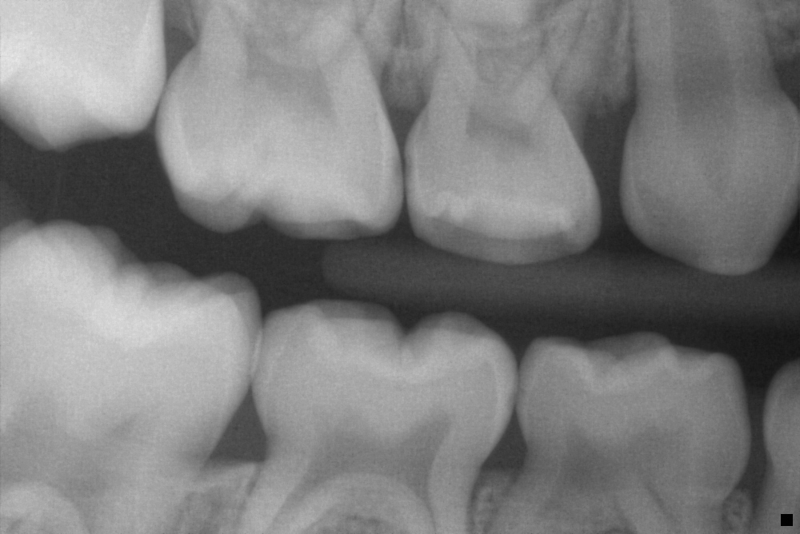
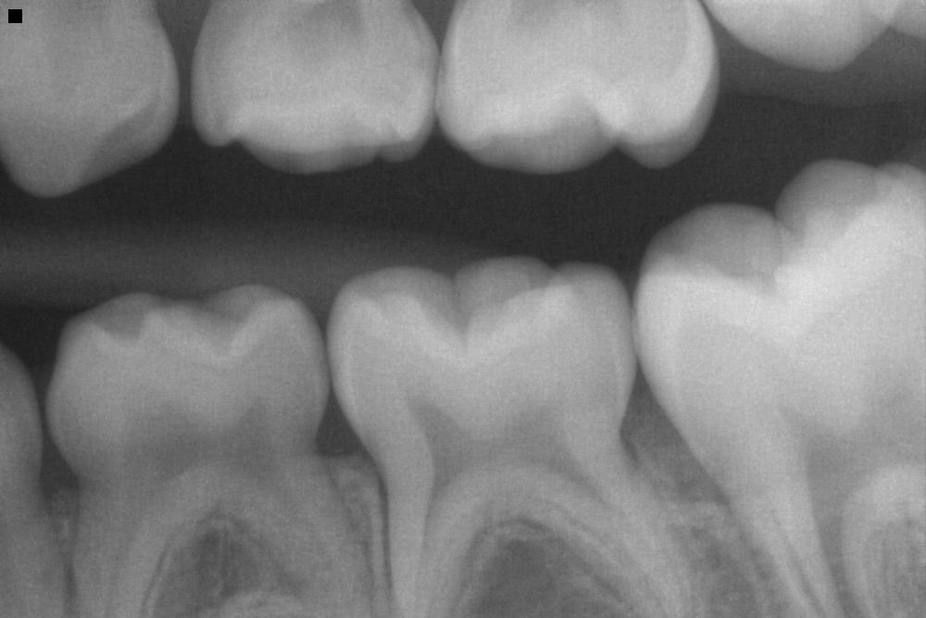
One Content
Clinical Case: 6-Year-Old Brother
Optional Subhead
This is an example of how body copy should be treated in template. Starting body copy will default to Arial 24pt font. Keep the messaging clear, concise and to the point. Text can be sized up or down as the need should arise, but the best bet is to keep primary copy at this size.
  First level bullet
    Second level bullet
      Third level bullet
        Fourth level bullet
Notes:
These are the radiographs for the 6-year-old brother. He exhibits an extremely high risk of developing cavities, as evidenced by his dietary habits, which include consuming gummies, chocolate candy bars, and soda. Also, he regularly eats pizza and chicken nuggets after school, further increasing his risk. His salivary diagnostic results (not pictured) indicate he has a high level of cariogenic bacteria, high acidity, and low buffer capacity.
Recommendations for this patient include:
Replace eating candy with Basic Bites and xylitol candy.
“Leave the foam alone.” This term was created by Dr. Brian Novy. “Leave the foam alone” (LFA) means not rinsing after. When a person brushes and spits out the extra toothpaste, there are little bubbles around the gums and teeth. It’s important to leave those bubbles there instead of rinsing them out. Those bubbles contain active ingredients for enhancing the oral microbiome and strengthening teeth.

Slide 29
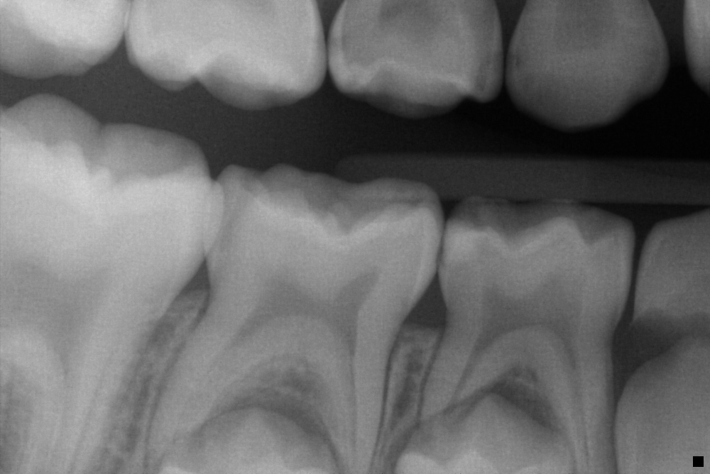
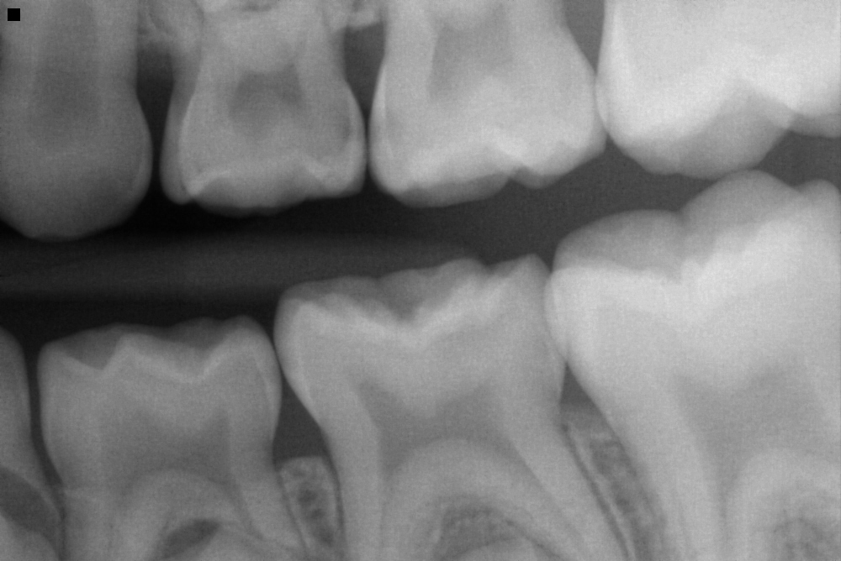
One Content
Clinical Case: 9-Year-Old Sister
Optional Subhead
This is an example of how body copy should be treated in template. Starting body copy will default to Arial 24pt font. Keep the messaging clear, concise and to the point. Text can be sized up or down as the need should arise, but the best bet is to keep primary copy at this size.
  First level bullet
    Second level bullet
      Third level bullet
        Fourth level bullet
Notes:
These are the radiographs for his 9-year-old sister. These radiographs are being shown in sequence of age to show that the environment impacts oral health. The older children have been in this cariogenic environment for longer, so they are going to have more advanced lesions.
She has similar habits as her brother but ate less candy than he does. She does have more advanced lesions since she has been in this environment longer. Her salivary diagnostic results (not pictured) indicate she has a high level of cariogenic bacteria, moderate acidity level, and moderate buffer capacity since she was exposed to less sugar.
Recommendations for this patient include:
Use xylitol toothpaste and xylitol packets in her water bottle. She uses her water bottle every day at school.
“Leave the foam alone.”

Slide 30
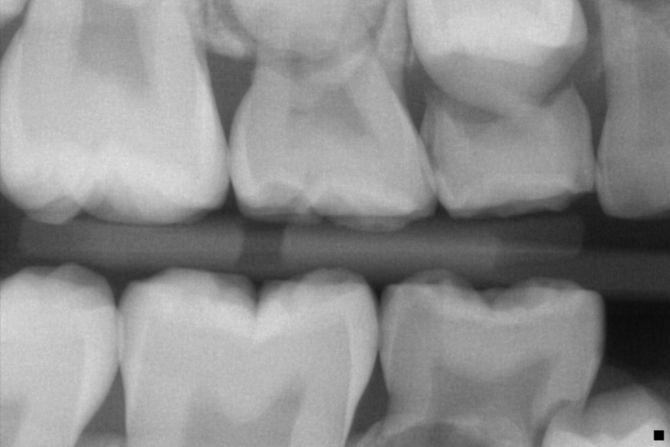
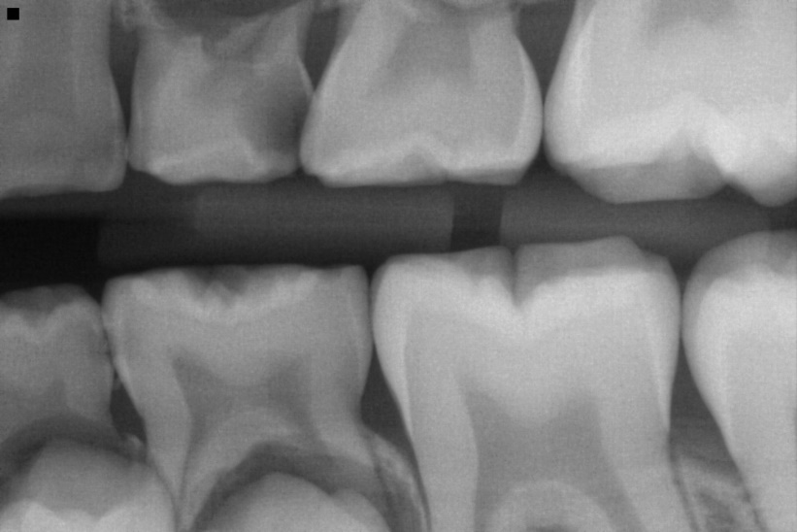
One Content
Clinical Case: 11-Year-Old Brother
Optional Subhead
This is an example of how body copy should be treated in template. Starting body copy will default to Arial 24pt font. Keep the messaging clear, concise and to the point. Text can be sized up or down as the need should arise, but the best bet is to keep primary copy at this size.
  First level bullet
    Second level bullet
      Third level bullet
        Fourth level bullet
Notes:
This is their 11-year-old brother. He has more advanced lesions, since he has been in the environment longer than his siblings. He drinks orange juice all day long and mainly eats chicken fingers.
His age made it a challenge to create behavior changes right away, so no food substitutions were given at first. The first recommendation was for him to “leave the foam alone.”
His salivary diagnostic results (not pictured) indicate he has a high level of cariogenic bacteria, moderate acidity levels, and low buffer capacity. He did not want to brush his teeth, so he had severe gingivitis, which results in the high level of blood leukocytes and proteins. He also has high ammonia levels.

Slide 31
One Content
Clinical Case: Older Family
Optional Subhead
This is an example of how body copy should be treated in template. Starting body copy will default to Arial 24pt font. Keep the messaging clear, concise and to the point. Text can be sized up or down as the need should arise, but the best bet is to keep primary copy at this size.
  First level bullet
    Second level bullet
      Third level bullet
        Fourth level bullet
Notes:
Next, we will examine involve a family with older children.

Slide 32
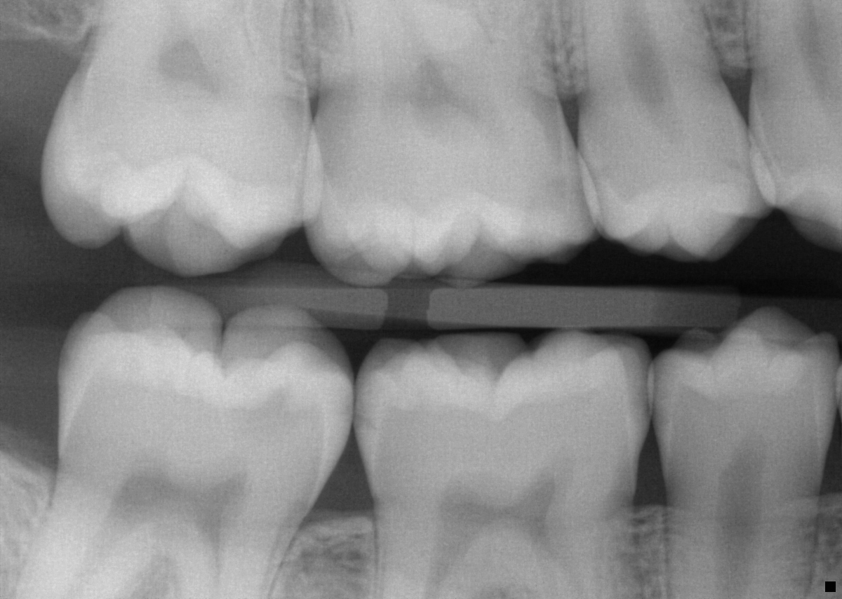
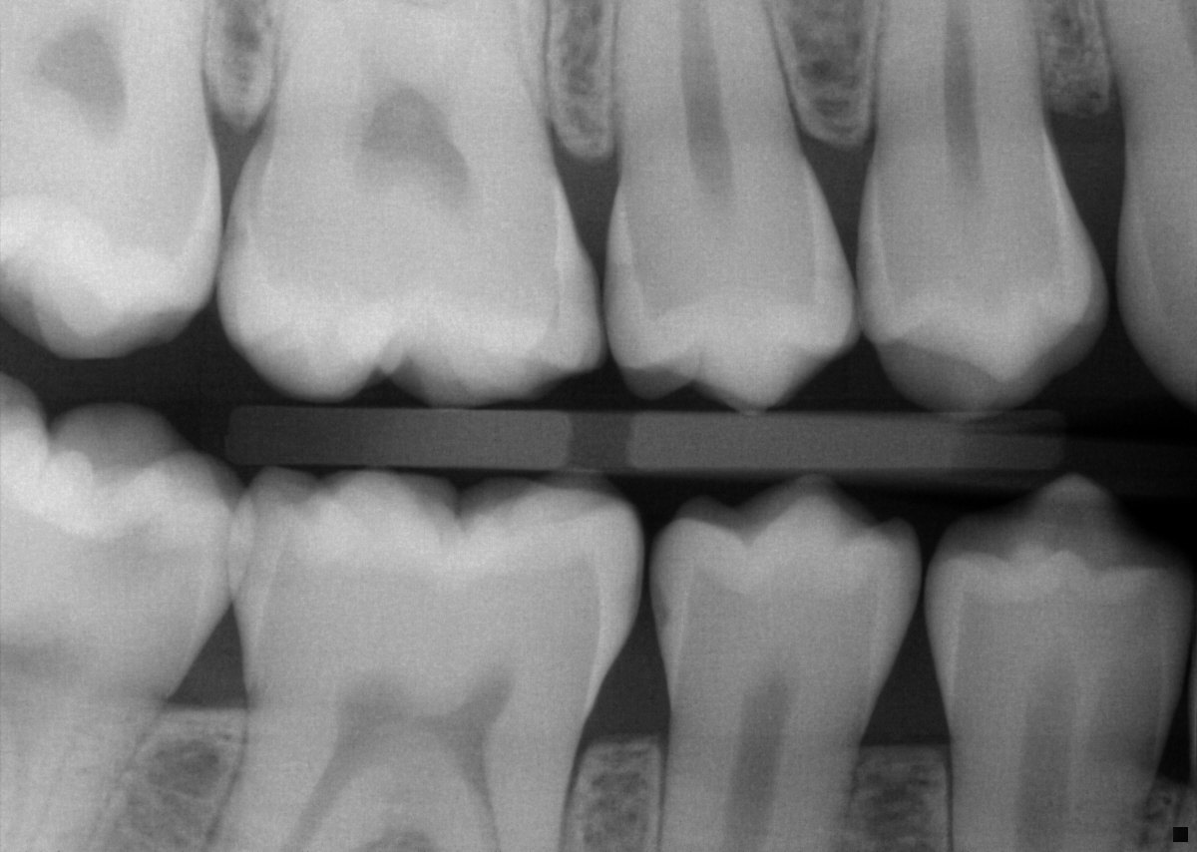
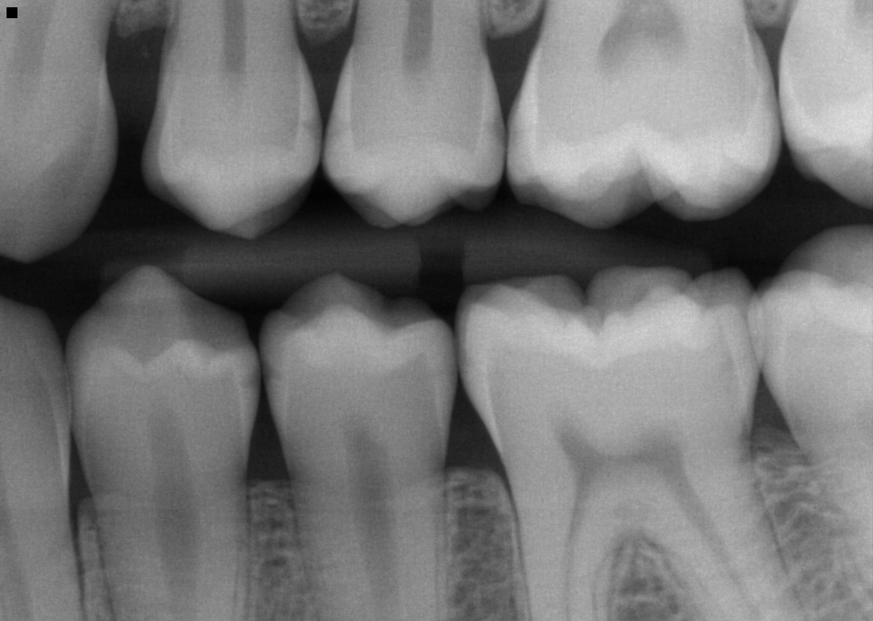
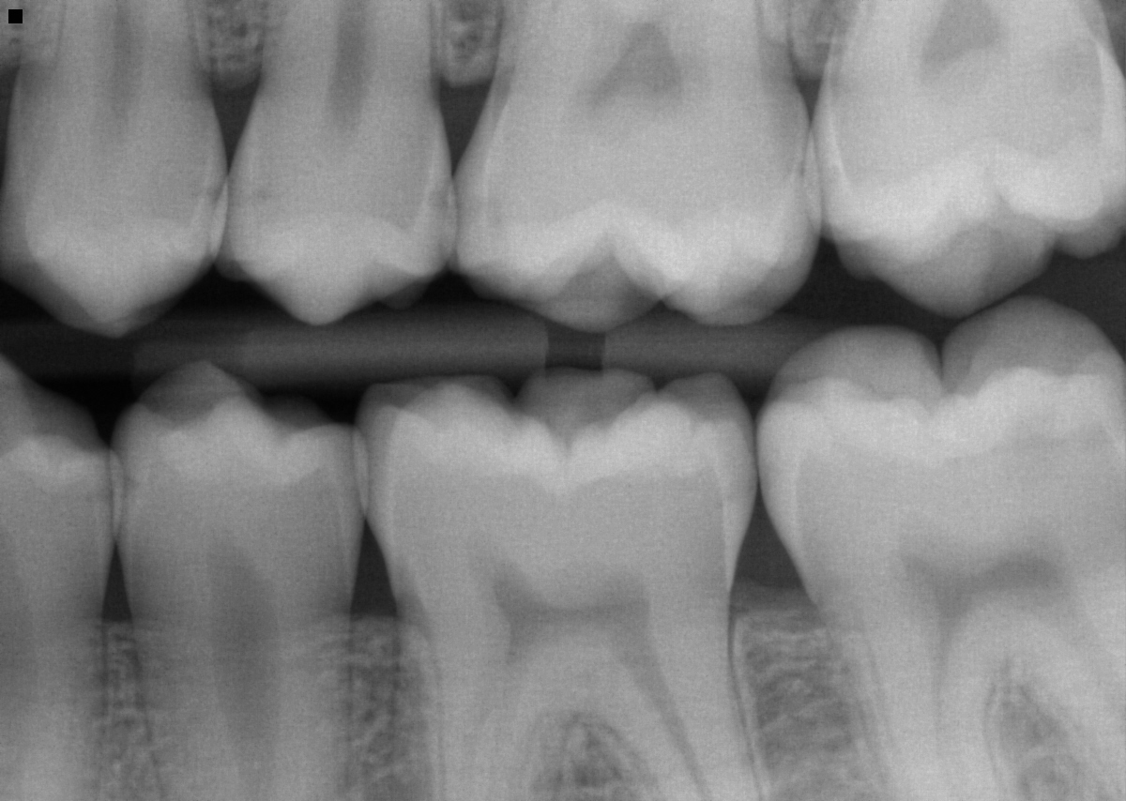
One Content
Clinical Case: 21-Year-Old Brother
Optional Subhead
This is an example of how body copy should be treated in template. Starting body copy will default to Arial 24pt font. Keep the messaging clear, concise and to the point. Text can be sized up or down as the need should arise, but the best bet is to keep primary copy at this size.
  First level bullet
    Second level bullet
      Third level bullet
        Fourth level bullet
Notes:
The patient is currently in high school and participates in football. They are planning to apply to college, aiming for either a philosophy program or a seminary.
Upon reviewing the medical history, it was noted that the patient experiences seasonal asthma and frequently uses inhalers. As a recommendation, it was advised to rinse their mouth after using the inhaler to mitigate any potential adverse effects.
Regarding the findings from the examination:
There are incipient lesions present on teeth #2, #3, #4, #5, #12, #13, #14, #15, #18, #19, #20, #21, #29, and #30.
Staining is observed on the occlusal surfaces of teeth #2, #14, #15, #18, #19, and #30.
Teeth #8 and #9 exhibit caries extending into dentin.
Moderate caries into dentin are noted on teeth #3 and #31.
For dental care products, it was recommended to use baking soda toothpaste and incorporate xylitol into sports bottles.
Two months later, upon reevaluation of the medical history, the patient reported no changes. They have discontinued the consumption of seltzer and soda, opting for water instead. However, they are encountering difficulty with nighttime brushing. To address this, it was suggested that they use topical tooth crème containing calcium and phosphate before bedtime if they happen to forget brushing.

Slide 33
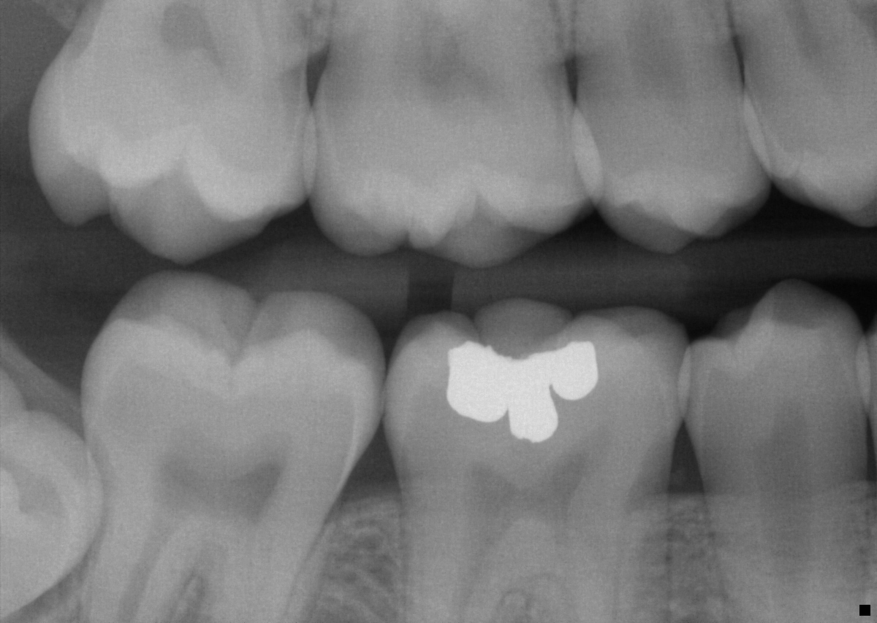
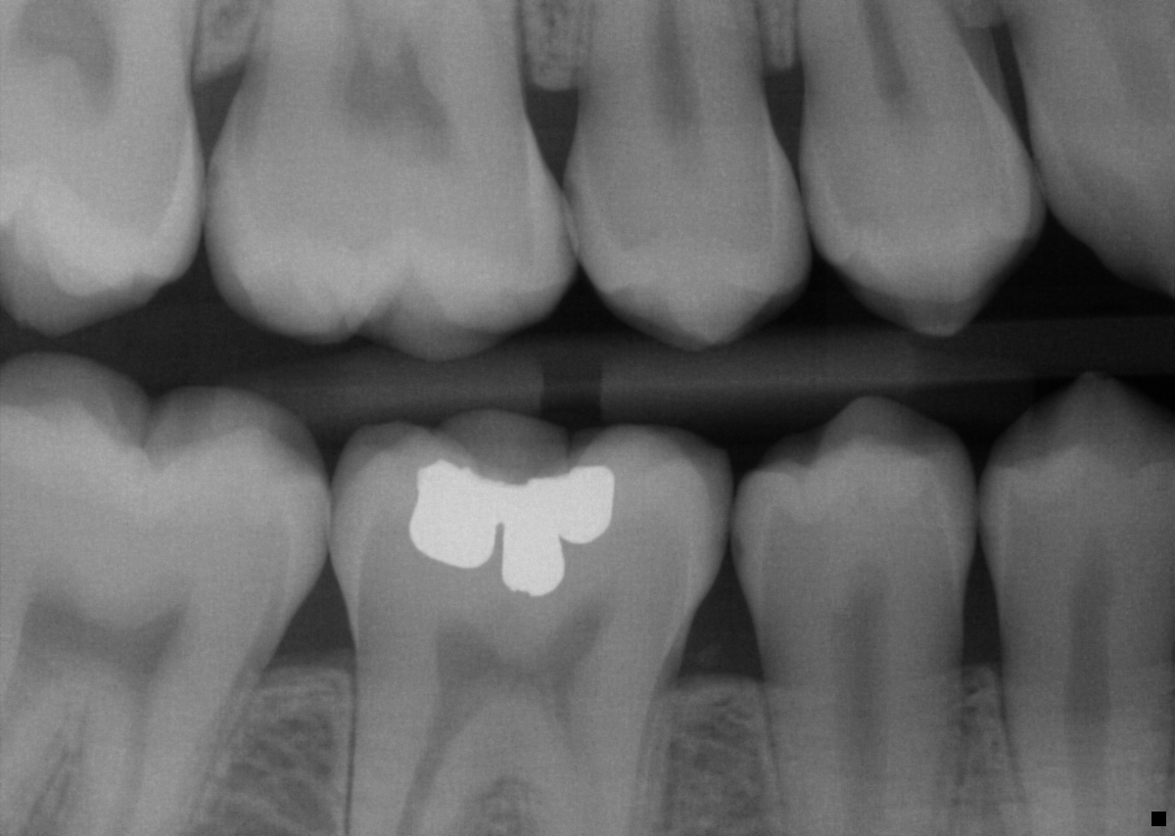
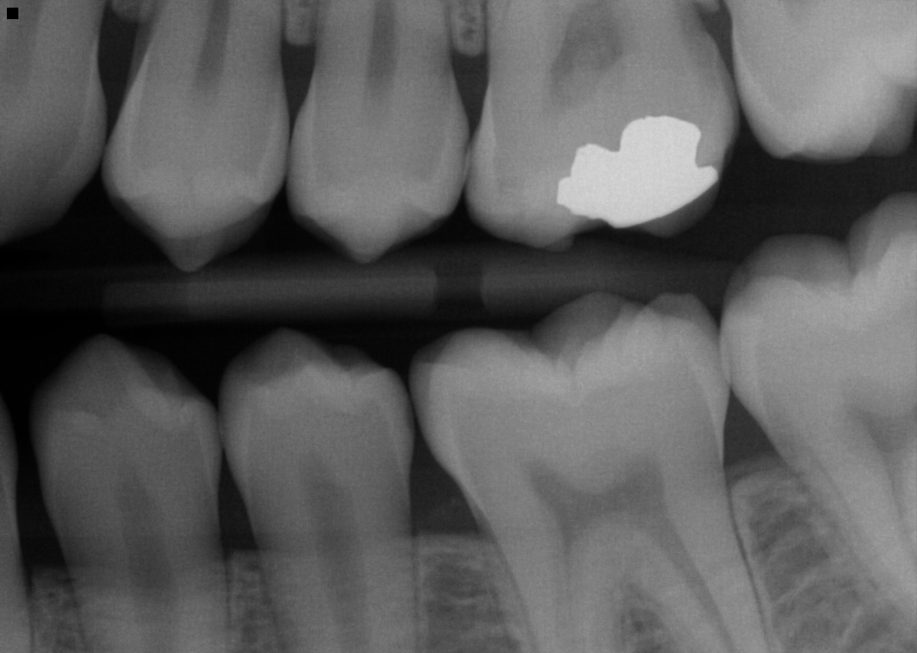
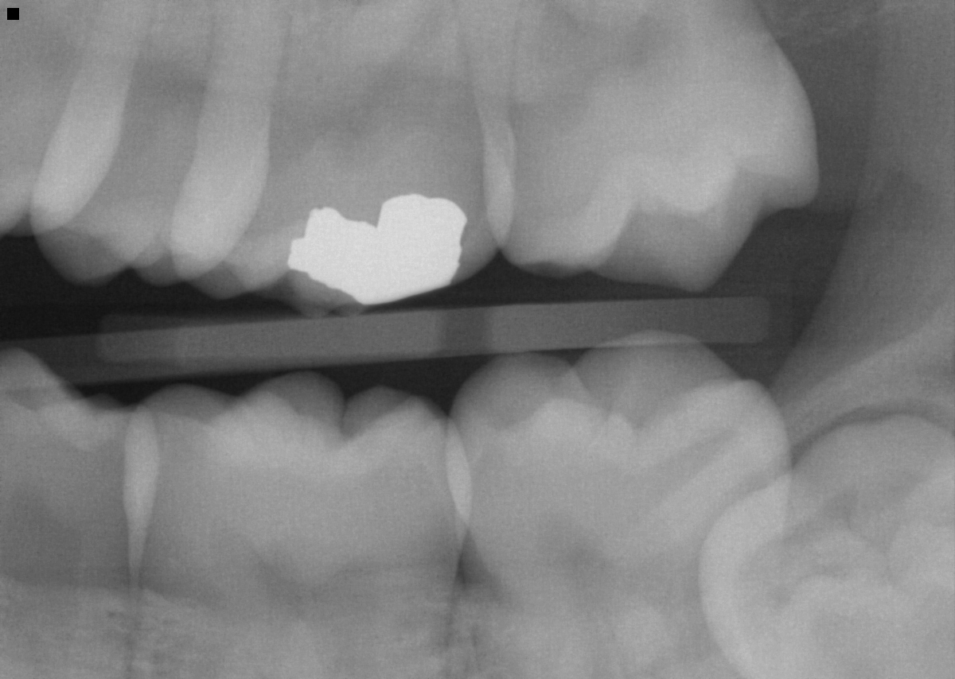
One Content
Clinical Case: 19-Year-Old Brother
Optional Subhead
This is an example of how body copy should be treated in template. Starting body copy will default to Arial 24pt font. Keep the messaging clear, concise and to the point. Text can be sized up or down as the need should arise, but the best bet is to keep primary copy at this size.
  First level bullet
    Second level bullet
      Third level bullet
        Fourth level bullet
Notes:
The patient, currently a math major at University of Massachusetts Boston, is navigating the challenges of balancing oral hygiene with their busy college schedule.
Upon examination, the following findings were noted:
Incipient lesions are present on teeth #4, #5, #28, and #29.
Staining is observed on the occlusal surfaces of teeth #2, #3, #14, #15, #18, #19, #30, and #31.
The third molars are impacted, making them difficult to clean effectively.
As for recommended dental products, the patient was advised to use baking soda toothpaste and non-alcohol mouthwash with xylitol, which ultimately resulted in an addition to the Modified Reitan’s Criteria (MRC) scale.
Two months later, during a follow-up discussion about the patient's home care routine, it was noted that while they have increased their frequency of brushing, they continue to struggle with maintaining a consistent routine. Additionally, heavy biofilm and inflamed gingiva were observed. Reviewing the patient’s daily schedule for school revealed that they wake up early and are out until late evening, often eating meals outside. Despite their efforts to improve their brushing habits, the patient still encountered difficulties. However, trying LivFresh toothpaste and practicing brushing techniques together proved to be beneficial.
Six months later, the patient's current home care routine involves brushing with Livionex toothpaste several times a week and using "regular fluoridated toothpaste" for brushing. They also rinse with non-alcohol mouthwash with xylitol daily.

Slide 34
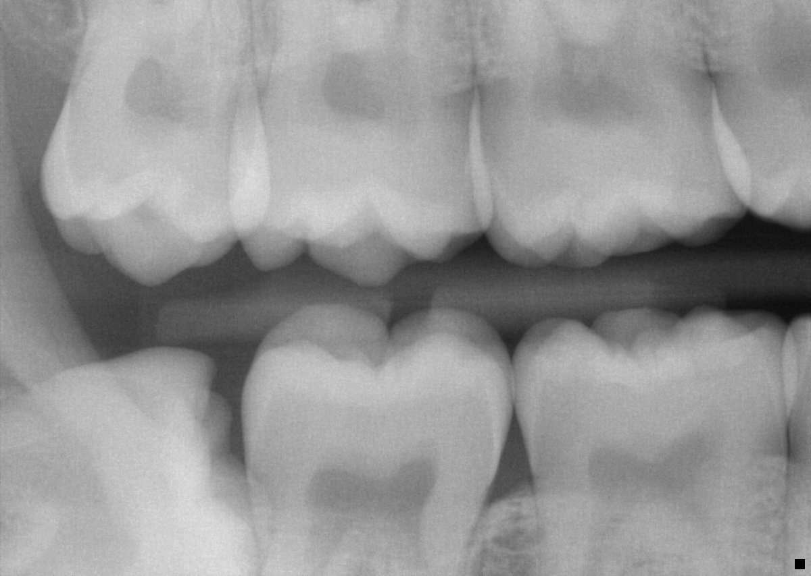
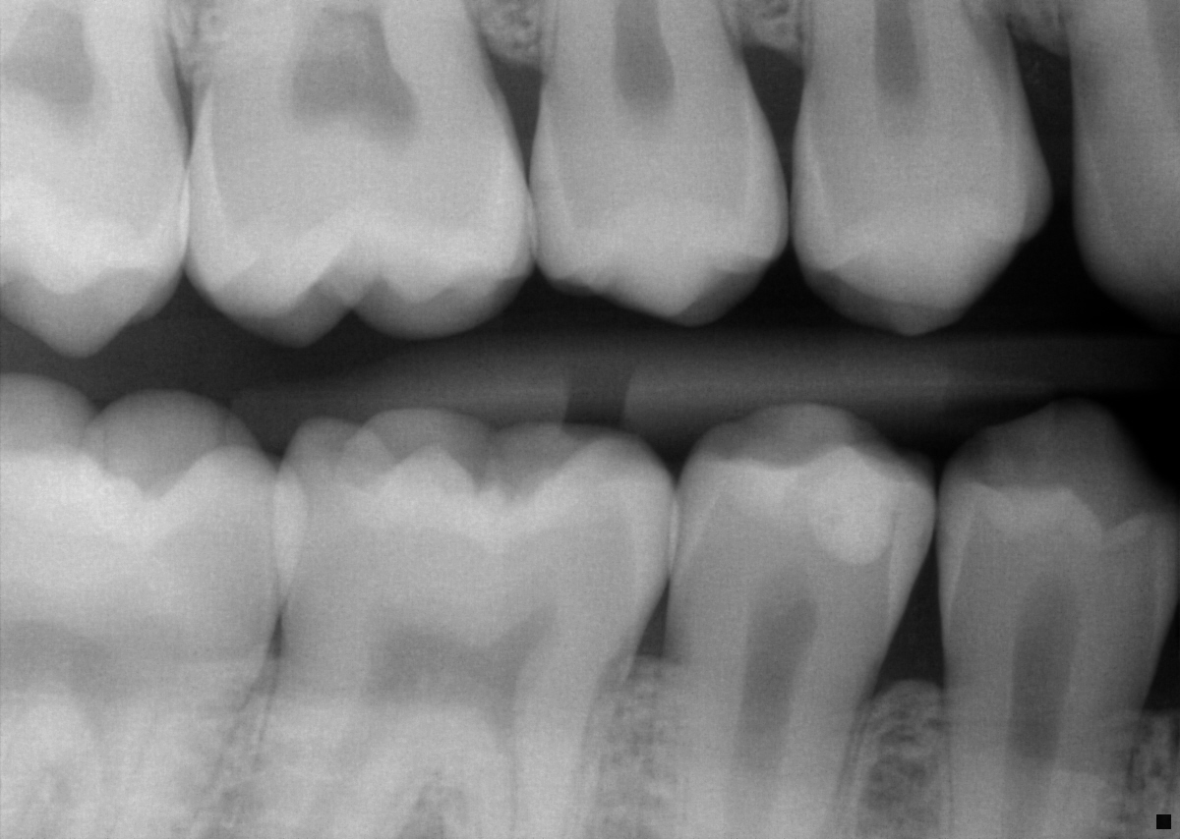
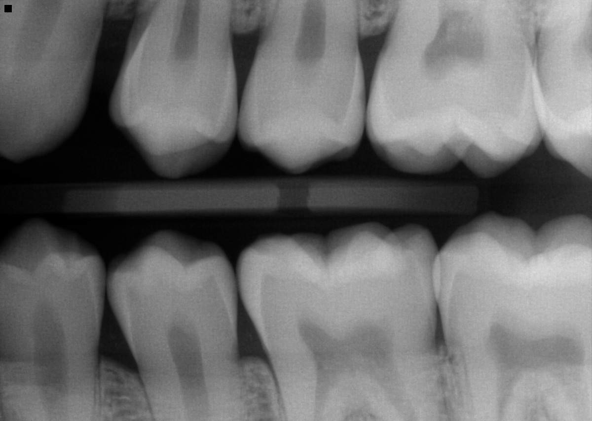
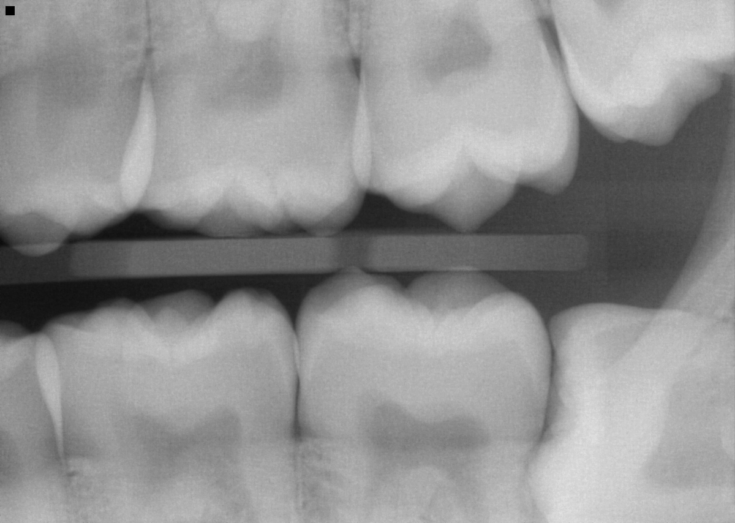
One Content
Clinical Case: 16-Year-Old Brother
Optional Subhead
This is an example of how body copy should be treated in template. Starting body copy will default to Arial 24pt font. Keep the messaging clear, concise and to the point. Text can be sized up or down as the need should arise, but the best bet is to keep primary copy at this size.
  First level bullet
    Second level bullet
      Third level bullet
        Fourth level bullet
Notes:
The patient, accompanied by his mother, shared information about his lifestyle habits, noting that he is actively engaged in swimming, drama, and choir activities at high school. He has a lot fewer lesions than his older brother did.
Upon reviewing the medical history, it was reported that the patient has no medical complications, allergies, or medications.
During the examination, the following findings were noted:
Initial incipient lesions are present on teeth #3, #4, #5, #28, and #29.
Deep occlusal surfaces are observed on teeth #18, #19, and #31.
Tooth #30 has an amalgam filling with leaking margins.
As part of the recommended dental care regimen, the patient was advised to use baking soda toothpaste and make dietary changes. Nutritional counseling was also reviewed with the patient.

Slide 35

Goal
Setting
Notes:
When we discuss goal setting, it pertains to families because we are addressing transmission within a familial context.

Slide 36

One Content
Shared Decision-Making: Goal Setting with Families
Optional Subhead
This is an example of how body copy should be treated in template. Starting body copy will default to Arial 24pt font. Keep the messaging clear, concise and to the point. Text can be sized up or down as the need should arise, but the best bet is to keep primary copy at this size.
  First level bullet
    Second level bullet
      Third level bullet
        Fourth level bullet
Ask the family what oral health goals feel realistic for them.
Encourage each child to choose a personal goal.
Identify one shared family goal.
Discuss recommended products and consider allergies or sensitivities.
Notes:
When setting goals with families, it’s important to have each child set their own goals. In addition to individual goals, think about establishing a collective goal for the entire family, such as reducing the purchase of juice from six gallons to just one. Encourage the whole family to use the recommended products while considering any allergies.

Slide 37

One Content
Shared Decision-Making: Individual Roles
Optional Subhead
This is an example of how body copy should be treated in template. Starting body copy will default to Arial 24pt font. Keep the messaging clear, concise and to the point. Text can be sized up or down as the need should arise, but the best bet is to keep primary copy at this size.
  First level bullet
    Second level bullet
      Third level bullet
        Fourth level bullet
Work with the family to assign roles that support the shared goal.
Encourage children to take age-appropriate responsibilities.
Use positive reinforcement to support participation.
Notes:
Ask the family how each person could help support the shared goal.
Children can take age-appropriate roles that make them part of the process.
Many families respond well to simple reward systems, similar to a chore chart where children earn recognition for completing tasks.
For example, a child who sets the table might help remind the family to drink water instead of juice at dinner.
This approach supports teamwork and helps distribute responsibility rather than placing the full burden on the parent.

Slide 38

One Content
Shared Decision-Making: Environmental Changes
Optional Subhead
This is an example of how body copy should be treated in template. Starting body copy will default to Arial 24pt font. Keep the messaging clear, concise and to the point. Text can be sized up or down as the need should arise, but the best bet is to keep primary copy at this size.
  First level bullet
    Second level bullet
      Third level bullet
        Fourth level bullet
Discuss what foods and drinks are commonly kept in the home.
Explore possible substitutions together.
Identify changes that feel realistic for the family.
Notes:
Environmental changes often depend on what foods and beverages are available in the home. Engage parents in a conversation about grocery purchasing and household routines. Ask what options might work for them and discuss possible substitutions, such as replacing sugary beverages with water or milk. The goal is to identify changes that the family feels confident they can maintain.

Slide 39
Wrap Up
Oral bacteria can be shared between individuals through saliva contact within families and close social environments.
Vertical transmission occurs when caregivers transfer oral bacteria to children, often after tooth eruption when teeth provide surfaces for bacterial colonization.
Horizontal transmission occurs between individuals of the same generation, such as siblings, playmates, or peers.
Dental caries develops when environmental conditions shift the oral biofilm toward acid-producing bacteria.
The Fisher-Owens conceptual model highlights the multiple influences on children’s oral health, including family behaviors, environmental factors, and community conditions.
Notes:
In summary, we've explored the transmission of caries-causing bacteria, noting horizontal spread among family, friends, and caregivers, while vertical transmission from mother to child during pregnancy and breastfeeding establishes oral microbiome susceptibility. The Fisher-Owens conceptual model highlights various influences on children’s oral health, including family dynamics and environmental factors. When setting goals with families, individual and collective aims should be considered, fostering shared responsibility and involvement. Lastly, addressing environmental change requires collaboration with parents to explore feasible substitutions and alternatives in household products.

Slide 40
CareQuest for Dental Education on Caries
To continue learning, explore our other sessions:
Session 1: Understanding Caries
Session 2: Caries Disease Process
Session 3: Caries Transmission
Session 4: Foundations of Caries Risk Assessment
Session 5: Applying Caries Risk Assessment to Guide Management Activity
Session 6: Apply Prevention Strategies
Session 7: CAMBRA Protocol Activity
Session 8: Saliva in Health: Part 1
Session 9: Saliva in Health: Part 2
Session 10: Saliva in Disease – Stroke and Heart Disease
Session 11: Saliva in Disease – Asthma and Allergic Rhinitis

