Slide 1
Caries Disease Process
Notes:
In this session, we will discuss the role of substrates such as carbohydrates and bacteria in the development of dental caries, emphasizing the significance of fluoride, calcium, and phosphate in fortifying teeth and saliva for prevention. We will further explore the nuances of plaque formation, microbiome disruption, and the consequential effects of acidic environments on demineralization processes.

Slide 2
Learning Objectives
Explain how biofilm metabolism of fermentable carbohydrates leads to acid production and repeated pH fluctuations.
Describe how diffusion and critical pH contribute to subsurface enamel demineralization.
Differentiate between demineralization and remineralization at the crystal level, including the role of fluoride in reducing enamel solubility.
Relate microscopic changes in enamel to clinical presentation, including white spot lesions and D1–D4 classification.
Describe how shifts in biofilm composition contribute to lesion initiation and progression.
Notes:
Our goals for this session are to achieve the following learning objectives: [Read slide]

Slide 3
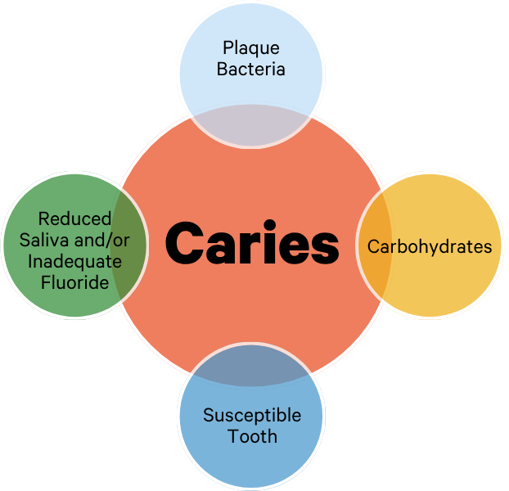
One Content
Caries: A Biofilm-Mediated Process
Optional Subhead
This is an example of how body copy should be treated in template. Starting body copy will default to Arial 24pt font. Keep the messaging clear, concise and to the point. Text can be sized up or down as the need should arise, but the best bet is to keep primary copy at this size.
  First level bullet
    Second level bullet
      Third level bullet
        Fourth level bullet
Biofilm bacteria metabolize carbohydrates.
Acid production lowers pH below the critical threshold.
Demineralization occurs when mineral loss exceeds remineralization.
Conditions Mechanisms
Notes:
Dental caries requires specific conditions: biofilm bacteria, fermentable carbohydrates, a susceptible tooth surface, and inadequate protective factors such as saliva and fluoride. However, these elements alone do not create a lesion. What drives disease is the mechanism. When biofilm bacteria metabolize carbohydrates, they produce acids. These acids lower the pH below the critical threshold, increasing enamel solubility. If repeated acid challenges cause mineral loss to exceed mineral repair, net demineralization occurs over time, and a clinical lesion develops.

Slide 4
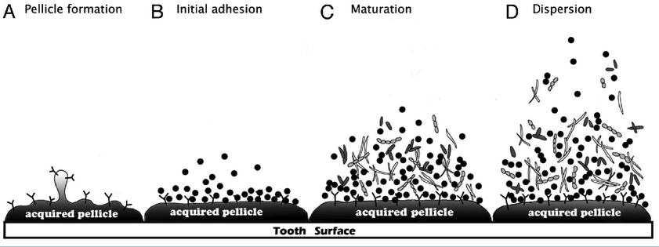
Plaque Formation – Pellicle Layer
Ruijie Huang, Mingyun Li, and Richard L. Gregory, “Bacterial interactions in dental biofilm,” Virulence, 2(5), 435–444 (2011), https://doi.org/10.4161/viru.2.5.16140.
Notes:
This diagram represents each step of oral biofilm formation.
(A) Pellicle formation: When glycoproteins found in saliva attach to a clean tooth surface, a thin film develops, termed the acquired pellicle. Once a tooth is cleaned, the acquired pellicle forms within 20 minutes.
(B) Initial adhesion: Initial colonizers, aka pioneer bacteria, naturally found in the mouth recognize the binding sites of proteins present in the acquired pellicle and attach to them. This process occurs within hours and the adhesion is reversible.
The first step to dental plaque (biofilm) formation is bacterial adherence to the proteinaceous salivary film on the surface of clean teeth by cocci bacteria. Within 12 hours, these pioneer bacteria begin to multiply, and by 24 hours microcolonies have formed. When left undisturbed, these colonies continue to grow and mature, eventually leading to the formation of dental plaque, which is the rough, almost furry coating you can feel on your teeth after an extended period of not brushing. The composition, thickness, and rate of growth of this dental plaque varies by individual.
(C) Maturation: Different bacterial species co-aggregate into micro-colonies depending on resource requirements. Therefore, different levels of the biofilm have different bacterial species.
(D) Dispersion: Bacteria disperse from the biofilm surface and spread to colonize a new site in the oral cavity. The formation of the acquired pellicle and subsequent biofilm formation and maturation are not restricted to one tooth/ surface. In short, the plaque bacteria would not be able to grow on the tooth surface without the presence of the acquired pellicle.
Summary: Plaque development initiates with the formation of a pellicle, a natural coating on the teeth where bacteria can attach. Managing the microbiome is key to prevent the survival of harmful pathogens in acidic conditions. The progression of plaque involves initial adhesion, maturation, and dispersion, resulting in a more intricate and diverse microbial environment, regardless of the acidity levels. Unlike the previous assumption that plaque inevitably leads to disease, certain individuals, such as older adults or special care patients with significant plaque accumulation, ample calcium and phosphate, and healthy saliva, may not experience tooth decay. However, the presence of an acidic environment can indeed contribute to the development of caries.
Reference: Ruijie Huang, Mingyun Li, and Richard L. Gregory, “Bacterial interactions in dental biofilm,” Virulence, 2(5), 435–444 (2011), https://doi.org/10.4161/viru.2.5.16140.

Slide 5
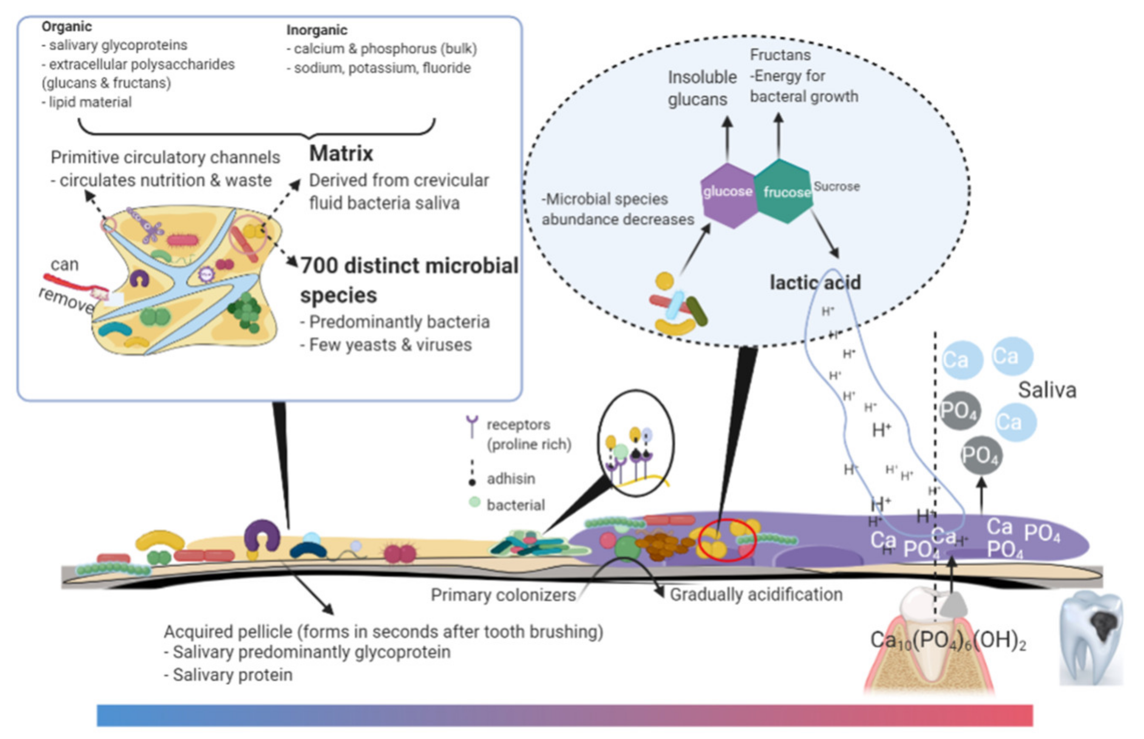
One Content
Dental Biofilm
Optional Subhead
This is an example of how body copy should be treated in template. Starting body copy will default to Arial 24pt font. Keep the messaging clear, concise and to the point. Text can be sized up or down as the need should arise, but the best bet is to keep primary copy at this size.
  First level bullet
    Second level bullet
      Third level bullet
        Fourth level bullet
Xiuqin Chen, Eric Banan-Mwine Daliri, Akanksha Tyagi, and Deog-Hwan Oh, “Cariogenic Biofilm: Pathology-Related Phenotypes and Targeted Therapy,” Microorganisms, 9(6):1311 (2011), https://doi.org/10.3390/microorganisms9061311.
Notes:
Dental biofilm is a microbial community living on a tooth surface.
Ninety-five percent of bacteria in nature exist in a biofilm. Biofilms form on moist surfaces, especially those rich in nutrients. The purpose of the biofilm is to allow bacteria to adhere to a surface and multiply. Throughout a biofilm there are different layers which contain varying levels of nutrients, pH and oxygen, thus making them more suitable for specific bacteria to adapt and survive. These are termed micro-colonies. Gene regulation allows this adaptation to occur. Between these micro-colonies are fluid channels which allow the passage of nutrients. Think of these channels as a type of circulatory system for the biofilm.
Within the biofilm, there exist both organic and inorganic components. The organic materials consist of proteins, polysaccharides, and lipids, while the inorganic elements include calcium, phosphate, sodium, potassium, and fluoride. These essential ions facilitate the remineralization of the tooth structure through a complex network that allows materials from saliva, like calcium and phosphate, to reach the tooth's surface. This surface serves as a platform for primary colonizers, housing a diverse range of approximately 700 microbial species, predominantly bacteria. Notably, in cases of severe lesions, fungi have been found in addition to bacteria. As the plaque persists, the localized bacterial metabolism of ingested carbohydrates leads to the acidification of the surrounding area, promoting the growth of acidogenic bacteria and contributing to the expansion of the plaque. This continuous process of acidification leads to demineralization, creating an environment conducive to the proliferation of acid-tolerant bacteria. Disrupting the biofilm and its bacterial composition prevents such acidification.
The metabolic processes of glucose and fructose give rise to sucrose, with glucose leading to the formation of insoluble glucans, and fructose providing energy for bacterial growth, consequently generating lactic acid, which accelerates the demineralization process and ultimately leads to caries.
Reference: Xiuqin Chen, Eric Banan-Mwine Daliri, Akanksha Tyagi, and Deog-Hwan Oh, “Cariogenic Biofilm: Pathology-Related Phenotypes and Targeted Therapy,” Microorganisms, 9(6):1311 (2011), https://doi.org/10.3390/microorganisms9061311.

Slide 6

Mutans Streptococci
  Why are some “heavily loaded” with mutans streptococci? Not completely sure, but may be due to:
    Diet, particularly high in sugar
    Irregularities in enamel surfaces and other retention sides
    Heavy colonization of other family members
    Genetic and immunological factors
Notes:
Some teeth are more susceptible to caries due to several possible factors. These may include dietary habits, especially sugar consumption, as well as irregularities in enamel surfaces. Other retention sites like pits and fissures can also contribute to increased vulnerability. Heavy colonization by cariogenic bacteria among other family members, often through the sharing of utensils, can lead to heightened transmission of these bacteria. Additionally, genetic and immunological factors might play a role in determining the susceptibility of certain individuals.

Slide 7
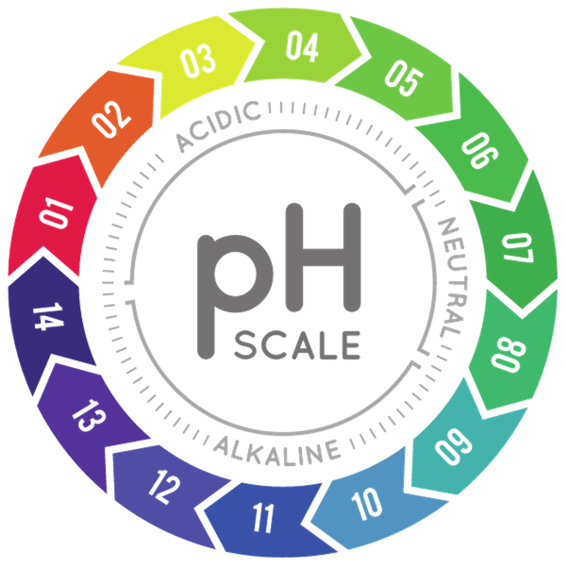
Why Are Mutans Streptococci (MS) Cariogenic?
  Acidogenic
    Produce acids that can dissolve the tooth
  Aciduric
    Can survive in a lower pH environment
  Produce extracellular glucans
    Can adhere to the tooth surface
  Transport sugar
Notes:
The primary culprit behind caries are the mutans streptococci, highly adaptable bacteria thriving in acidic conditions. These acidogenic microbes generate acids capable of dissolving tooth structures and can persist in low pH environments, known as aciduric conditions. They have the capability to produce extracellular glucans, acting like an adhesive or glue, enabling them to firmly attach to various surfaces, including the tooth. They actively participate in the transportation of sugars within their environment.

Slide 8
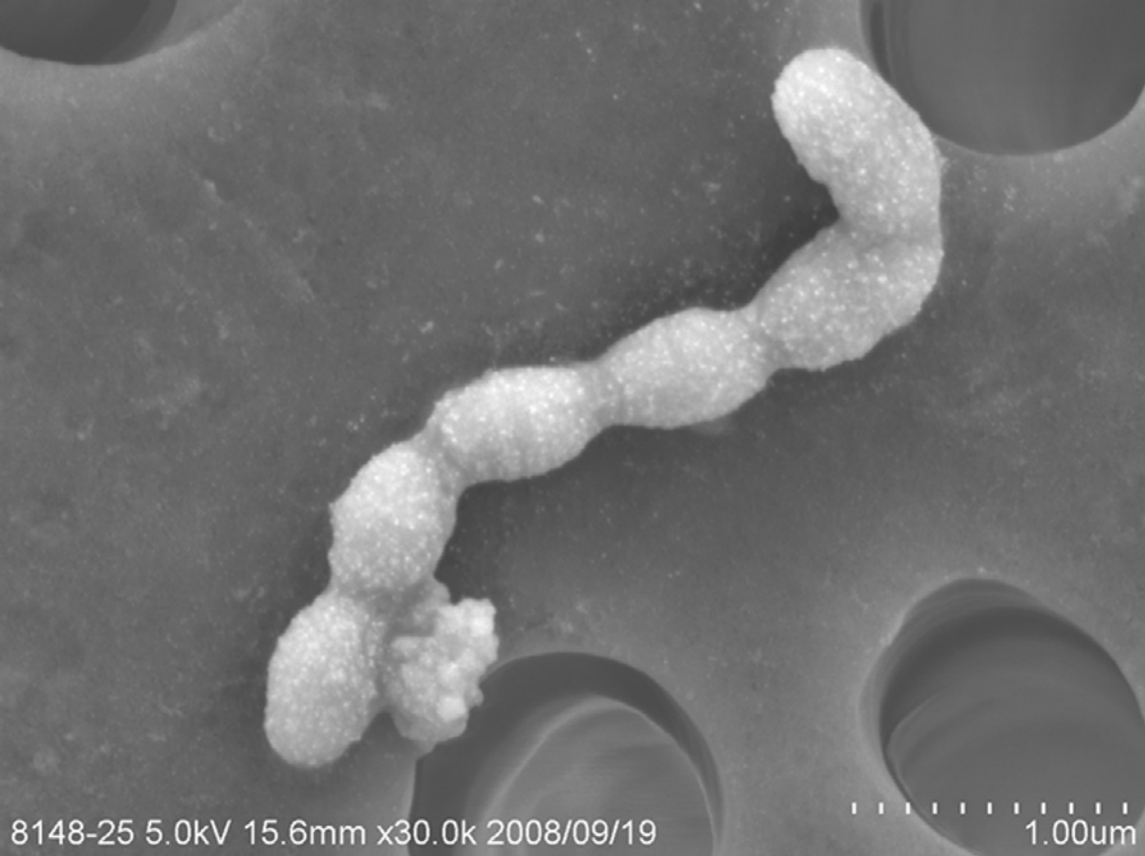
Bacterial Nature of Caries
  Primary cariogenic bacteria
    Mutans streptococci in humans (MS)
      Streptococcus mutans – most common
      Streptococcus sobrinus
      Streptococcus crecitus
    Lactobacilli
    Others
Image: Michiyo Matsumoto-Nakano, ”Dental Caries,” Reference Module in Biomedical Sciences, (2014), https://doi.org/10.1016/B978-0-12-801238-3.00001-5.
Notes:
Caries is predominantly influenced by specific cariogenic bacteria. These include mutans streptococci in humans, with Streptococcus mutans being the most prevalent, along with Streptococcus sobrinus and Streptococcus crecitus. Additionally, lactobacilli and various types of candida contribute to the decay process.
Image: Michiyo Matsumoto-Nakano, ”Dental Caries,” Reference Module in Biomedical Sciences, (2014), https://doi.org/10.1016/B978-0-12-801238-3.00001-5.

Slide 9
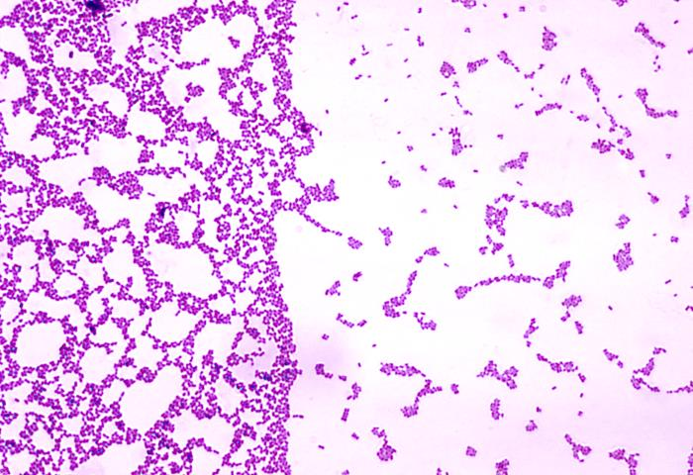
Mutans Streptococci Characteristics
Streptococcus mutans culture showing active cell divisions.
Sucrose leads to extracellular polysaccharides that stick the plaque together.
This Gram-stained photomicrograph revealed the presence of a number of round, Gram- positive, Streptococcus mutans bacteria.
Image: Public Health Image Library(PHIL), (1975), https://phil.cdc.gov/Details.aspx?pid=1070.
Notes:
Here is a visual representation of Streptococcus mutans, displaying its active cell division, resembling a bubbly, foamy structure. As it produces polysaccharides or glucans, they intertwine, acting as a binding agent, similar to glue, cementing the plaque together.
Image: Public Health Image Library(PHIL), (1975), https://phil.cdc.gov/Details.aspx?pid=1070.
‌
‌

Slide 10

Acid producing bacteria are usually less than 1% of the total flora in the plaque.
Notes:
The activity of acid-producing bacteria depends on the presence of active lesions. If a high bacterial challenge and active lesions are present, the likelihood of a higher abundance of mutans streptococci increases. Typically, acid-producing bacteria constitute less than 1% of the entire plaque flora but are major predictors of disease.

Slide 11
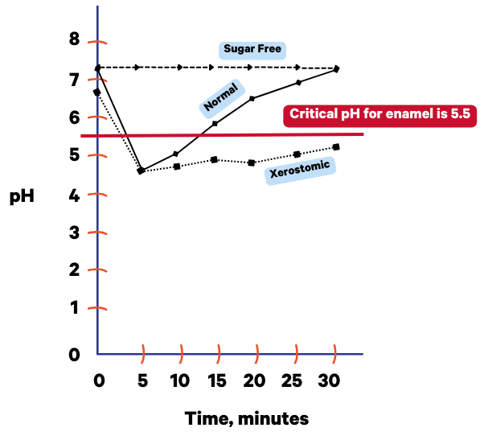
pH in dental plaque after a one-minute rinse with 10% sucrose. Sugar-free gum is shown for comparison.
Notes:
After a one-minute rinse with 10% sucrose, the pH in dental plaque is compared to that after using sugar-free gum. This graph, referred to as the Stephan curve, demonstrates how in a healthy individual at rest, the pH remains at 7 due to the presence of saliva. When considering the example of consuming a muffin, the pH drops to approximately 4.5, prompting the body to utilize sodium bicarbonate along with several other peptides and proteins for buffering. At about 30 minutes, the pH should ideally return to 7. However, if the patient has limited saliva production due to a medical condition or medication, achieving a pH of 5.5 within 30 minutes might be challenging. It could take such patients around an hour and 45 minutes to restore a neutral pH, and they might require additional assistance to improve their buffering capacity.

Slide 12
What type of sugar?
Carbohydrates
Sugars
Starch
Dietary Fiber
Intrinsic Sugars
Ex: sugars in whole fruit
Extrinsic Sugars
Milk Sugars
Free Sugars
Added by consumer
Ex: sugar added to tea and coffee, or during cooking including honey
Added to foods and drinks by manufacturer or caterer
Ex: sugar or honey added to products during production
Fruit juice smoothies, pulps
Chart modified from: Chuen Albert Yeung and Ashley Goodfellow, ”The Truth about Sugar,” Dental Update, pp. 507-512 (2015), https://www.researchgate.net/publication/282823209_The_truth_about_sugar.
Notes:
What kind of sugar is it? There exist various types of carbohydrates, including sugars, starches, and dietary fibers. Within the category of sugars, there are intrinsic sugars, such as those naturally found in an apple, and extrinsic sugars, like those present in milk or the free sugars added by individuals.
Chart modified from: Chuen Albert Yeung and Ashley Goodfellow, ”The Truth about Sugar,” Dental Update, pp. 507-512 (2015), https://www.researchgate.net/publication/282823209_The_truth_about_sugar.

Slide 13
Diffusion
The caries process is diffusion-controlled
  Acid produced by bacteria in the plaque diffuses rapidly through the plaque and into the enamel or dentin, traveling among the crystals.
  After demineralization, the dissolved calcium and phosphate each diffuse out to the plaque.
  Diffusion occurs from a high concentration to a lower concentration.
Notes:
The caries process is controlled by diffusion. Acid, produced by plaque bacteria, quickly diffuses through the plaque and reaches the enamel or dentin, moving within the crystal structure. Following demineralization, both dissolved calcium and phosphate diffuse out into the plaque. This diffusion occurs from regions of higher concentration to those of lower concentration.

Slide 14

Bacterial Nature of Caries
Biofilm composition shifts as the environment becomes more acidic.
  Mutans streptococci associated with…
    Early demineralization
      Levels of mutans in a white spot lesion are 10–100 times higher than an adjacent sound enamel.
  Lactobacilli associated with…
    Lesion progression and cavitation
Notes:
An increased presence of streptococci is linked to the initial stages of demineralization. Mutans streptococci are known to contribute to early demineralization. Levels of mutans in a white spot lesion can be 10–100 times higher compared to an adjacent sound enamel. The prevalence of lactobacilli is associated with the progression of lesions meaning deeper cavities and eventual cavitation, often leading to the rapid progression of caries.

Slide 15
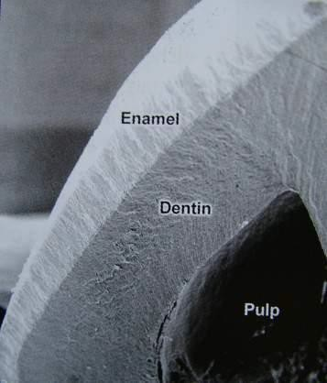
A Susceptible Tooth
 | Enamel | Dentin | Cementum
Mineral | 95% | 55% | 45%
Organic | 4% | 30% | 55%
Water | 1% | 15% | 0%
Image: “Enamel: Composition, Formation, and Structure,” Pocket Dentistry, (January 5, 2015), https://pocketdentistry.com/7-enamel-composition-formation-and-structure/#:~:text=Fully%20formed%20enamel%20consists%20of.
Notes:
In a tooth, enamel is composed mainly (95%) of minerals. Dentin is 55% composed of minerals. While the demineralization of enamel is a slow process due to its high mineral count, once it reaches the comparatively less mineral-rich dentin, the progression of caries becomes considerably quicker.
Image: “Enamel: Composition, Formation, and Structure,” Pocket Dentistry, (January 5, 2015), https://pocketdentistry.com/7-enamel-composition-formation-and-structure/#:~:text=Fully%20formed%20enamel%20consists%20of.
‌

Slide 16
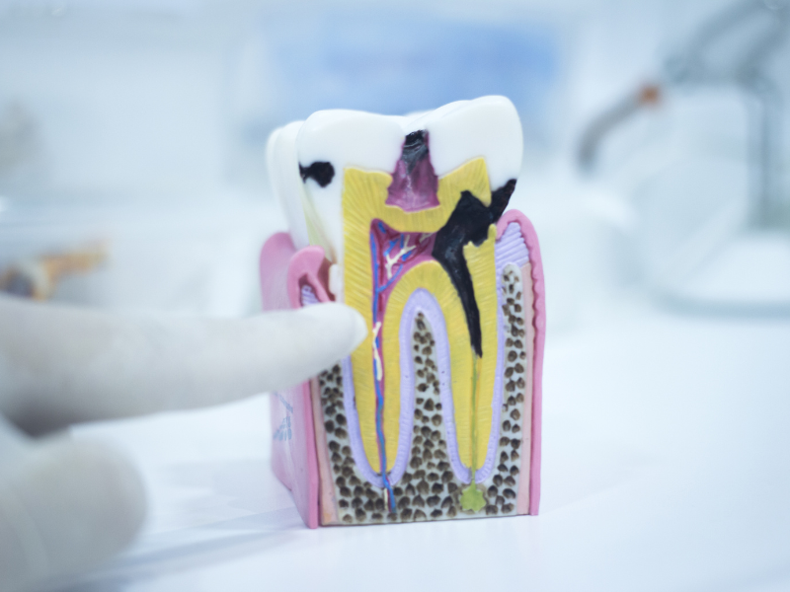
What Is Dental Enamel?
  It is a highly mineralized acellular tissue that consists of microscopic calcium phosphate crystals.
      99% dry weight
  Enamel crystals resemble the mineral hydroxyapatite.
  Solubility of hydroxyapatite affected by pH.
Notes:
This highly mineralized acellular tissue primarily comprises microscopic calcium phosphate crystals, constituting 99% of its dry weight. These crystals bear a resemblance to the mineral hydroxyapatite. The solubility of hydroxyapatite is influenced by the pH level. A lower pH leads to an increased dissolution of hydroxyapatite.

Slide 17
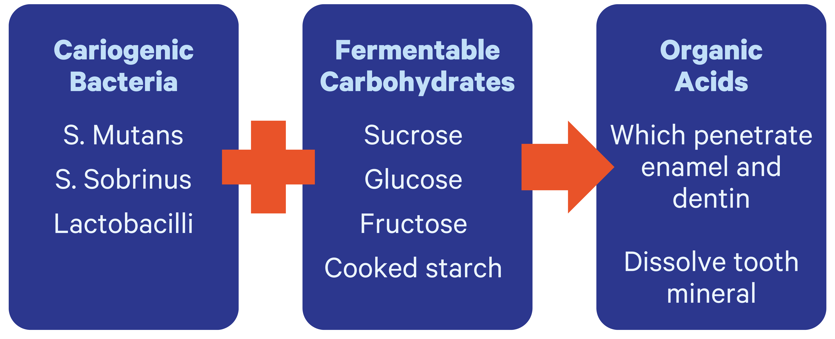
Demineralization: Step 1
Image modified from: John Featherstone, “Dental caries: A dynamic disease process,” Australian Dental Journal, 53(3), (2018) 286–291, https://doi.org/10.1111/j.1834-7819.2008.00064.x.
Notes:
The demineralization process is initiated by cariogenic bacteria like Streptococcus mutans, Streptococcus sobrinus, and lactobacilli. These bacteria, in conjunction with fermentable carbohydrates such as sucrose, glucose, fructose, and cooked starch, convert into organic acids. Subsequently, these organic acids infiltrate the enamel and dentin, leading to the dissolution of the tooth structure.
Image modified from: John Featherstone, “Dental caries: A dynamic disease process,” Australian Dental Journal, 53(3), (2018) 286–291, https://doi.org/10.1111/j.1834-7819.2008.00064.x.

Slide 18
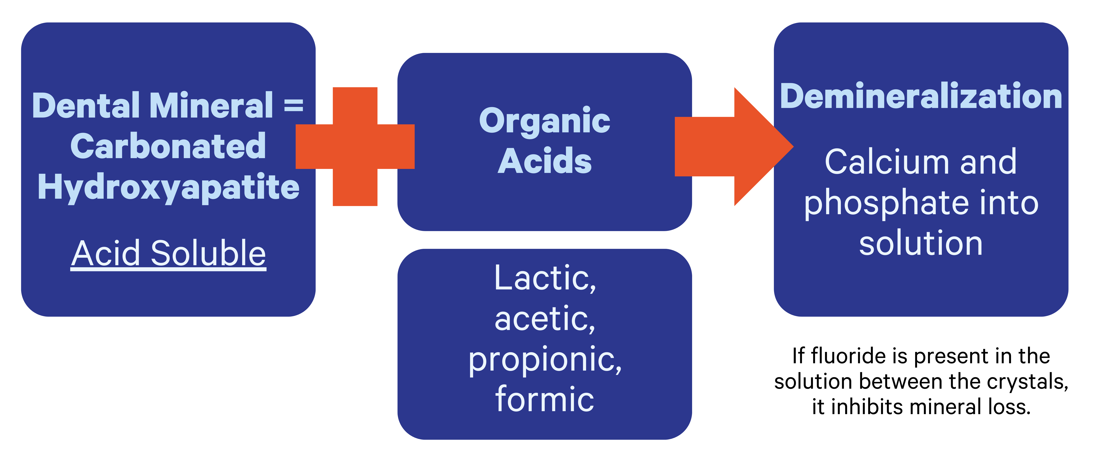
Demineralization: Step 2
Image modified from: John Featherstone, “Dental caries: A dynamic disease process,” Australian Dental Journal, 53(3), (2018) 286–291, https://doi.org/10.1111/j.1834-7819.2008.00064.x.
Notes:
In the second phase of demineralization, the dental mineral adopts a carbonated hydroxyapatite structure, which is soluble in acid. Organic acids, including lactic, acetic, propionic, and formic acids, contribute to the process of demineralization. When fluoride is present within the calcium and phosphate solution, it effectively prevents the loss of minerals.
Image modified from: John Featherstone, “Dental caries: A dynamic disease process,” Australian Dental Journal, 53(3), (2018) 286–291, https://doi.org/10.1111/j.1834-7819.2008.00064.x.

Slide 19
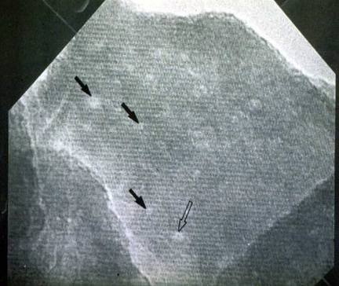
Crystal Comparison
  About 20% of the crystal is carbonated hydroxyapatite. It is more easily dissolved by acids.
  Sound enamel crystal at 3,000,000x showing rows of calcium atoms. White patches (arrows) are calcium-deficient defect regions.
Image modified from: John Featherstone, “Dental caries: A dynamic disease process,” Australian Dental Journal, 53(3), (2018) 286-291, https://doi.org/10.1111/j.1834-7819.2008.00064.x.
Notes:
Approximately 20% of the crystal consists of carbonated hydroxyapatite, which is more susceptible to dissolution by acids. At 3,000,000x magnification, the sound enamel crystal displays orderly rows of calcium atoms, while the white patches (indicated by arrows) represent regions of calcium-deficient defects.
Image modified from: John Featherstone, “Dental caries: A dynamic disease process,” Australian Dental Journal, 53(3), (2018) 286–291, https://doi.org/10.1111/j.1834-7819.2008.00064.x.

Slide 20
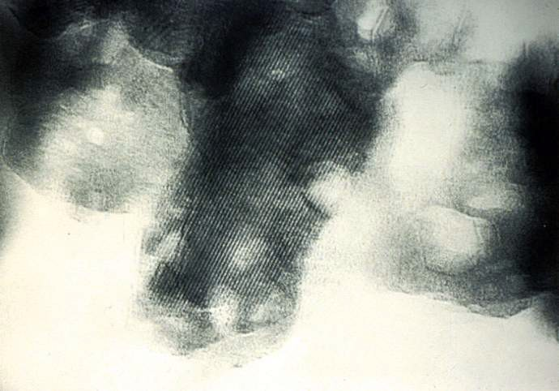
Crystal Comparison
  Acid-damaged enamel crystals from a carious lesion at 3,000,000x showing rows of calcium atoms.
  Hexagonal white patches (arrows) are where acid has dissolved mineral from calcium-deficient / carbonate-rich regions.
Image modified from: John Featherstone, “Dental caries: A dynamic disease process,” Australian Dental Journal, 53(3), (2018) 286–291, https://doi.org/10.1111/j.1834-7819.2008.00064.x.
Notes:
At 3,000,000x magnification, the image displays acid-damaged enamel crystals from a carious lesion, featuring orderly rows of calcium atoms. The presence of hexagonal white patches (indicated by arrows) signifies areas where acid has dissolved minerals from calcium-deficient and carbonate-rich regions.
Image modified from: John Featherstone, “Dental caries: A dynamic disease process,” Australian Dental Journal, 53(3), (2018) 286–291, https://doi.org/10.1111/j.1834-7819.2008.00064.x.

Slide 21
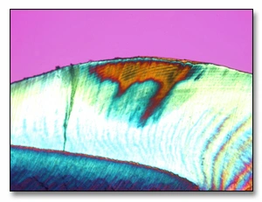
Experimental Caries Model
Dissolution of calcium and phosphate from enamel crystals
Response to acidic conditions
Initiation of demineralization process
  Begins 10–15 microns beneath the surface
  Relatively intact surface layer during early stages
  Impenetrable by dental explorer
Micrograph under polarized light (in a water medium) displaying an initial subsurface enamel lesion. The blue region represents the normal enamel and the surface zone above the lesion, while the brown area indicates the presence of the early lesion.
Robert V. Faller, “An Update on Demineralization/Remineralization,” dentalcare.com, January 29, 2021, https://assets.ctfassets.net/u2qv1tdtdbbu/6k08YJRvFXDDNxIMvPe8fD/afc8500392bc74f3d480f54a51270509/ce73_1-29-21.pdf.
Notes:
The enamel crystals undergo dissolution, releasing calcium and phosphate, in response to acidic conditions. This reaction marks the initiation of the demineralization process, which begins at a depth of 10–15 microns beneath the surface. During the early stages, a relatively intact surface layer forms, proving impervious to penetration by a dental explorer.
Resource: Robert V. Faller, “An Update on Demineralization/Remineralization,” dentalcare.com, January 29, 2021, https://assets.ctfassets.net/u2qv1tdtdbbu/6k08YJRvFXDDNxIMvPe8fD/afc8500392bc74f3d480f54a51270509/ce73_1-29-21.pdf.

Slide 22
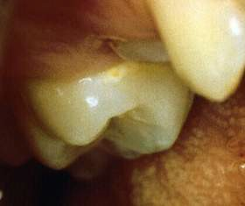
Microscopic Examination of Demineralization
Microscopic: Polarized light (in a water medium) displaying an initial subsurface enamel lesion.
Macroscopic: White spot lesion
Left Image: Robert V. Faller, “An Update on Demineralization/Remineralization,” dentalcare.com, January 29, 2021, https://assets.ctfassets.net/u2qv1tdtdbbu/6k08YJRvFXDDNxIMvPe8fD/afc8500392bc74f3d480f54a51270509/ce73_1-29-21.pdf.
Right Image: John Featherstone, “Dental caries: A dynamic disease process,” Australian Dental Journal, 53(3), (2018) 286–291, https://doi.org/10.1111/j.1834-7819.2008.00064.x.
Notes:
Under the scanning electron microscope, demineralization and porosity become evident in the dental enamel, while on a larger scale, a white spot lesion is observable.
Left Image: Robert V. Faller, “An Update on Demineralization/Remineralization,” dentalcare.com, January 29, 2021, https://assets.ctfassets.net/u2qv1tdtdbbu/6k08YJRvFXDDNxIMvPe8fD/afc8500392bc74f3d480f54a51270509/ce73_1-29-21.pdf.
Right Image: John Featherstone, “Dental caries: A dynamic disease process,” Australian Dental Journal, 53(3), (2018) 286–291, https://doi.org/10.1111/j.1834-7819.2008.00064.x.

Slide 23
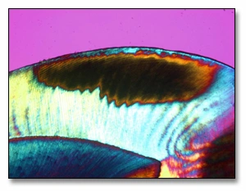
Experimental Caries Model
Acid challenge continuation
  Increased demineralization of subsurface enamel
Lesion progression
  Advances deeper under intact surface layer
A polarized-light micrograph (captured in water) depicting an early enamel lesion situated approximately midway through the enamel. The body of the lesion is visualized in brown, with its advancing front, while a blue surface zone is evident at the enamel surface area
Resource: Robert V. Faller, “An Update on Demineralization/Remineralization,” dentalcare.com, January 29, 2021, https://assets.ctfassets.net/u2qv1tdtdbbu/6k08YJRvFXDDNxIMvPe8fD/afc8500392bc74f3d480f54a51270509/ce73_1-29-21.pdf.
Notes:
The continuation of the acid challenge leads to increased demineralization of subsurface enamel. This results in the progression of the lesion, advancing deeper under the intact surface layer.
Resource: Robert V. Faller, “An Update on Demineralization/Remineralization,” dentalcare.com, January 29, 2021, https://assets.ctfassets.net/u2qv1tdtdbbu/6k08YJRvFXDDNxIMvPe8fD/afc8500392bc74f3d480f54a51270509/ce73_1-29-21.pdf.

Slide 24
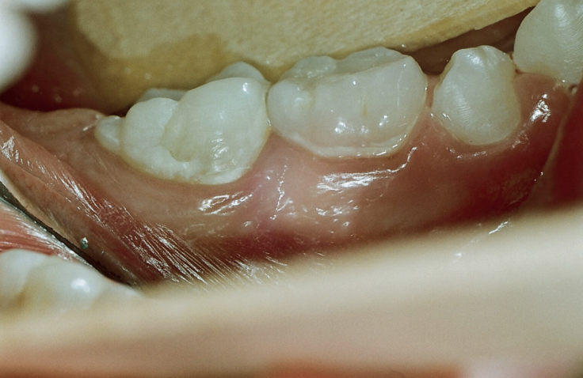
What Happens When Plaque Is Removed?
  When plaque is removed after one week, the tooth is less chalky.
  After two weeks, the enamel is restored and shiny.
Why?
  Saliva contains calcium and phosphate.
Image: Edwina Kidd and Ola Fejerskov, “Essentials of dental caries,” Oxford University Press, 2016, Figure 1.10.
Notes:
When plaque is removed, the tooth undergoes distinct changes. After one week, the chalky appearance lessens, and after two weeks, the surface returns to its natural enamel shine. This underscores the significance of regular brushing and flossing, disrupting plaque and altering the mouth's bacterial environment. Saliva, containing essential calcium and phosphate, aids in the tooth’s natural remineralization process. Additionally, consuming fluoridated water helps in this regard because fluoride is known for its ability to prevent and reverse demineralization.
Image: Edwina Kidd and Ola Fejerskov, “Essentials of dental caries,” Oxford University Press, 2016, Figure 1.10.

Slide 25
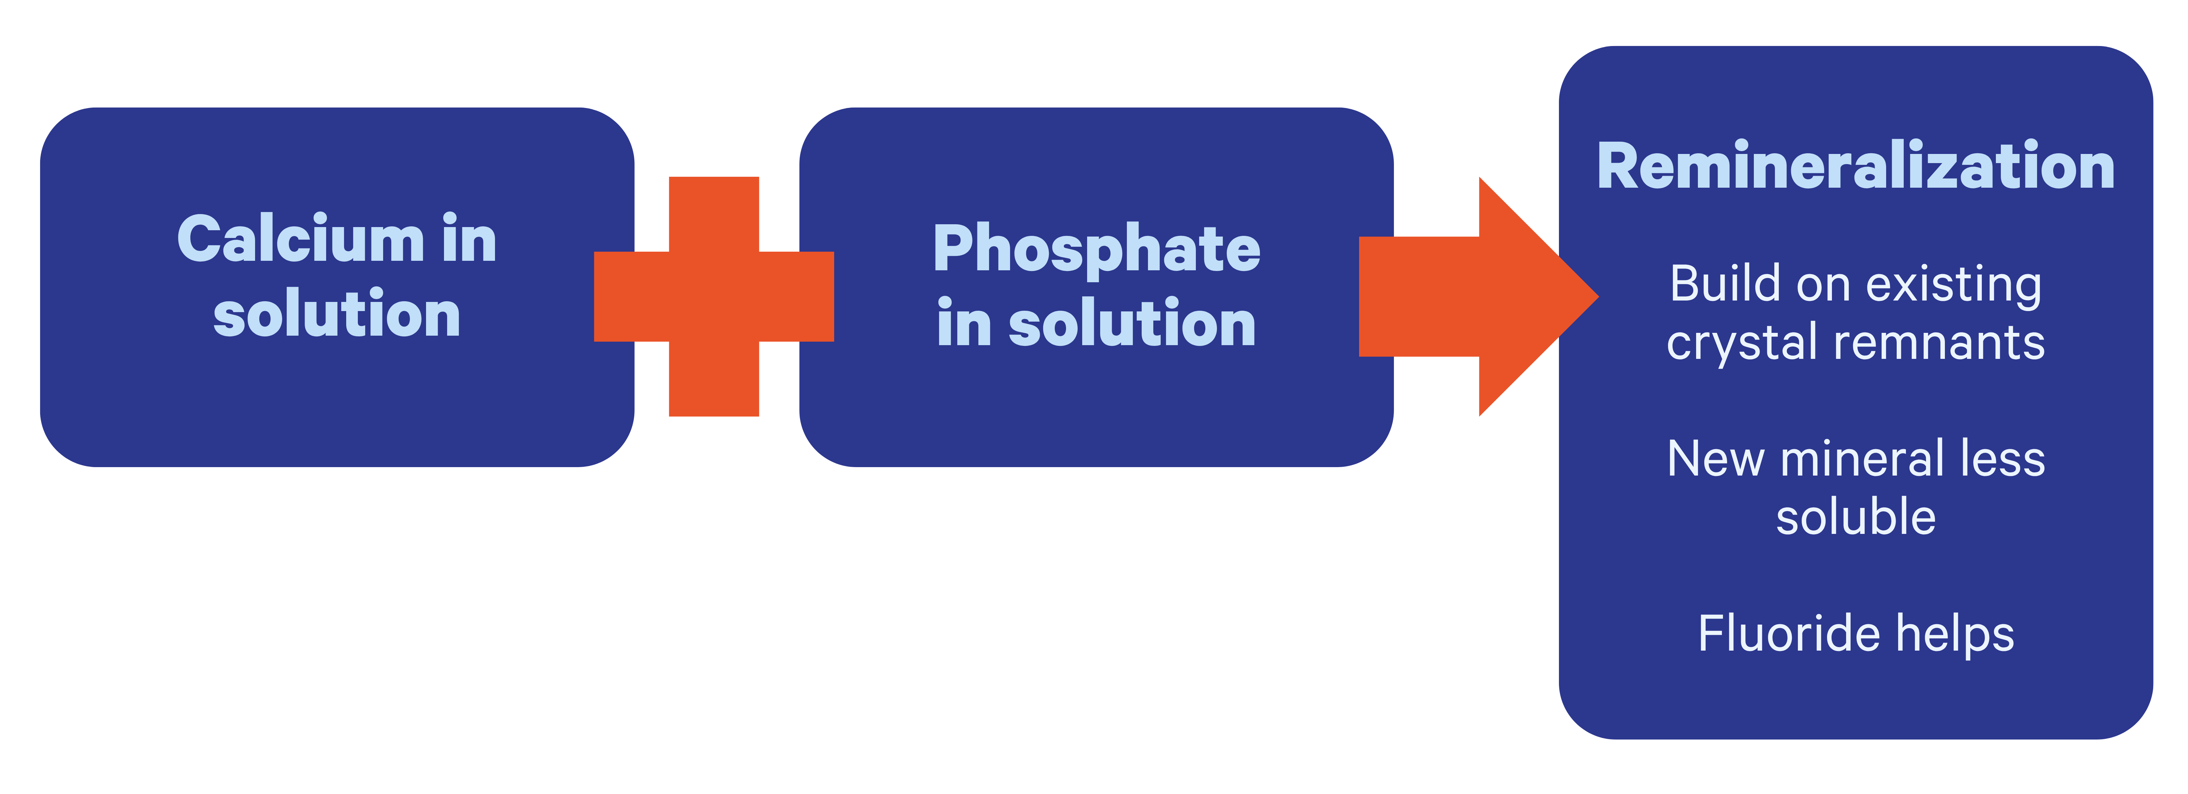
Remineralization: The Natural Repair Process for Caries
Image modified from: John Featherstone, “Dental caries: A dynamic disease process,” Australian Dental Journal, 53(3), (2018) 286–291, https://doi.org/10.1111/j.1834-7819.2008.00064.x.
Notes:
The natural repair process for caries, known as remineralization, relies on the presence of calcium and phosphate in the solution, countering the effects of demineralization. This process builds upon existing crystal remnants, forming new, less soluble minerals. Fluoride aids in this restorative process.
Wrap Up: This session covered the biochemical intricacies within biofilms, saliva, and dental tissues, highlighting their influence on oral health. It emphasized the roles of substrates like carbohydrates and bacteria in causing dental caries, along with the protective effects of fluoride, calcium, and phosphate. The discussion also explored plaque formation, microbiome disruption, and the consequences of acidic environments on demineralization, focusing on the significant role of mutans streptococci (MS) in tooth decay. This comprehensive understanding equips you with essential insights for the process of caries.
Image modified from: John Featherstone, “Dental caries: A dynamic disease process,” Australian Dental Journal, 53(3), (2018) 286–291, https://doi.org/10.1111/j.1834-7819.2008.00064.x.

Slide 26
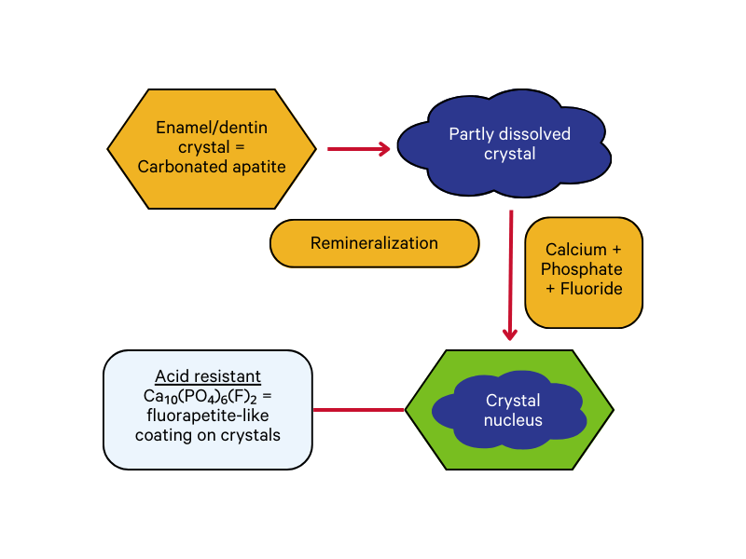
Remineralization
  Partially demineralized apatite crystals can grow to their original size
    Especially in the presence of fluoride
  Formation of entirely new crystals is rare
  If goal is to remineralize…
    Removal of intact surface layer is NOT advisable
Summary of the caries process including demineralization by acids produced by the cariogenic bacteria and subsequent remineralization to form a low-solubility surface on the crystals.
Image modified from: John Featherstone, “Dental caries: A dynamic disease process,” Australian Dental Journal, 53(3), (2018) 286–291, https://doi.org/10.1111/j.1834-7819.2008.00064.x.
Notes:
The flowchart provides an overview of the caries process, outlining the demineralization caused by acids produced by cariogenic bacteria, followed by subsequent remineralization to establish a low solubility surface on the crystals. Partially demineralized apatite crystals can regrow to their original size, particularly when fluoride is present. The formation of entirely new crystals is uncommon. If the objective is to facilitate remineralization, it is not recommended to remove the intact surface layer; you will use that layer to remineralize the tooth.
Image modified from: John Featherstone, “Dental caries: A dynamic disease process,” Australian Dental Journal, 53(3), (2018) 286–291, https://doi.org/10.1111/j.1834-7819.2008.00064.x.

Slide 27
What form of apatite is least soluble?
Ca_{10-x}Na_{x}(PO₄)_{6-y}(CO₃)_{z}(OH)_{2-u}(F)_{u}
Ca₁₀(PO₄)₆(OH)₂
Ca₁₀ (PO₄)₆ (F)
Marise Oliveira and Herman Mansur, “Synthetic tooth enamel: SEM characterization of a fluoride hydroxyapatite coating for dentistry applications,” Materials Research, 10(2), 115–118 (April 12, 2007), https://doi.org/10.1590/S1516-14392007000200004.
Notes:
Take a vote by a raise of hands among the learners on which form of apatite they think is least soluble.
Reference: Marise Oliveira and Herman Mansur, “Synthetic tooth enamel: SEM characterization of a fluoride hydroxyapatite coating for dentistry applications,” Materials Research, 10(2), 115–118 (April 12, 2007), https://doi.org/10.1590/S1516-14392007000200004.

Slide 28
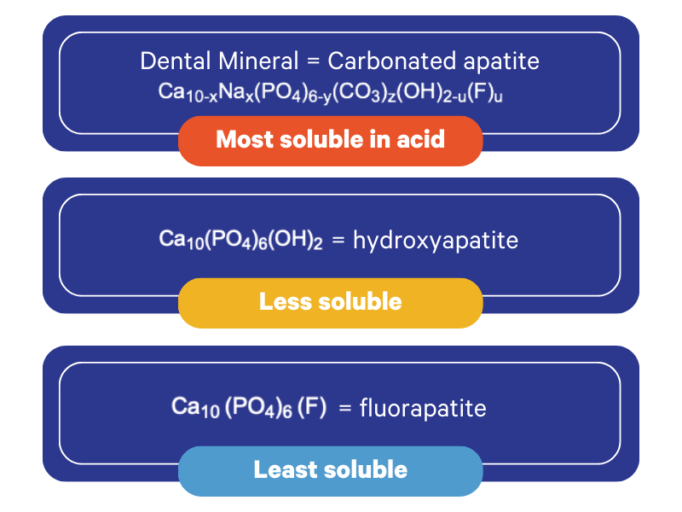
Marise Oliveira and Herman Mansur, “Synthetic tooth enamel: SEM characterization of a fluoride hydroxyapatite coating for dentistry applications,” Materials Research, 10(2), 115–118 (April 12, 2007), https://doi.org/10.1590/S1516-14392007000200004.
Notes:
The answer is number three. The third option is the least soluble, known as fluorapatite. The most soluble is the first one, carbonated apatite, whereas the second one, hydroxyapatite, is comparatively less soluble.
Reference: Marise Oliveira and Herman Mansur, “Synthetic tooth enamel: SEM characterization of a fluoride hydroxyapatite coating for dentistry applications,” Materials Research, 10(2), 115–118 (April 12, 2007), https://doi.org/10.1590/S1516-14392007000200004.

Slide 29
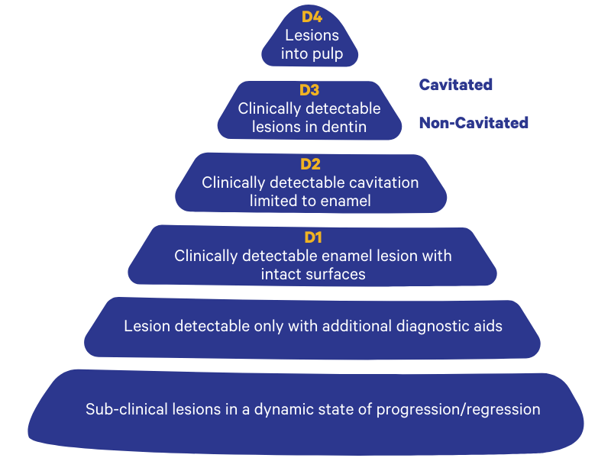
Caries Classification D1-D4
Image modified from: Nigel Pitts, “Diagnostic tools and measurements-impact on appropriate care,” Community dentistry and oral epidemiology, 25(1), 24–35 (May 29, 2006), https://doi.org/10.1111/j.1600-0528.1997.tb00896.x.
Notes:
This diagram represents a caries classification system, providing an alternative perspective on distinguishing between cavitated and non-cavitated lesions. Caries is classified as non-cavitated until reaching the stage denoted as D3, where a clinically detectable lesion appears in the dentin. Beyond this point, it is deemed cavitated.
Our goal in dentistry is to detect lesions as early as possible D1 or before and provide preventative therapies at that time.
Image modified from: Nigel Pitts, “Diagnostic tools and measurements — impact on appropriate care,” Community dentistry and oral epidemiology, 25(1), 24–35 (May 29, 2006), https://doi.org/10.1111/j.1600-0528.1997.tb00896.x.

Slide 30
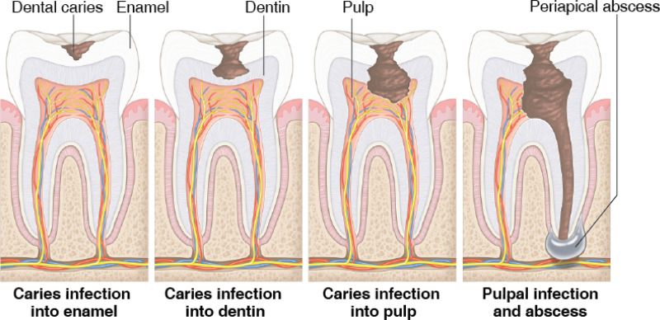
Dental Caries
  Chronic disease that progresses very slowly in most individuals.
  In the absence of “treatment,” caries will progress until the tooth is destroyed.
Image: “Oral Health in America: Advances and Challenges,” National Institute of Dental and Craniofacial Research (US), 2021, https://www.ncbi.nlm.nih.gov/books/NBK578299/figure/ch3.fig8/.
Notes:
Interventions and prevention are necessary from both dental professionals and individuals to combat dental caries, which can manifest as a chronic disease progressing slowly in most cases. Without proper treatment, the condition can lead to the gradual destruction of the tooth.
Image: “Oral Health in America: Advances and Challenges,” National Institute of Dental and Craniofacial Research (US), 2021, https://www.ncbi.nlm.nih.gov/books/NBK578299/figure/ch3.fig8/.

Slide 31
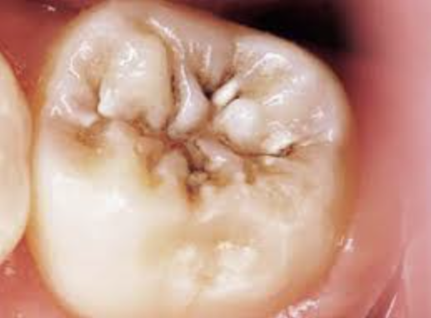
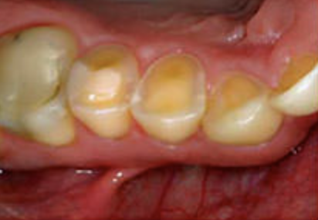
Caries
Erosion
Low pH
Low pH
Chemical dissolution of the dental hard tissues by acidic bacterial products from degradation of lower molecular weight sugars
Dissolution of the dental hard tissues caused by acids of any other origin or mechanical wear
Left image: James Hamilton, Joseph Dennison, Kenneth Stoffers, William Gregory, and Kathleen Welch, “Early treatment of incipient carious lesions: A two-year clinical evaluation,” The Journal of the American Dental Association, 133(12), 1643–1651 (December 2002), https://doi.org/10.14219/jada.archive.2002.0114.
Right image: A. Lussi, N. Schlueter, E. Rakhmatullina, C. Ganss, “Dental Erosion — An Overview with Emphasis on Chemical and Histopathological Aspects,” Caries Research, 45 (Suppl. 1): 2–12 (May 31, 2011), https://doi.org/10.1159/000325915
Notes:
When the pH falls below 5.5, dental enamel begins to dissolve. This dissolution is primarily attributed to the acidic byproducts generated by the degradation of lower molecular weight sugars, along with the chemical erosion of the dental hard tissues. The acids sourced from various origins or mechanical wear can also contribute to the dissolution of the dental hard tissues.
Left image: James Hamilton, Joseph Dennison, Kenneth Stoffers, William Gregory, and Kathleen Welch, “Early treatment of incipient carious lesions: A two-year clinical evaluation,” The Journal of the American Dental Association, 133(12), 1643–1651 (December 2002), https://doi.org/10.14219/jada.archive.2002.0114.
Right image: A. Lussi, N. Schlueter, E. Rakhmatullina, C. Ganss, “Dental Erosion — An Overview with Emphasis on Chemical and Histopathological Aspects,” Caries Research, 45 (Suppl. 1): 2–12 (May 31, 2011), https://doi.org/10.1159/000325915.

Slide 32
CareQuest for Dental Education on Caries
To continue learning, explore our other sessions:
Session 1: Understanding Caries
Session 2: Caries Disease Process
Session 3: Caries Transmission
Session 4: Foundations of Caries Risk Assessment
Session 5: Applying Caries Risk Assessment to Guide Management Activity
Session 6: Apply Prevention Strategies
Session 7: CAMBRA Protocol Activity
Session 8: Saliva in Health: Part 1
Session 9: Saliva in Health: Part 2
Session 10: Saliva in Disease – Stroke and Heart Disease
Session 11: Saliva in Disease – Asthma and Allergic Rhinitis

