Slide 1
Understanding Caries
Notes:
This session introduces the complexity of dental caries, explaining its pathology and how the process of dental caries affects teeth on a molecular level. The session is designed to encourage students to think critically in small groups and engage interactively. The causes of dental caries, such as host factors, saliva, diet, and oral hygiene, will be covered. We'll look into how carbohydrates, bacteria, and saliva influence caries, highlighting the concept of maintaining a healthy balance. Additionally, we will discuss the impact of caries on pulp and dentin biology, examining their specific reactions and effects on the tooth's structure.
What is dental caries and why does it behave the way it does?

Slide 2
Learning Objectives
Explain dental caries as a chronic, dynamic, biofilm-mediated disease process driven by repeated pH changes and influenced by host and environmental factors.
Describe how microbial activity within dental biofilms leads to cycles of demineralization and remineralization over time.
Describe how caries progression varies by individual risk and contextual factors.
Interpret high-level population data on dental caries to explain why early detection and prevention are central to oral health practice.

Slide 3

What Is
Dental Caries?
Think – Pair – Share
Notes:
Take 90 seconds to discuss with the person next to you what you know about dental caries, combining your readings and personal knowledge. Following this, we will open up the floor for sharing.

Slide 4
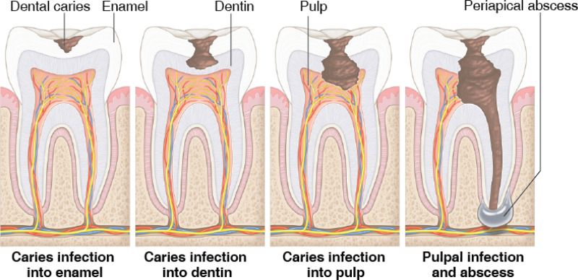
What Is Dental Caries?
It is a localized, chemical dissolution of a tooth surface brought about by metabolic acidity in a microbial deposit covering a tooth surface at any given time.
Essentials of Dental Caries – Section 1.3 Dental Caries – a definition
Image: “Oral Health in America: Advances and Challenges,” National Institute of Dental and Craniofacial Research (US). 2021, https://www.ncbi.nlm.nih.gov/books/NBK578299/figure/ch3.fig8/.
Notes:
According to our pre-session reading, dental caries is defined as: [read slide]
Image: “Oral Health in America: Advances and Challenges,” National Institute of Dental and Craniofacial Research (US), 2021, https://www.ncbi.nlm.nih.gov/books/NBK578299/figure/ch3.fig8/.

Slide 5
Terminology
Term | Definition
Caries, Caries Lesion, Carious Lesion | Tooth decay
Cariology | The study of dental caries
Cariogenesis | The process by which caries form and develop
Cariogenic | Having involvement in the development of caries
Acidogenic | Producing acid or causing acidity
Aciduric | Able to grow in an acidic environment
Demineralize | To remove mineral from
Notes:
Here are some fundamental terms to remember when we discuss caries. [Read slide]

Slide 6
Terminology: Commonly Confused Terms
Dental caries vs. Cavity
Dental caries (disease/process): A biofilm-mediated disease where frequent sugar exposure leads to acid and repeated cycles of mineral loss and repair. Over time, this can create non-cavitated lesions or progress to cavitation in enamel and dentin.
Cavity (cavitated lesion): A break in the tooth surface (a hole) that occurs when a caries lesion progresses. It may start in enamel and can extend into dentin.
Notes:
Say: “Caries is the disease. A cavity is the damage the disease can cause.”
Patient-friendly translations you can model for students:
Dental caries “Tooth decay is a process that weakens a tooth over time. It happens when plaque germs use sugar to make acid that slowly wears down the tooth.”
Cavity “A cavity is a hole that can form after the tooth has been weakened for a while.”

Slide 7
Terminology: Commonly Confused Terms, cont.
Risk factors vs. Cause
Risk factors increase the likelihood or speed of disease. Examples include frequent sugar intake or dry mouth.
Cause (mechanism): acid produced by plaque biofilm after sugar exposure shifts the balance toward demineralization over time.
Notes:
Say: “Risk factors are what make the disease more likely or faster. Cause is the mechanism that actually produces the damage.”
Patient-friendly translations you can model for students
Risk factor vs. cause “Some things make tooth decay more likely, like sipping sweet drinks often or having a dry mouth. The reason decay happens is that plaque germs make acid when they feed on sugar.”

Slide 8
What About the Definition over Time?
1970s
1990s
Present
?
Modified image: Edwina Kidd and Ola Fejerskov, “Essentials of dental caries,” Oxford University Press. 2016, Figure 1.7.
Notes:
Dental caries, a transmissible disease, occurs due to the repeated attack of oral bacteria metabolizing sugar and producing acid, which leads to the breakdown of the tooth’s outer layers — enamel, dentin, and cementum — eventually forming cavities over several months to years. This process requires a vulnerable tooth lacking protective factors, dietary sugars, and plaque-harboring bacteria. In the 1970s, it became clear that the interaction between bacteria and the tooth, along with an appropriate substrate, contributes to the development of caries. In the 1990s, the importance of saliva in dental caries became evident. As our understanding of caries continues to evolve over the years, how do we define the development of caries in the present day?
Modified image: Edwina Kidd and Ola Fejerskov, “Essentials of dental caries,” Oxford University Press. 2016, Figure 1.7.

Slide 9
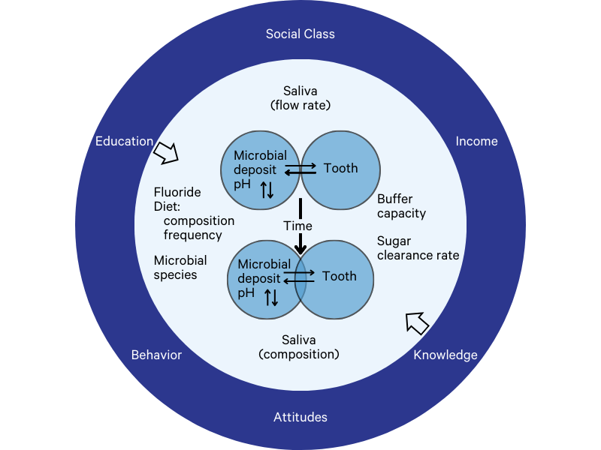
What About the Definition over Time?
1970s
1990s
Present
Modified image: Edwina Kidd and Ola Fejerskov, “Essentials of dental caries,” Oxford University Press, 2016, Figure 1.7.
Notes:
In the current framework, the external dark blue factors represent social drivers of health. Within the lighter blue filling, the listed factors represent biological determinants at the individual level. Regarding fluoride, it involves considering the levels during development and the present. With bacteria, each individual has a distinct composition and varying levels. Our buffer capacity refers to how much our saliva can neutralize, influenced by diet, hydration, and food. The small inner circle includes saliva flow rate and composition, emphasizing the importance of adequate and high-quality saliva.
Modified image: Edwina Kidd and Ola Fejerskov, “Essentials of dental caries,” Oxford University Press, 2016, Figure 1.7.

Slide 10
Dental Caries
Review the figure to the right as a small group:
Which of the following factors are modifiable?
Which of the following factors are not modifiable?
Are any factors missing?
Should any factors be relabeled?
Modified image: Edwina Kidd and Ola Fejerskov, “Essentials of dental caries,” Oxford University Press. 2016, Figure 1.7.
Notes:
Take 4 minutes to review in the figure in small groups of three or four and answer the questions on this slide.
Modified image: Edwina Kidd and Ola Fejerskov, “Essentials of dental caries,” Oxford University Press, 2016, Figure 1.7.

Slide 11

What Impact Does Dental Caries Have Globally?
Notes:
Why do we care about tooth decay? What impact does dental caries have globally?

Slide 12
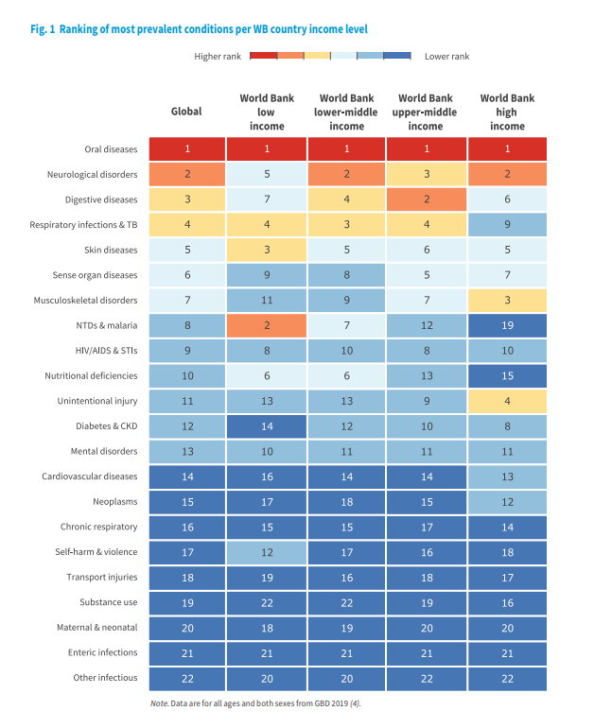
Oral diseases are global public health problems.
“Global oral health status report: towards universal health coverage for oral health by 2030,” Geneva: World Health Organization, 2022, License: CC BY-NC-SA 3.0 IGO.
Notes:
In this report, tooth decay is the #1 most prevalent condition. No matter a country's income status, the number one thing they are battling is tooth decay or oral disease.

Slide 13
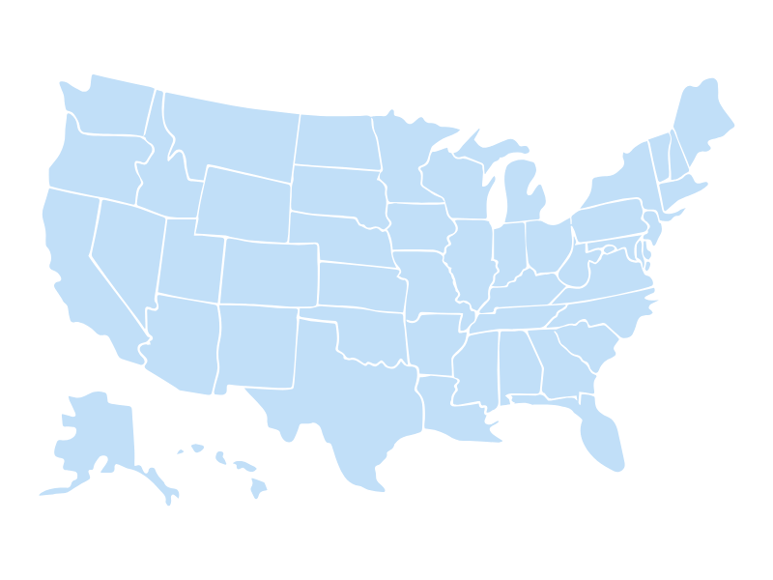
What Impact Does Dental Caries Have Nationally?
Notes:
What impact does dental caries have nationally? The varying rates of caries exist across different states, counties, and school systems. This variation spans from local to national levels, but finding effective solutions at the national level can facilitate their application at the local level.

Slide 14
Untreated Dental Caries US 2015–2018
Age Range | % people with untreated dental caries in US in 2015–2018
5–19 | 13.2%
20–44 | 25.9%
45–64 | 25.3%
65 and up | 20.2%
“Untreated dental caries, by selected characteristics: United States, selected years 1988–1994 through 2015–2018,” Center for Disease Control and Prevention, 2019, https://www.cdc.gov/nchs/data/hus/2019/028-508.pdf.
Notes:
Diagnosing, restoring, and preventing caries is one of the most critical responsibilities of the dental profession. According to the CDC, between the years of 2015 and 2018, the prevalence of untreated dental caries by age group was 13.2% for ages 5–19, 25.9% for ages 20–44, 25.3% for ages 45–64, and 20.2% for ages 65 and older. In other words, over a quarter of the US population aged 20–44 and 45–64 suffered from untreated tooth decay within the last decade. These statistics are significant because dental caries is a progressive disease that lasts an individual’s lifetime and ultimately results in loss of teeth if proper oral care does not begin. To address this endemic, oral health professionals need to understand the etiology, development, and risk of developing this disease.
Reference: “Untreated dental caries, by selected characteristics: United States, selected years 1988–1994 through 2015–2018,” Center for Disease Control and Prevention, 2019, https://www.cdc.gov/nchs/data/hus/2019/028-508.pdf.

Slide 15
What About Different Populations?
US Data
Children 2–5 years old
Children 6–8 years old
Children 6–11 years old
Adolescents 12–19
Adults 20–64
Older Adults 65+
[Insert Your State’s Name] Data
Children 2–5 years old
Children 6–8 years old
Children 6–11 years old
Adolescents 12–19
Adults 20–64
Older Adults 65+
Notes:
We are going to divide into 12 groups. Each group will be assigned an age group to research the trends of untreated and treated caries prevalence and incidence for each population using the US or [insert your state’s name] data. Researching this information will enable you to track the impact of various public health initiatives. You will have 5 minutes, and then each group will share its findings with the class.

Slide 16

What Are the Trends in Tooth Decay?
What have you noticed?
Notes:
Now that we have reviewed the trends nationally, and within our state, what trends have we noticed? [Class discussion]

Slide 17

Reasons for the Decline in Caries
Increased exposure to fluoride
Fluoride toothpaste
Fluoridated water
Improved preventative behaviors/services
Better oral hygiene (brushing with fluoridated toothpaste)
Dental sealants
Notes:
The decline in caries can be attributed to different factors. Increased fluoride exposure, facilitated through fluoride toothpaste and fluoridated water, has played a role. Improved preventive behaviors and services and better oral hygiene practices, such as regular brushing with fluoridated toothpaste, have significantly contributed to this trend. Additionally, applying dental sealants has also been instrumental in reducing caries rates.

Slide 18
Progression of Caries
Permanent Teeth
Progression is a slow process in most individuals
There are exceptions
Takes an average of about 4 years for a lesion to progress through the enamel of permanent teeth
Primary Teeth
Progression is faster
M.J. Friedman, “Early detection of caries,” Compendium of continuing education in dentistry, August 2000, PMID: 11199657.
Notes:
The progression of caries in permanent teeth typically occurs gradually, although individual exceptions exist, influenced by specific medical conditions and habits. On average, it takes approximately four years for a lesion to develop through the enamel of permanent teeth. Conversely, in primary teeth, caries progression is notably faster, primarily due to differences in tooth anatomy.
Reference: M.J. Friedman, “Early detection of caries,” Compendium of continuing education in dentistry, August 2000, PMID: 11199657.

Slide 19
Dental Caries
Chronic disease that develops and progresses over time through repeated biofilm-driven pH changes.
Disease progression is strongly influenced by behaviors, environment, and protective factors such as saliva and fluoride.
Early, non-cavitated stages of caries may occur without symptoms and can be arrested or remineralized.
Image: “Oral Health in America: Advances and Challenges,” National Institute of Dental and Craniofacial Research (US), 2021, https://www.ncbi.nlm.nih.gov/books/NBK578299/figure/ch3.fig8/.
Notes:
Dental caries is a chronic disease that develops over time through repeated interactions among biofilm activity, diet, saliva, fluoride exposure, and oral hygiene behaviors. Like other chronic diseases, its progression is strongly influenced by individual behaviors and environmental factors. While caries may eventually present with acute symptoms if left untreated, the underlying disease process reflects long-term imbalance rather than a single acute event.
Image: “Oral Health in America: Advances and Challenges,” National Institute of Dental and Craniofacial Research (US), 2021, https://www.ncbi.nlm.nih.gov/books/NBK578299/figure/ch3.fig8/.

Slide 20

Wrap Up
Understanding Dental Caries as a Disease Dental caries is a chronic, biofilm-mediated disease influenced by behavior, environment, and biology.
Key Concepts from This Session
Dental caries develops through repeated cycles of demineralization and remineralization driven by biofilm activity and pH changes.
Host factors, saliva, diet, fluoride, and oral hygiene influence whether disease progresses or arrests.
Caries progression varies across individuals and populations and often occurs without early symptoms.
Notes:
In this session, we focused on understanding dental caries as a chronic, dynamic disease process rather than a single clinical event. We examined how biofilm activity, repeated pH fluctuations, and host factors such as saliva, diet, fluoride exposure, and oral hygiene influence cycles of demineralization and remineralization over time. This foundational understanding is essential for recognizing why caries progression varies across individuals and populations and why early stages of disease may occur without symptoms.

Slide 21
Wrap Up, cont.
Looking Ahead
Future sessions will focus on transmission, risk assessment, diagnosis, and prevention and management strategies.
Notes:
In the sessions that follow, we will build on this disease model to explore transmission, risk assessment, diagnosis, and evidence-based strategies for prevention and management, including how clinicians and communities can intervene to achieve and maintain caries balance.

Slide 22
CareQuest for Dental Education on Caries
To continue learning, explore our other sessions:
Session 1: Understanding Caries
Session 2: Caries Disease Process
Session 3: Caries Transmission
Session 4: Foundations of Caries Risk Assessment
Session 5: Applying Caries Risk Assessment to Guide Management Activity
Session 6: Apply Prevention Strategies
Session 7: CAMBRA Protocol Activity
Session 8: Saliva in Health: Part 1
Session 9: Saliva in Health: Part 2
Session 10: Saliva in Disease – Stroke and Heart Disease
Session 11: Saliva in Disease – Asthma and Allergic Rhinitis

